Slide 1
Imbalanced Data Processing

Slide 2
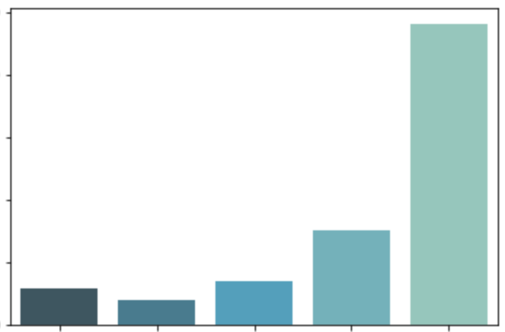
Data Class Imbalance
Star rating count in millions
ML models may be biased towards the dominant class.
Applications:
Fraud Detection
Anomaly Detection
Medical Diagnosis
Etc.
2.5
2
1.5
Star rating count
1
0.5
1
2
3
4
5
Star rating
* Amazon review dataset

Slide 3
Data Class Imbalance
How to solve class imbalance problem?
Downsampling
Reduce the size of the dominant class(es).
Upsampling
Increase the size of the rare or small class(es).
Data Generation
Create new data that are similar but not identical.
e.g., Distorting original images by rotating, introducing noise or skewing.
Up/Down Weights
Assign higher weights to rare class(es) and lower weights to dominant class(es) in the loss function.

Slide 4
Image Augmentation
To produce similar, but different, training examples
For improving model’s capability for generalization
Common methods:
Resizing (with different scales and ratios)
Cropping and flipping
Changing color, brightness
etc.
More details

Slide 5
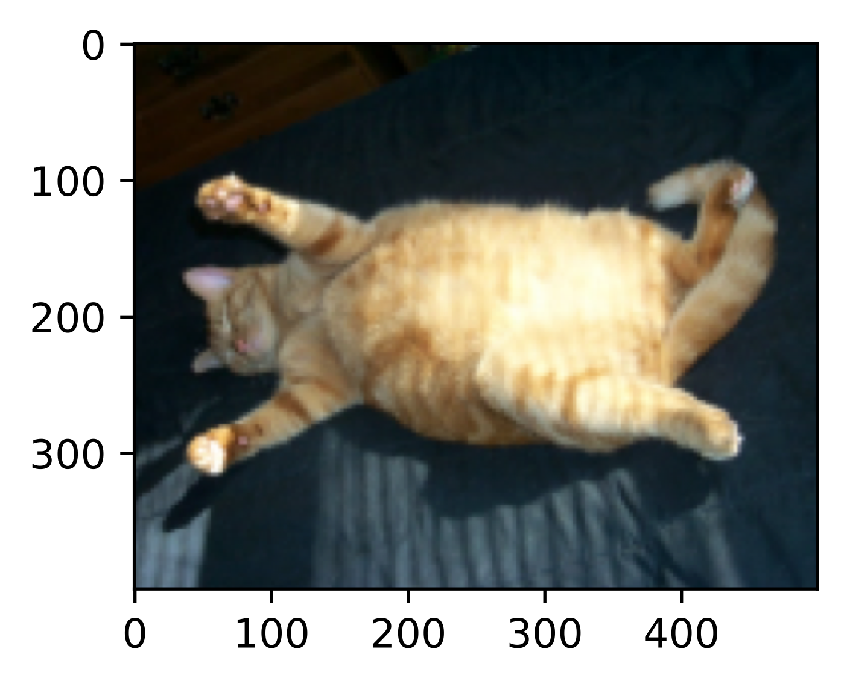
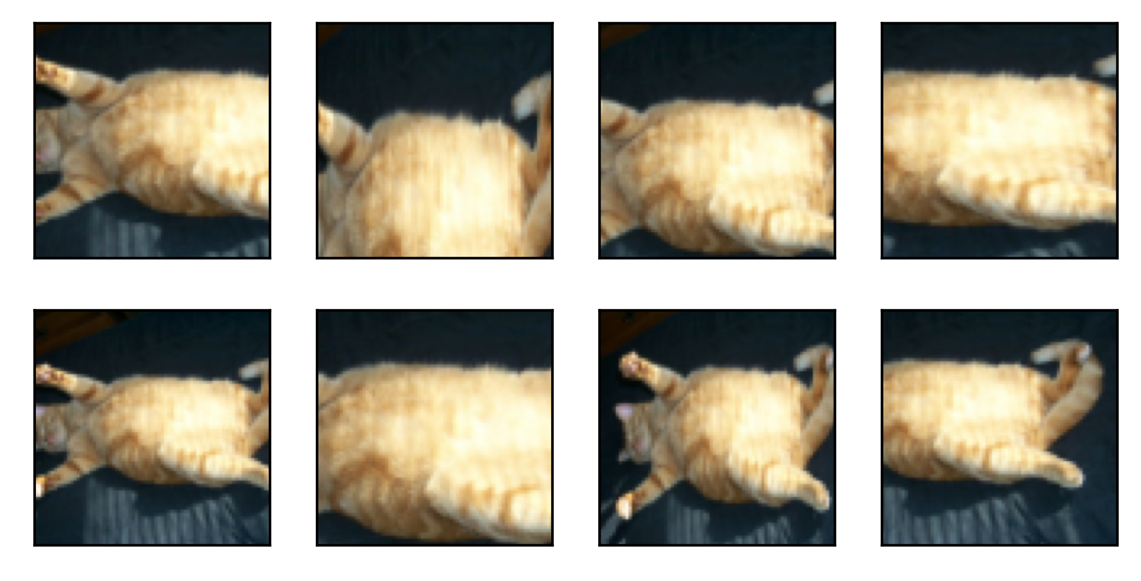
Image Augmentation
Cropping and flipping

Slide 6
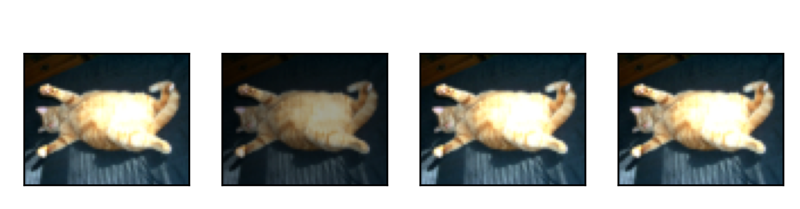
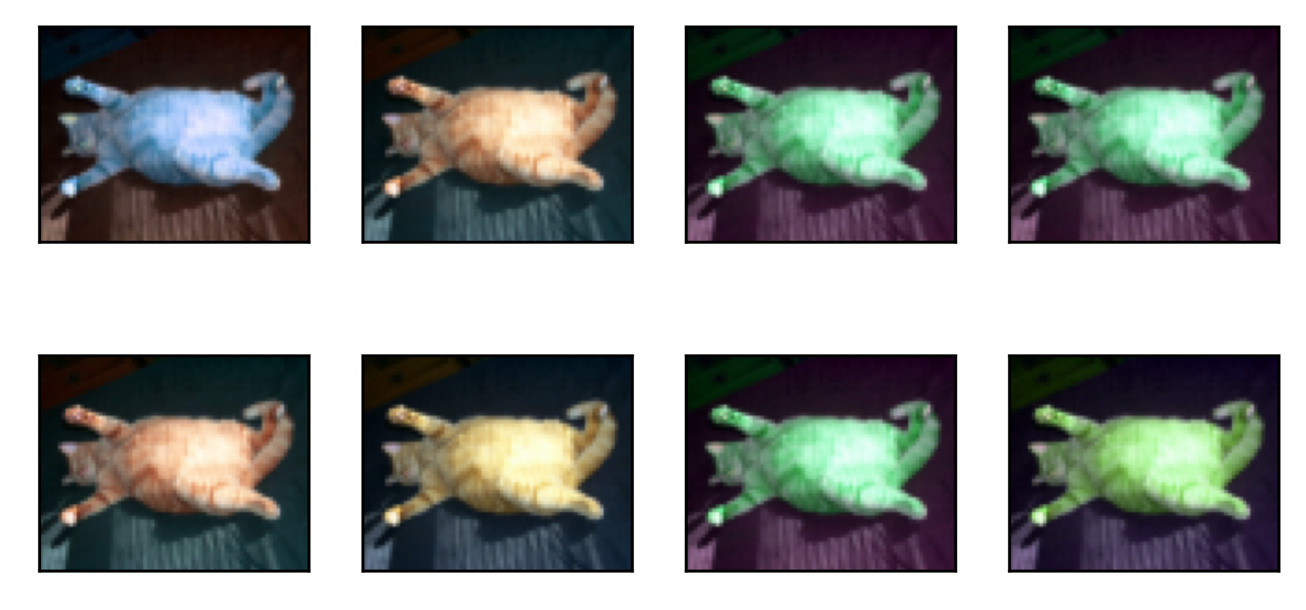
Image Augmentation
Changing color and brightness

Slide 7
Data Splitting
Training - Validation - Test Datasets
Original set
Shuffle the dataset before the split!
Training set
Test set
Training set
Validation set
Test set
Training, tuning, and evaluation
Machine learning algorithm
Model
More details.
Final performance estimate

