Slide 1
Computer Vision Tasks

Slide 2
Computer Vision Tasks
1. Image Classification: What category does this image belong to?
Who
What
Where
Source: Amazon Rekognition

Slide 3
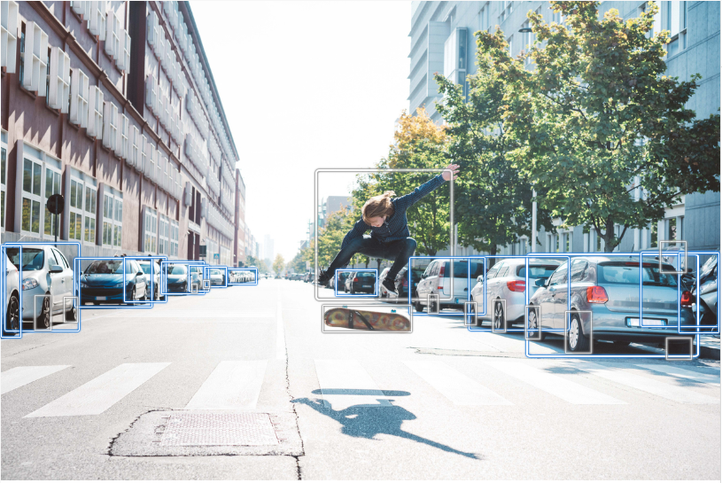
Computer Vision Tasks
2. Object Detection: Where are the locations of detected objects?
Person 98.3%
Car 98.8%
Source: Amazon Rekognition

Slide 4
Computer Vision Tasks
3. Semantic Segmentation: What are the boundaries of detected objects?
Source: Amazon Ground Truth

Slide 5
Computer Vision Tasks

