Slide 1
LeNet

Slide 2
Why CNN in 1990s?
Image Source: Wikipedia

Slide 3
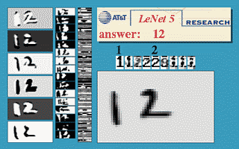
LeNet*
A CNN trained to classify digits (MNIST Dataset)
* LeCun et al., (1998). Gradient-based learning applied to document recognition.

Slide 4
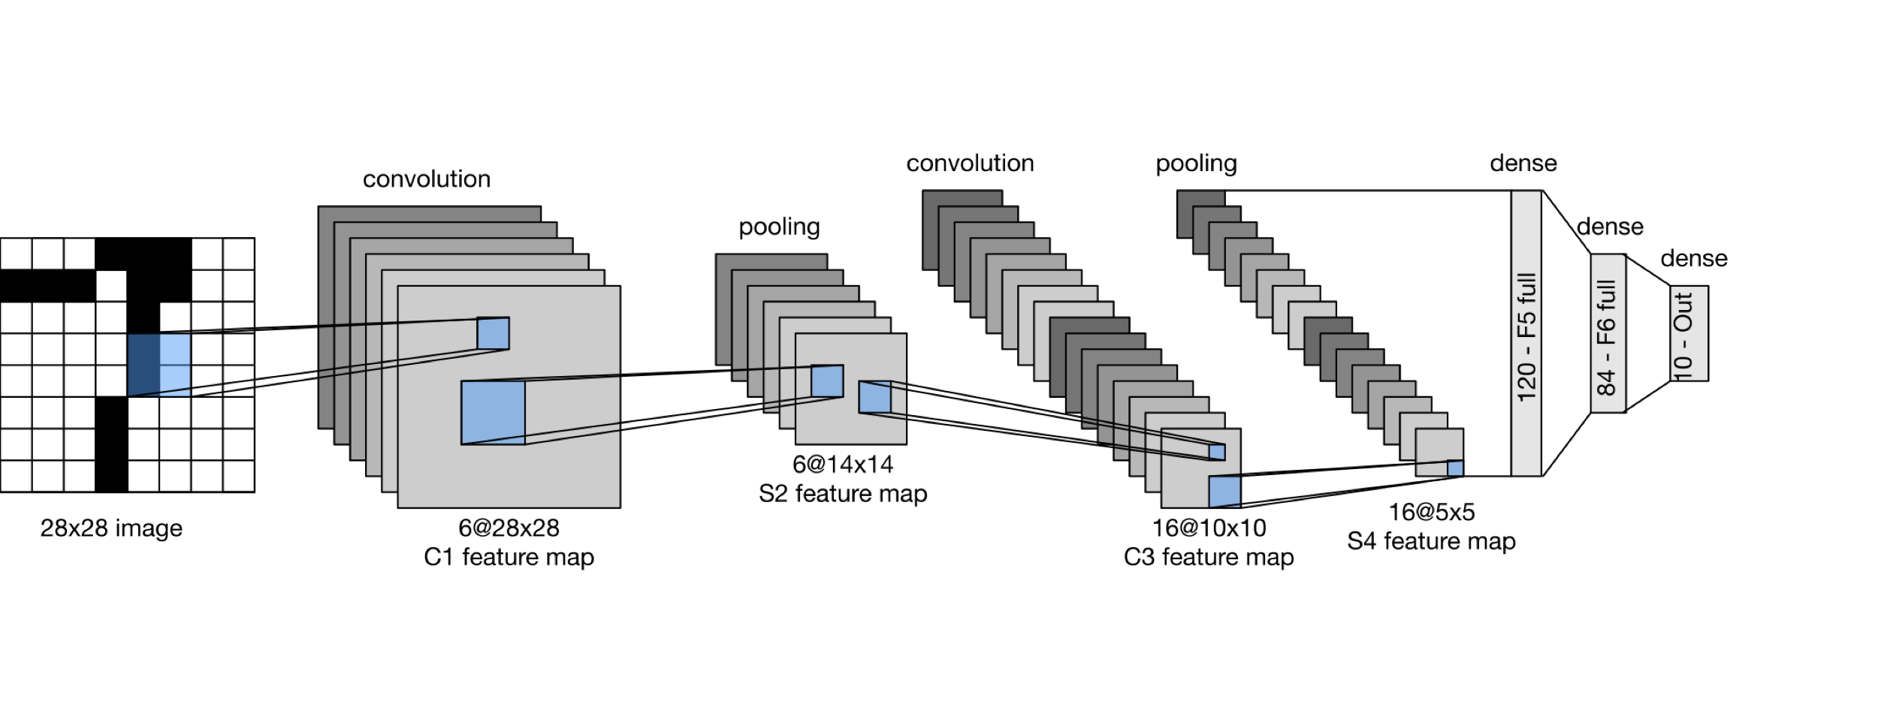
LeNet
LeNet is a five layer convolutional neural network.

Slide 5
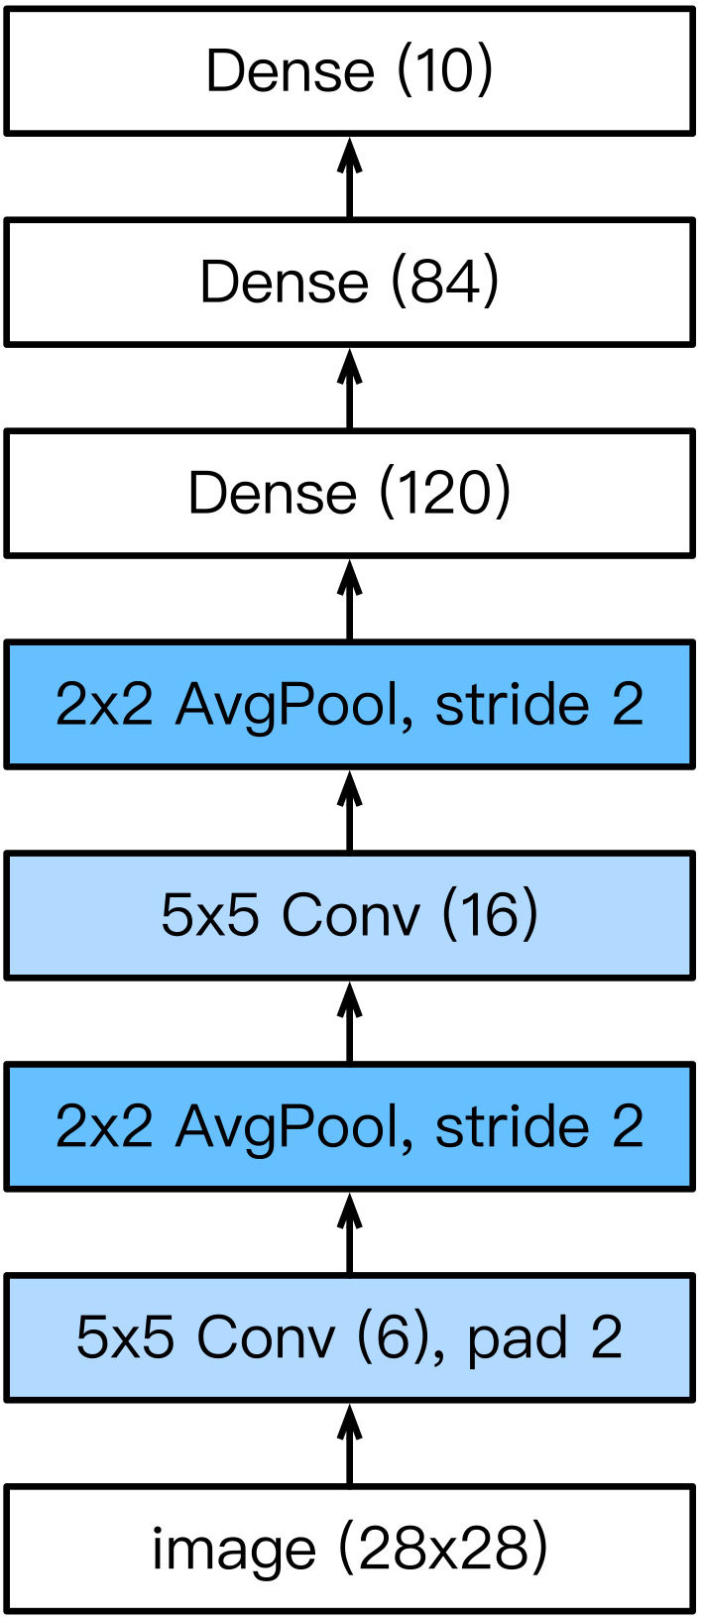
LeNet
LeNet consists of two parts:
Part I. Convolution Block
  Convolution layer
    to recognize the spatial patterns
    5×5 kernel with sigmoid activation function
  Average pooling layer
    to reduce the dimensionality
Part II. Fully-connected layers Block
  3 fully-connected (or Dense) layers

Slide 6
LeNet

