Slide 1
Bounding Box

Slide 2
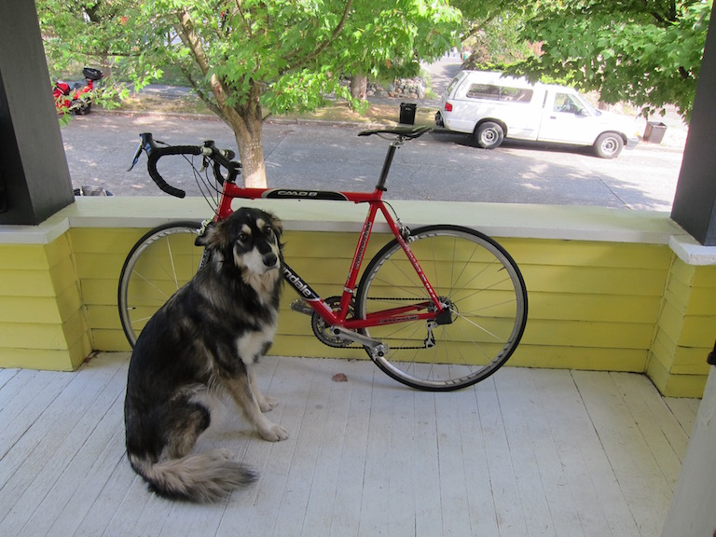
Bounding Box
To detect object/target locations
Determined by 2 (x, y) axis coordinates
upper-left corner
lower-right corner

Slide 3
Bounding Box
How do we determine whether these are good detections?
Ground-truth
Prediction

Slide 4
Intersection over Union (IoU)
Intersection over Union (IoU)
Area of overlap
IoU =
Area of union

Slide 5
Intersection over Union (IoU)
Intersection over Union (IoU): Goodness of the proposed object box
IoU: 0.4034
IoU: 0.9264
Ground-truth
Prediction
BAD
GREAT

Slide 6
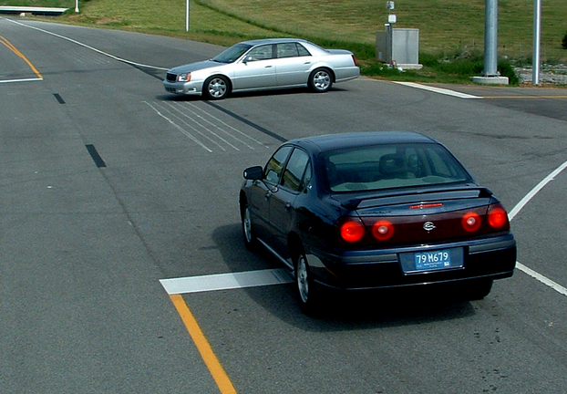
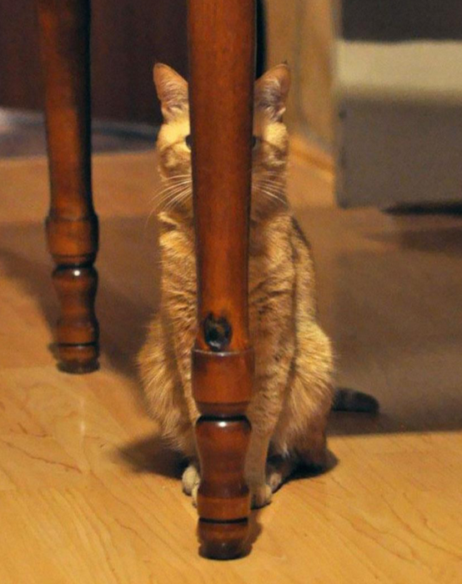
Bounding Box Issues
Various aspect ratios
Occlusion
The solution:
Anchor Box

Slide 7
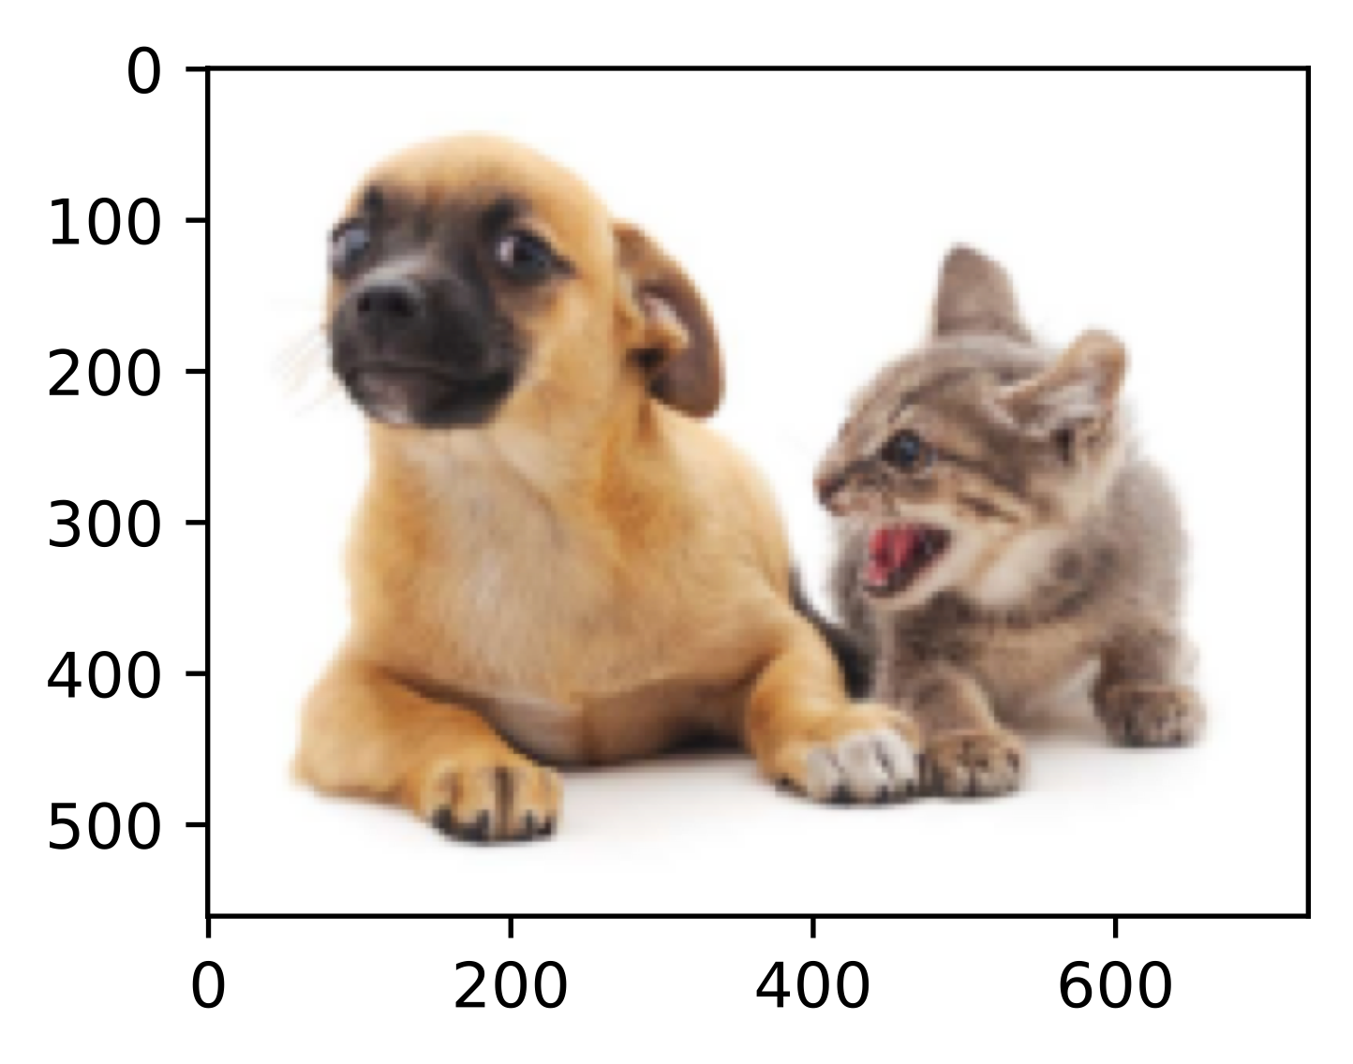
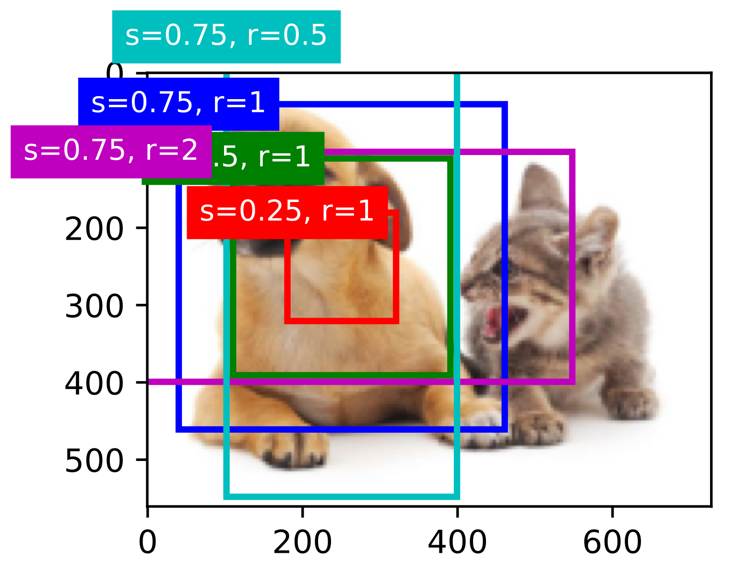
Anchor Box
Anchor boxes: multiple bounding boxes with different sizes and aspect ratios while centering on each pixel

