Slide 1
Sliding Window Method & Non-max Suppression

Slide 2
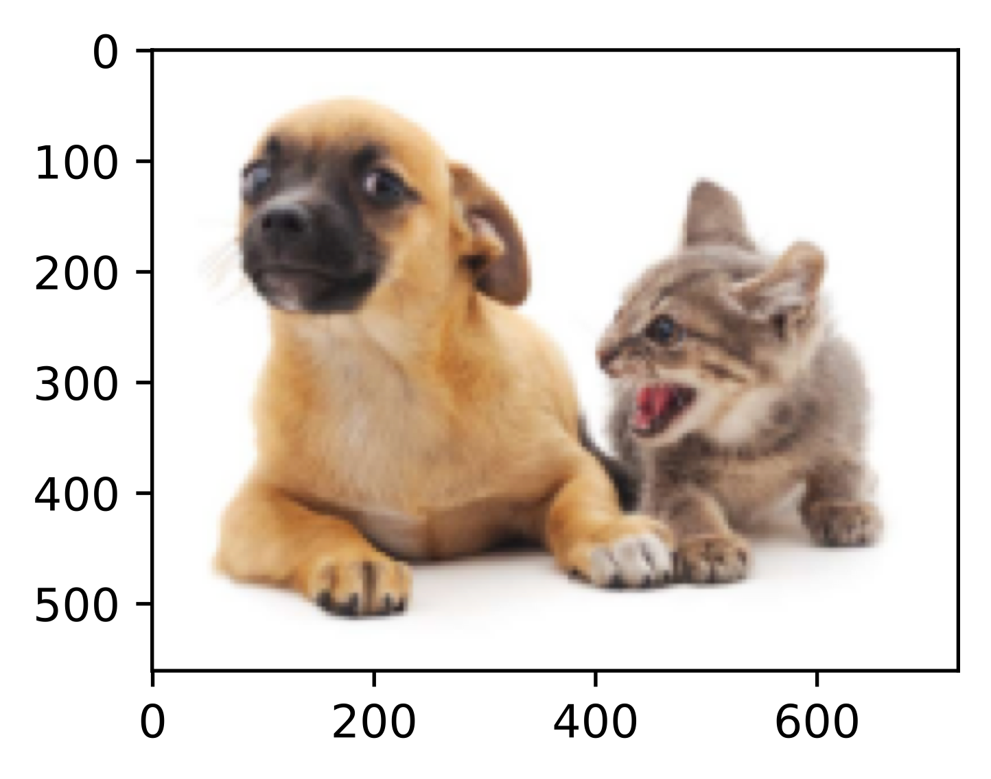
Sliding Window Method
Training:
Running through every window

Slide 3
Sliding Window Method
Training:
Running through every window

Slide 4
Sliding Window Method
Training:
Running through every window

Slide 5
Sliding Window Method
Training:
Running through every window

Slide 6
Sliding Window Method
Training:
Running through every window

Slide 7
Sliding Window Method
Training:
Running through every window

Slide 8
Sliding Window Method
Training:
Running through every window

Slide 9
Sliding Window Method
Training:
Running through every window

Slide 10
Sliding Window Method
Training:
Running through every window

Slide 11
Sliding Window Method
Training:
Running through every window

Slide 12
Sliding Window Method
Training:
Running through every window
Each window returns a probability vector, e.g.,
[P_{dog} = 0.3, P_{cat} = 0, P_{empty} = 0.7]
Deciding the class for that box
Compared with a threshold p. If P_{class} < p, remove the box

Slide 13
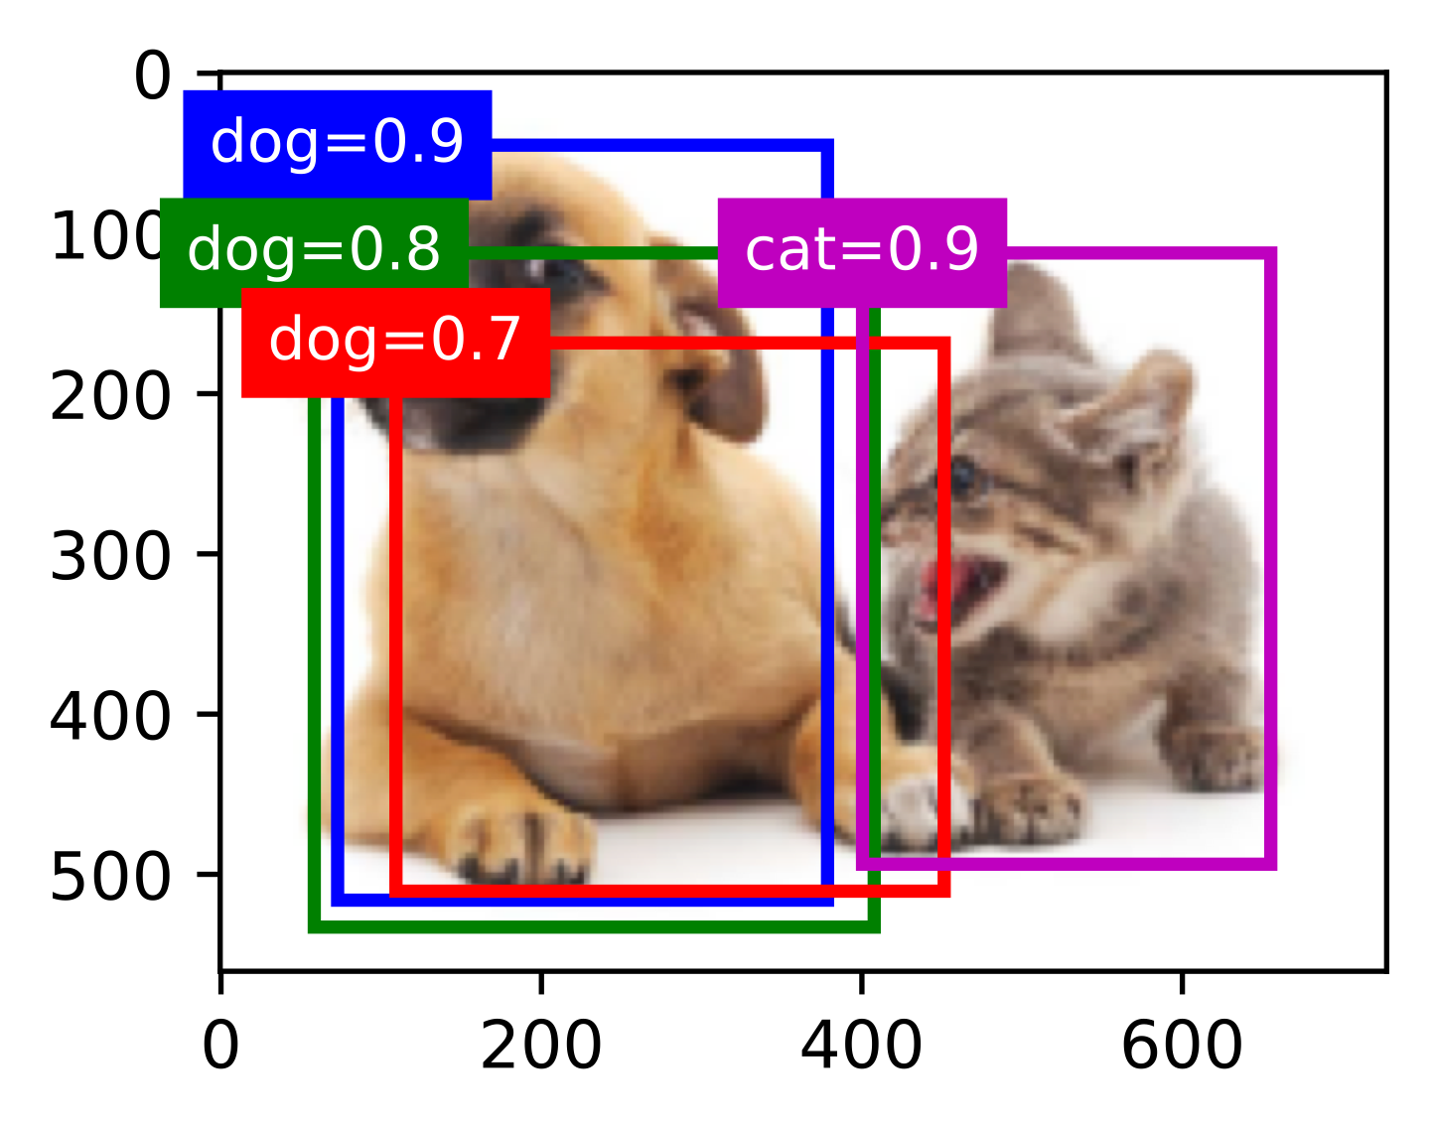
Sliding Window Method
Training:
Running through every window
Each window returns a probability vector, e.g.,
[P_{dog} = 0.3, P_{cat} = 0, P_{empty} = 0.7]
Deciding the class for that box
Compared with a threshold p. If P_{class} < p, remove the box

Slide 14
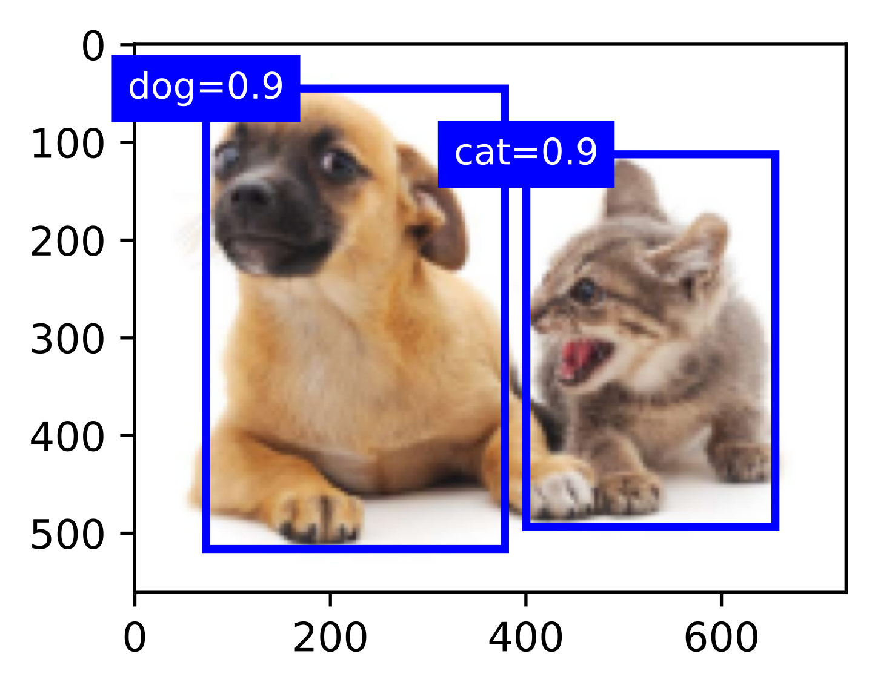
Non-max Suppression (NMS)

Slide 15
Non-max Suppression (NMS)
NMS removes similar bounding box predictions:
For all the remaining boxes (for an object):
Select the box with highest probability
Remove boxes that overlap a lot (high IoU) with the selected box in step 1

Slide 16
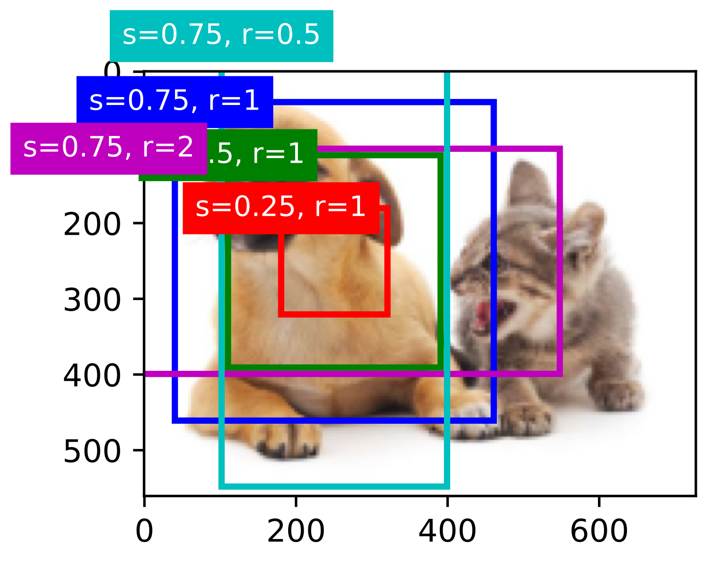
Sliding Window Summary
Steps:
Use a sliding window with anchor boxes
Run through every window location and decide the class for that window
Greedily remove/select boxes using Non-max suppression

Slide 17
Sliding Window Summary
Steps:
Use a sliding window with anchor boxes
Run through every window location and decide the class for that window
Greedily remove/select boxes using Non-max suppression
It is inefficient and slow to run through every region in the image ...

