Slide 2
Decision Trees & Ensemble Models
Lecture 1

Slide 3
Course Schedule
Lecture 1: Introduction to Tree-Based Method
Lecture 2: Bias-Variance Tradeoff and Ensembling Approaches
Lecture 3: Bootstrap sampling, Bagging and Random Forests
Lecture 4: Random Forest Proximities and Feature Importance
Lecture 5: Boosting
Lecture 6: Project Presentation

Slide 4
Lecture 1 Agenda
Class Introduction
An intro to decision trees
Impurity Functions
Basic properties of decision trees
Basic regularization of trees
Interface in Sklearn
Conclusions
Final Project

Slide 5
Lecture 1 Agenda
Class Introduction
An intro to decision trees
Impurity Functions
Basic properties of decision trees
Basic regularization of trees
Interface in Sklearn
Conclusions
Final Project

Slide 6
Class Introduction
Welcome to Decision Trees and Ensemble Methods!
In this class, we will investigate two closely intertwined machine learning concepts:
Tree based methods: These are a fairly simple set of ML algorithms that allow you to make predictions.
Ensembling techniques: These are the ways you can combine several ML models into a single one to make predictions.

Slide 7
Class Introduction
“Why do we care about these techniques? Aren’t deep learning models setting all the records these days?”
While deep learning models are setting state-of-the-art records on tasks involving images, video, audio, and text, in the business world this is not always the majority of tasks.
Often times, what you have is a big spreadsheet of data. When that is the case, deep learning techniques are not the ones setting the records.
In fact, ensembled tree-based methods are often:
Faster (many of them not based on gradient optimization)
Easier to control overfitting (via ensembling)
Easier to understand!

Slide 8
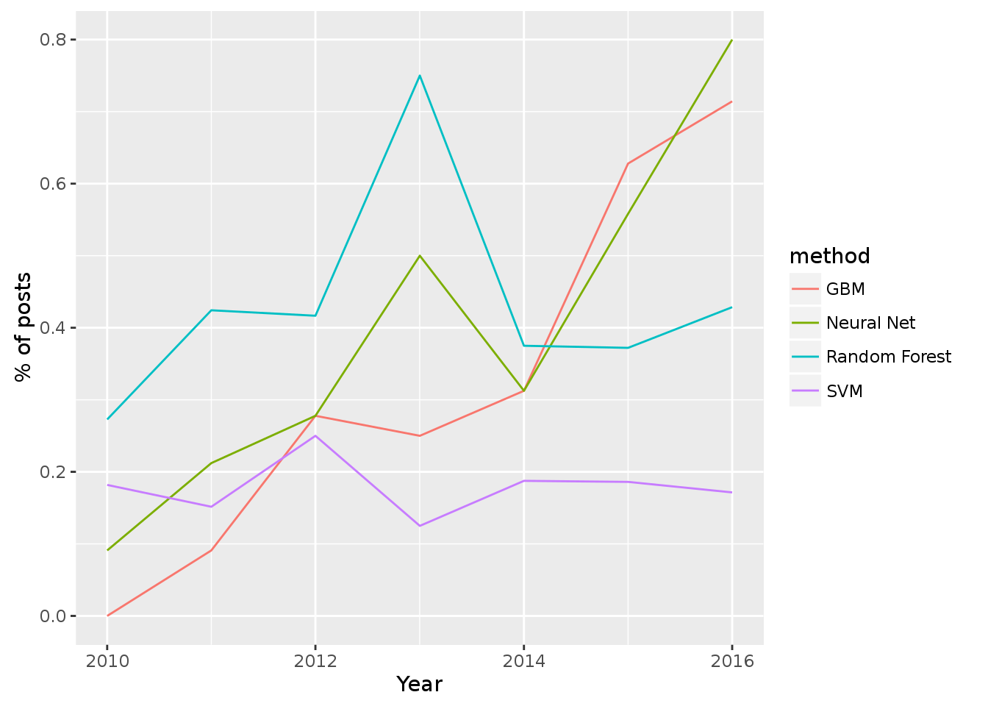
Tree based methods win competitions
In general if you are dealing with tabular data, boosting trees (an ensemble method) is often the most successful technique.
In 2016, Kaggle analyzed their competitions to see what techniques won the most:
Deep Learning and GBM (Gradient Boosted Machines) were tied for most victories!
Random Forests, were not far behind.
In total, GBM + Random Forests were key to more wins than Neural Nets alone.
From Here.

Slide 9
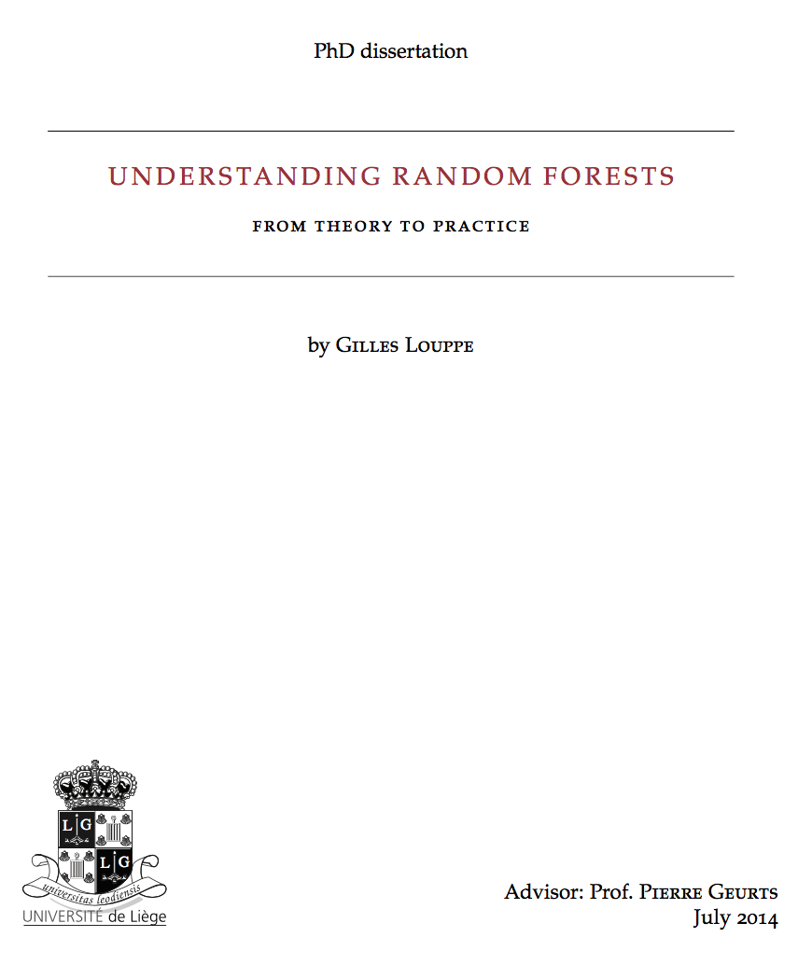
Our Primary Resource
Throughout the first 4 lectures of this class, I’ll be making many references to our ”textbook,” which is a PhD thesis on the theory and best practices in random forests, entitled: Understanding Random Forests

Slide 10
Agenda
Class Introduction
An intro to decision trees
Impurity Functions
Basic properties of decision trees
Basic regularization of trees
Interface in sklearn
Conclusions
Final Project

Slide 11
What is A Decision Tree?
A decision tree is a series of yes/no questions about your input that you ask in sequence.
Tree
Dataset
$$x_{2}≤5$$
x₁ | x₂ | y
3.5 | 2 | 1
5 | 2.5 | 2
1 | 3 | 1
2 | 4 | 1
4 | 2 | 1
6 | 6 | 2
2 | 9 | 2
4 | 9 | 2
5 | 4 | 1
3 | 8 | 2
yes
no
$$x_{1}≤4.5$$
$$Class=2$$
yes
no
$$Class=1$$
$$x_{2}≥3$$
yes
no
$$Class=1$$
$$Class=2$$

Slide 12
What is A Decision Tree?
A decision tree is a series of yes/no questions about your input that you ask in sequence.
Tree
Dataset
: Split nodes
$$x_{2}≤5$$
x₁ | x₂ | y
3.5 | 2 | 1
5 | 2.5 | 2
1 | 3 | 1
2 | 4 | 1
4 | 2 | 1
6 | 6 | 2
2 | 9 | 2
4 | 9 | 2
5 | 4 | 1
3 | 8 | 2
yes
no
$$x_{1}≤4.5$$
$$Class=2$$
yes
no
$$Class=1$$
$$x_{2}≥3$$
yes
no
$$Class=1$$
$$Class=2$$

Slide 13
What is A Decision Tree?
A decision tree is a series of yes/no questions about your input that you ask in sequence.
Tree
Dataset
: Leaf nodes
$$x_{2}≤5$$
x₁ | x₂ | y
3.5 | 2 | 1
5 | 2.5 | 2
1 | 3 | 1
2 | 4 | 1
4 | 2 | 1
6 | 6 | 2
2 | 9 | 2
4 | 9 | 2
5 | 4 | 1
3 | 8 | 2
yes
no
$$x_{1}≤4.5$$
$$Class=2$$
yes
no
$$Class=1$$
$$x_{2}≥3$$
yes
no
$$Class=1$$
$$Class=2$$

Slide 14
What is A Decision Tree?
Let’s plot our data!
x₁ | x₂ | y
3.5 | 2 | 1
5 | 2.5 | 2
1 | 3 | 1
2 | 4 | 1
4 | 2 | 1
6 | 6 | 2
2 | 9 | 2
4 | 9 | 2
5 | 4 | 1
3 | 8 | 2
x₂
x₁

Slide 15
What is A Decision Tree?
What feature (x₁ or x₂) to split first in order to best separate class 1 from class 2?
$$x_{2}≤5$$
yes
no
$$x_{1}≤4.5$$
$$Class=2$$
x₂
x₁

Slide 16
What is A Decision Tree?
What feature (x₁ or x₂) to split second in order to best separate class 1 from class 2?
$$x_{2}≤5$$
yes
no
$$x_{1}≤4.5$$
$$Class=2$$
yes
no
x₂
$$Class=1$$
$$x_{2}≥3$$
x₁
4.5

Slide 17
What is A Decision Tree?
What feature (x₁ or x₂) to split third in order to best separate class 1 from class 2?
$$x_{2}≤5$$
yes
no
$$x_{1}≤4.5$$
$$Class=2$$
yes
no
x₂
$$Class=1$$
$$x_{2}≥3$$
yes
no
3
$$Class=1$$
$$Class=2$$
x₁
4.5

Slide 18
What is A Decision Tree?
Predict y from x₁ and x₂.
$$x_{2}≤5$$
x₁ | x₂ | y
3.5 | 2 | 1
5 | 2.5 | 2
1 | 3 | 1
2 | 4 | 1
4 | 2 | 1
6 | 6 | 2
2 | 9 | 2
4 | 9 | 2
5 | 4 | 1
3 | 8 | 2
yes
no
$$x_{1}≤4.5$$
$$Class=2$$
yes
no
$$Class=1$$
$$x_{2}≥3$$
yes
no
$$Class=1$$
$$Class=2$$

Slide 19
What is A Decision Tree?
$$f\left(x_{1}=2, x_{2}=4\right)= ?$$
$$x_{2}≤5$$
x₁ | x₂ | y
3.5 | 2 | 1
5 | 2.5 | 2
1 | 3 | 1
2 | 4 | 1
4 | 2 | 1
6 | 6 | 2
2 | 9 | 2
4 | 9 | 2
5 | 4 | 1
3 | 8 | 2
yes
no
$$x_{1}≤4.5$$
$$Class=2$$
yes
no
$$Class=1$$
$$x_{2}≥3$$
yes
no
$$Class=1$$
$$Class=2$$

Slide 20
What is A Decision Tree?
$$f\left(x_{1}=2, x_{2}=4\right)=1$$
$$x_{2}≤5$$
x₁ | x₂ | y
3.5 | 2 | 1
5 | 2.5 | 2
1 | 3 | 1
2 | 4 | 1
4 | 2 | 1
6 | 6 | 2
2 | 9 | 2
4 | 9 | 2
5 | 4 | 1
3 | 8 | 2
yes
no
$$x_{1}≤4.5$$
$$Class=2$$
yes
no
$$Class=1$$
$$x_{2}≥3$$
yes
no
$$Class=1$$
$$Class=2$$

Slide 21
What is A Decision Tree?
$$f\left(x_{1}=7.5, x_{2}=5\right)= ?$$
$$x_{2}≤5$$
x₁ | x₂ | y
3.5 | 2 | 1
5 | 2.5 | 2
1 | 3 | 1
2 | 4 | 1
4 | 2 | 1
6 | 6 | 2
2 | 9 | 2
4 | 9 | 2
5 | 4 | 1
3 | 8 | 2
yes
no
$$x_{1}≤4.5$$
$$Class=2$$
yes
no
$$Class=1$$
$$x_{2}≥3$$
yes
no
$$Class=1$$
$$Class=2$$

Slide 22
What is A Decision Tree?
$$f\left(x_{1}=7.5, x_{2}=5\right)=1$$
$$x_{2}≤5$$
x₁ | x₂ | y
3.5 | 2 | 1
5 | 2.5 | 2
1 | 3 | 1
2 | 4 | 1
4 | 2 | 1
6 | 6 | 2
2 | 9 | 2
4 | 9 | 2
5 | 4 | 1
3 | 8 | 2
yes
no
$$x_{1}≤4.5$$
$$Class=2$$
yes
no
$$Class=1$$
$$x_{2}≥3$$
yes
no
$$Class=1$$
$$Class=2$$

Slide 23
What is a decision tree?
Traditionally (although there is a near-infinite variety), these decisions are made by splitting on a single input feature (for instance, $x_{1}>3?$)
Models are learned greedily; they recursively pick a split in each node that maximizes the increase in “purity” (more on that later)
You end the process with a stopping criteria, again with many options:
Once you have reached a maximum depth
Once you have reached a maximum number of “leaves” (the regions in which you assign a particular decision)
Once there are too few data points in a particular leaf
Once the leaf has met some desired level of purity

Slide 24
Agenda
Class Introduction
An intro to decision trees
Impurity Functions
Basic properties of decision trees
Basic regularization of trees
Interface in sklearn
Conclusions
Final Project

Slide 25
Impurity
The key to making this entire procedure work is some notion of impurity.
When deciding which question to ask at a node, we consider the impurity in its child nodes after the question. We want it to be as low as possible (or high purity).
Let’s look at this example (assume a bucket below is simply a node in decision tree):
Impurity
Class 1
Class 2
Low
Medium
High

Slide 26
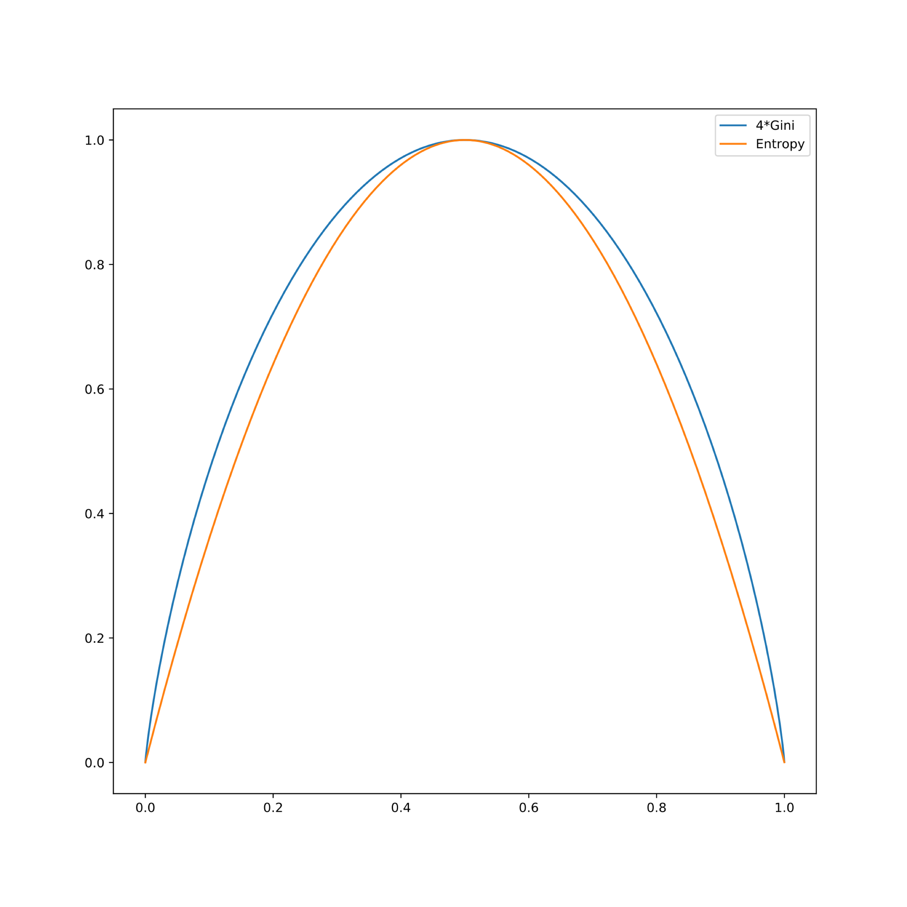
Impurities for Classification
Gini and Entropy for two classes
There are two common choices:
Entropy: $i\left(p_{1},…,p_{k}\right)=−\sum_{j=1}^{k}{p_{j}\log_{2}\left(p_{j}\right)}$
Gini: $i\left(p_{1},…,p_{k}\right)=\sum_{j=1}^{k}{p_{j}(1−p_{j})}$
These are extremely similar, and have basically no difference in performance of the final model.
Since the logarithm is more complex to compute, the Gini Index is the most commonly recommended.
Impurities
$$p_{j}$$

Slide 27
Impurities for Classification - Example
There are two common choices:
Entropy: $i\left(p_{1},…,p_{k}\right)=−\sum_{j=1}^{k}{p_{j}\log_{2}\left(p_{j}\right)}$
Gini: $i\left(p_{1},…,p_{k}\right)=\sum_{j=1}^{k}{p_{j}(1−p_{j})}$
These are extremely similar, and have basically no difference in performance of the final model.
Since the logarithm is more complex to compute, the Gini Index is the most commonly recommended.
Example: Let’s calculate Gini impurity for this sample split
$$i_{1}\left(p_{1}, p_{2}\right)=0.55∗\left(1−0.55\right)+0.45∗\left(1−0.45\right)$$
$$=0.495$$
$$i_{2}\left(p_{1}, p_{2}\right)=0.0∗\left(1−0.0\right)+1.0∗\left(1−1.0\right)$$
$$=0.0$$
The resulting Gini score is the “weighted” sum of these scores.
condition
$$Class1$$
$$Class2$$
$$Class2$$
%55
%45
%100
$$i_{1}\left(p_{1}, p_{2}\right)$$
$$i_{2}\left(p_{1}, p_{2}\right)$$

Slide 28
Impurities for Regression
For regression, the most common impurity measure is simply the variance:
$$i\left(\vec{y}\right)=var\left(\vec{y}\right)=\frac{1}{N}\sum_{i=1}^{N}{{\left(y_{i}−\overline{y}\right)}^{2}}$$
Also common is the mean absolute error (MAE):
$$i\left(\vec{y}\right)=mae\left(\vec{y}\right)=\frac{1}{N}\sum_{i=1}^{N}{|y_{i}−\overline{y}|}$$
Note: Differentiability is not needed in any of this, so we can take a fully arbitrary function as our measure of impurity.

Slide 29
Information Gain
Information Gain (IG)
Difference between the impurity of the parent node and the weighted sum of the child node impurities
The lower the impurity of the child nodes, the larger the information gain
Let’s remember
Parent node
Child node #1
Child node #2
Impurity
Class 1
Class 2
Low
Medium
High

Slide 30
Gini Impurity and Regression
The Gini Impurity is actually very closely tied to the notion of mean squared error.
Encode the two classes as $y_{i}∈\{0,1\}$. Then note that
$$\overline{y}= \frac{1}{N}\sum_{i=1}^{N}{y_{i}}=p_{1}$$
Thus we can conclude that
$$\frac{1}{N}\sum_{i=1}^{N}{{\left(y_{i}−\overline{y}\right)}^{2}}=\frac{1}{N}\sum_{i=1}^{N}{(y_{i}^{2}−2y_{i}\overline{y}+{\overline{y}}^{2})}=\overline{y}−{\overline{y}}^{2}=p_{1}\left(1−p_{1}\right)$$

Slide 31
Gini Impurity and Regression
The Gini Impurity is actually very closely tied to the notion of mean squared error.
Encode the two classes as $y_{i}∈\{0,1\}$. Then note that
$$\overline{y}= \frac{1}{N}\sum_{i=1}^{N}{y_{i}}=p_{1}$$
Thus we can conclude that
$$\frac{1}{N}\sum_{i=1}^{N}{{\left(y_{i}−\overline{y}\right)}^{2}}=\frac{1}{N}\sum_{i=1}^{N}{(y_{i}^{2}−2y_{i}\overline{y}+{\overline{y}}^{2})}=\overline{y}−{\overline{y}}^{2}=p_{1}\left(1−p_{1}\right)$$
${y_{i}^{2}→y}_{i} if y_{i}∈\{0,1\}$

Slide 32
Gini Impurity and Regression
The Gini Impurity is actually very closely tied to the notion of mean squared error.
Encode the two classes as $y_{i}∈\{0,1\}$. Then note that
$$\overline{y}= \frac{1}{N}\sum_{i=1}^{N}{y_{i}}=p_{1}$$
Thus we can conclude that
$$\frac{1}{N}\sum_{i=1}^{N}{{\left(y_{i}−\overline{y}\right)}^{2}}=\frac{1}{N}\sum_{i=1}^{N}{(y_{i}−2y_{i}\overline{y}+{\overline{y}}^{2})}=\overline{y}−{\overline{y}}^{2}=p_{1}\left(1−p_{1}\right)$$
${y_{i}^{2}→y}_{i} if y_{i}∈\{0,1\}$

Slide 33
Gini Impurity and Regression
The Gini Impurity is actually very closely tied to the notion of mean squared error.
Encode the two classes as $y_{i}∈\{0,1\}$. Then note that
$$\overline{y}= \frac{1}{N}\sum_{i=1}^{N}{y_{i}}=p_{1}$$
Thus we can conclude that
$$\frac{1}{N}\sum_{i=1}^{N}{{\left(y_{i}−\overline{y}\right)}^{2}}=\frac{1}{N}\sum_{i=1}^{N}{(y_{i}−2y_{i}\overline{y}+{\overline{y}}^{2})}=\overline{y}−{\overline{y}}^{2}=p_{1}\left(1−p_{1}\right)$$
$$−2\overline{y}\frac{1}{N}\sum_{i=1}^{N}{(y_{i})}={−2\overline{y}}^{2}$$

Slide 34
The General Algorithm (CART)
Assume we have a way to measure label “impurity”.
CART stands for Classification and Regression Trees. It constructs a binary tree (yes-no splits).
Assume we have a data matrix $X=(x_{i,j})$ where $i$ refers to the particular datapoint, and $j$ to the particular feature.
We have our target label vector $\vec{y}=(y_{i})$ which can be either categorical or numerical
We have an impurity measure $i(\vec{y})$ that tells you how pure a collection of labels are.

Slide 35
The General Algorithm (CART)
Loop over every feature $j$ and split every value it takes $x_{i,j}$ :
Split the dataset into two parts (left and right):
$X_{l}, {\vec{y}}_{l}$ for data points ${\vec{x}}_{k}$ where $x_{k,j}<x_{i,j}$,
$X_{r}, {\vec{y}}_{r}$ for data points ${\vec{x}}_{k}$ where $x_{k,j}≥x_{i,j}$.
Let them have sizes $N_{l}, N_{r}$ respectively.
Keep track of the split that maximizes the average decrease in impurity (information gain):
$$i\left(\vec{y}\right)− \frac{N_{l}∗i\left({\vec{y}}_{l}\right)+N_{r}∗i\left({\vec{y}}_{r}\right)}{N_{l}+N_{r}}$$
Recursively pass the left and right datasets to the child nodes.
If some stopping criteria is met, do nothing: just identify the value to return
the best guess: average or most common class
Parent node
Left child node
Right child node

Slide 36
The General Algorithm (CART)
Loop over every feature $j$ and split every value it takes $x_{i,j}$ :
Split the dataset into two parts (left and right):
$X_{l}, {\vec{y}}_{l}$ for data points ${\vec{x}}_{k}$ where $x_{k,j}<x_{i,j}$,
$X_{r}, {\vec{y}}_{r}$ for data points ${\vec{x}}_{k}$ where $x_{k,j}≥x_{i,j}$.
Let them have sizes $N_{l}, N_{r}$ respectively.
Keep track of the split that maximizes the average decrease in impurity (information gain):
$$i\left(\vec{y}\right)− \frac{N_{l}∗i\left({\vec{y}}_{l}\right)+N_{r}∗i\left({\vec{y}}_{r}\right)}{N_{l}+N_{r}}$$
Recursively pass the left and right datasets to the child nodes.
If some stopping criteria is met, do nothing: just identify the value to return
the best guess: average or most common class
Parent node
Left child node
Right child node
impurity before split
impurity after split

Slide 37
Different Variable Types
Our CART algorithm in the previous slides used a numerical attribute ($x_{k,j}$). How many splits do we have to choose from for different variable types?
Nominal Categorical Variable: With C categories ,there are $2^{C−1}−1$ possible splits. For example: [”Red”, “Green”, “Blue”] give three possible splits:
”Red”, [“Green” , “Blue”]
”Green”, [“Red”, “Blue”]
“Blue”, [“Red” , “Green”]
Ordinal Categorical or Continuous Variable: With K different values ,there are $K−1$ possible splits. For example: [12, 15, 18, 20, 23] give 4 possible splits: 13.5, 16.5, 19, 21.5 (mid points)

Slide 38
The General Algorithm (CART)
Often times you want to sort your datapoints before computing the splits since updating the impurities will often be easy when you switch one datapoint from $X_{r}$ to $X_{l}$. See p.50 of Understanding Random Forests
Now to predict, all you need to do is send your particular datapoint down the branches of the tree corresponding to the particular if statement.
Once you hit a leaf, you return the desired value (for predictions) or potentially probability (if you want to make soft decisions like ”80% sure it is a cat, 20% sure it is a dog” rather than hard decisions like “it is a cat.”)
Parent node
$$X_{l}$$
$$X_{r}$$

Slide 39
Agenda
Class Introduction
An intro to decision trees
Impurity Functions
Basic properties of decision trees
Basic regularization of trees
Interface in sklearn
Conclusions
Final Project

Slide 40
Invariance of decision trees
Decision trees are fairly unique in the world of ML in that there is no reason to scale features, or do any type of standardization.
Suppose $f(x)$ is an increasing function ($x>y \overset{⇒}{}f\left(x\right)>f\left(y\right)$) then transforming any feature of your data by $f$ will not change the learned tree (it only really cares about the order)
Similarly any decreasing function can be used, and for many implementations it will not change much (the only issue is the difference between $<$ and $≤$).
However, it is not true that all linear functions can be used since they might mix features together.

Slide 41
Computational Complexity
Assume N: Number of data points, k: Number of features, d: Depth of the tree
Time complexity to learn a single node of a decision tree is $𝒪(kN\log{N})$ assuming you use the sorting method and update the impurities as you go.
If you go through and compute the impurities over the entire dataset each time, it is $𝒪(kN^{2})$.
When you compute a split, you hopefully will split the node into two approximately equal halves. So then the complexity will be something like:
$$𝒪\left(kN\log{N}\right)+2⋅𝒪\left(k\frac{N}{2}\log{\frac{N}{2}}\right)+4⋅𝒪\left(k\frac{N}{4}\log{\frac{N}{4}}\right)+…≈𝒪(dkN\log{N})$$
Worst case performance can be extremely bad!

Slide 42
Agenda
Class Introduction
An intro to decision trees
Impurity Functions
Basic properties of decision trees
Basic regularization of trees
Interface in sklearn
Conclusions
Final Project

Slide 43
Bounding the Complexity
In general when you want to regularize an ML model, it is key to bound the complexity of the model.
When working with gradient based methods like neural networks or even linear or logistic regression, you impose norm constraints on the weights to indirectly mediate complexity
With tree based methods, there is a much more direct way to control the complexity, which is with the number of decision nodes.
Note that a decision tree which subdivides all the way to individual datapoints is maximally overfit
This can be controlled either directly (say by limiting the number of leaves) or by imposing a maximum depth
This idea (stopping early when some criteria isn’t met) is called pre-pruning. This works entirely on training data.
As always, cross-validate to select the parameter.

Slide 44
Post-Pruning
Start with a complex tree, and trim backwards
There are again a near infinite number of options
Simplest is reduced error pruning: iterate over leaf nodes removing those that can be removed without hurting the predictive accuracy on a withheld validation set.
In the modern world, post-pruning is not as important due to the ensembling techniques we’ll discuss in lectures 3-5 to the degree that sklearn doesn’t even implement it, however if you want a single decision tree for efficiency at prediction time, you might need to do it!

Slide 45
Pre-pruning – Hands on
In this exercise, we will apply pre-pruning by controlling:
Max depth
Max number of leaves
Minimum impurity decrease
This exercise uses Sklearn library. We will see more details about Sklearn trees later today.
Let’s open the following notebook:
DTE-LECTURE-1-PRUNE.ipynb

Slide 46
Agenda
Class Introduction
An intro to decision trees
Impurity Functions
Basic properties of decision trees
Basic regularization of trees
Interface in sklearn
Conclusions
Final Project

Slide 47
Sklearn.tree
A nice tree implementation for classification
sklearn.tree.DecisionTreeClassifier(criterion=‘gini’,
max_depth=None,
min_samples_split=2,
min_samples_leaf=1,
max_leaf_nodes=None,
min_impurity_decrease=0.0)
There are other options as well, here is more details.

Slide 48
Sklearn.tree
A nice tree implementation for regression
sklearn.tree.DecisionTreeRegressor(criterion=’mse’,
max_depth=None,
min_samples_split=2,
min_samples_leaf=1,
max_leaf_nodes=None,
min_impurity_decrease=0.0)
There are other options as well, here is more details.

Slide 49
Agenda
Class Introduction
An intro to decision trees
Impurity Functions
Basic properties of decision trees
Basic regularization of trees
Interface in sklearn
Conclusions
Final Project

Slide 50
Conclusion
We learned about the basic algorithm for learning decision trees
Key to learning a decision tree is the choice of an impurity measure that dictates how uniform the contents of a node are (this is similar to choosing a loss function).
Overfitting can be controlled by directly specifying the model complexity via the number of splits
However, the model can still overfit very easily just by picking a single overoptimized split.
Next time: we introduce Extra Trees, and similar models, to help regularize this type of overfitting.

Slide 51
Agenda
Class Introduction
An intro to decision trees
Impurity Functions
Basic properties of decision trees
Basic regularization of trees
Interface in sklearn
Conclusions
Final Project

Slide 52
Final Project – Predict Pet Adoption Time
You will working with pet adoption data from Austin Animal Center.
We joined two datasets that cover intake and outcome of animals. Intake data is available from here and outcome is from here.
We want you to predict whether a pet is adopted within the 30 days stay time in the animal center.
We give you a starter notebook: DTE-FINAL-PROJECT.ipynb
Dataset schema:
Pet ID - Unique ID of pet
Outcome Type - State of pet at the time of recording the outcome
Sex upon Outcome - Sex of pet at outcome
Name - Name of pet
Found Location - Found location of pet before entered the center
Intake Type - Circumstances bringing the pet to the center
Intake Condition - Health condition of pet when entered the center
Pet Type - Type of pet
Sex upon Intake - Sex of pet when entered the center
Breed - Breed of pet
Color - Color of pet
Age upon Intake Days - Age of pet when entered the center (days)
Time at Center - Time at center (0 = less than 30 days; 1 = more than 30 days). This is the value to predict.

Slide 53
Libraries-tools and licenses
Numpy: BSD
Pandas: BSD
Sagemaker: Apache license 2.0
Seaborn: BSD
Sklearn: BSD
Matplotlib: BSD
CatBoost: Apache license 2.0
LightGBM: MIT
XGBoost: Apache license 2.0
MXNet: Apache license 2.0

