Slide 2
Decision Trees & Ensemble Models
Lecture 2

Slide 3
Agenda
Class review
The Bias-Variance Trade-off
Generalizations of the Bias-Variance Trade-off
The ExtraTrees Algorithm
Interface in sklearn
Conclusions

Slide 4
Class Review
Welcome to Decision Trees and Ensemble Methods!
In this class, we will investigate two closely intertwined machine learning concepts:
Tree based methods: These are a fairly simple set of ML algorithms that allow you to make predictions.
Ensembling techniques: These are the ways you can combine several ML models into a single one to make predictions.

Slide 5
What is A Decision Tree?
Let’s plot our data!
x₁ | x₂ | y
3.5 | 2 | 1
5 | 2.5 | 2
1 | 3 | 1
2 | 4 | 1
4 | 2 | 1
6 | 6 | 2
2 | 9 | 2
4 | 9 | 2
5 | 4 | 1
3 | 8 | 2
x₂
x₁

Slide 6
What is A Decision Tree?
What feature (x₁ or x₂) to split first in order to best separate class 1 from class 2?
$$x_{2}≤5$$
yes
no
$$x_{1}≤4.5$$
$$Class=2$$
x₂
x₁

Slide 7
What is A Decision Tree?
What feature (x₁ or x₂) to split second in order to best separate class 1 from class 2?
$$x_{2}≤5$$
yes
no
$$x_{1}≤4.5$$
$$Class=2$$
yes
no
x₂
$$Class=1$$
$$x_{2}≥3$$
x₁
4.5

Slide 8
What is A Decision Tree?
What feature (x₁ or x₂) to split third in order to best separate class 1 from class 2?
$$x_{2}≤5$$
yes
no
$$x_{1}≤4.5$$
$$Class=2$$
yes
no
x₂
$$Class=1$$
$$x_{2}≥3$$
yes
no
3
$$Class=1$$
$$Class=2$$
x₁
4.5

Slide 9
The General Algorithm (CART)
Loop over every feature $j$ and split every value it takes $x_{i,j}$ :
Split the dataset into two parts (left and right):
$X_{l}, {\vec{y}}_{l}$ for data points ${\vec{x}}_{k}$ where $x_{k,j}<x_{i,j}$,
$X_{r}, {\vec{y}}_{r}$ for data points ${\vec{x}}_{k}$ where $x_{k,j}≥x_{i,j}$.
Let them have sizes $N_{l}, N_{r}$ respectively.
Keep track of the split that maximizes the average decrease in impurity (information gain):
$$i\left(\vec{y}\right)− \frac{N_{l}∗i\left({\vec{y}}_{l}\right)+N_{r}∗i\left({\vec{y}}_{r}\right)}{N_{l}+N_{r}}$$
Recursively pass the left and right datasets to the child nodes.
If some stopping criteria is met, do nothing: just identify the value to return
the best guess: average or most common class
Parent node
Left child node
Right child node
impurity before split
impurity after split

Slide 10
Impurities
For Regression:
Variance: $i\left(\vec{y}\right)=var\left(\vec{y}\right)=\frac{1}{N}\sum_{i=1}^{N}{{\left(y_{i}−\overline{y}\right)}^{2}}$
Mean Absolute Error: $i\left(\vec{y}\right)=mae\left(\vec{y}\right)=\frac{1}{N}\sum_{i=1}^{N}{|y_{i}−\overline{y}|}$
For Classification:
Entropy: $i\left(p_{1},…,p_{k}\right)=−\sum_{i=1}^{k}{p_{i}\log_{2}\left(p_{i}\right)}$
Gini: $i\left(p_{1},…,p_{k}\right)=\sum_{i=1}^{k}{p_{i}(1−p_{i})}$

Slide 11
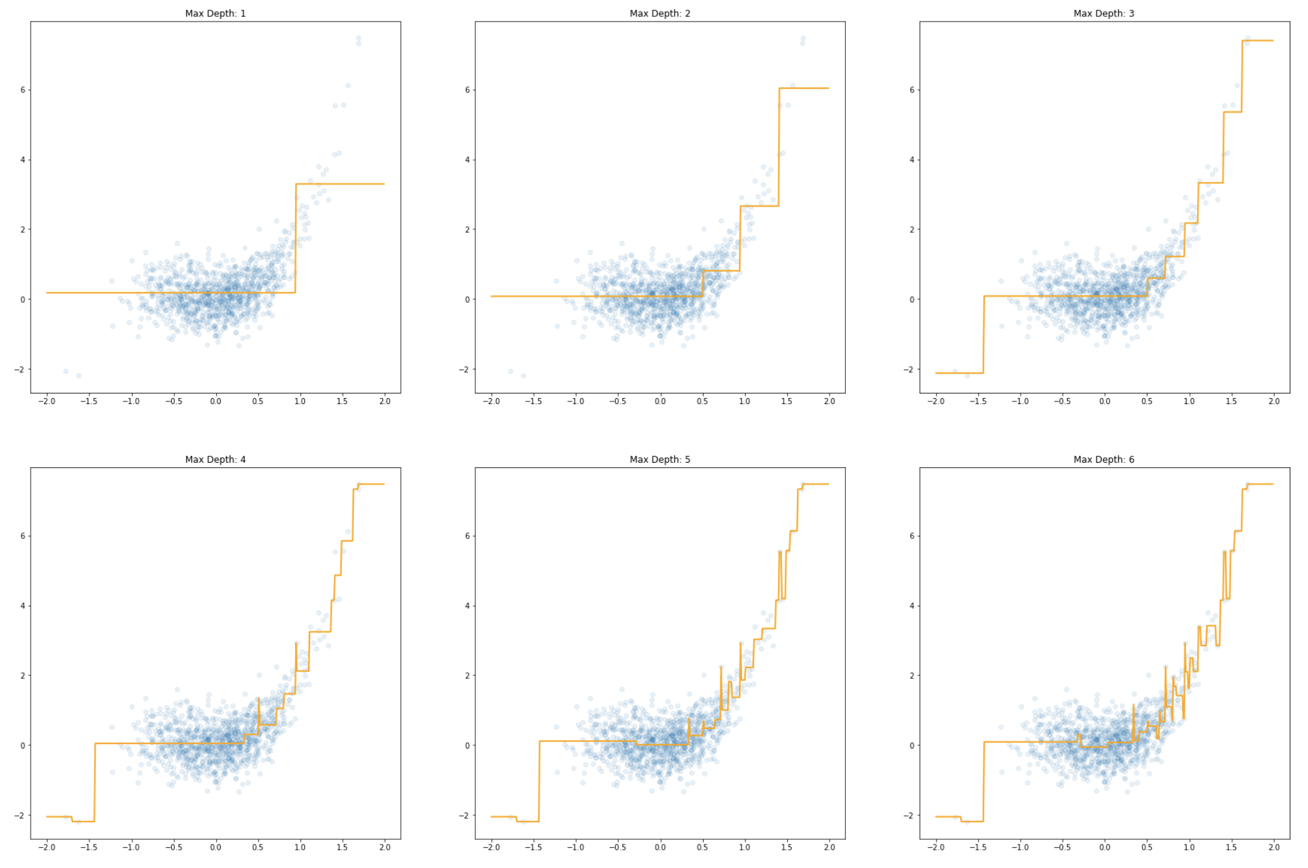
Controlling Overfitting via Maximum Depth
As with most areas of ML, overfitting is the biggest enemy of a decision tree.
We can control the complexity of the model by controlling the size of the tree.
This allows us to avoid overfitting, at the cost of over-simplicity of the prediction.

Slide 12
Further Controlling Overfitting
This is a very simple technique, but it clearly induces an extremely biased model (the fact they are ”step-functions” ensures it always makes systematic errors).
To see how to best counteract this, we need to dive further into the nature of overfitting, and really drill down into the Bias-Variance Trade-off.

Slide 13
Agenda
Class review
The Bias-Variance Trade-off
Generalizations of the Bias-Variance Trade-off
The ExtraTrees Algorithm
Interface in sklearn
Conclusions

Slide 14
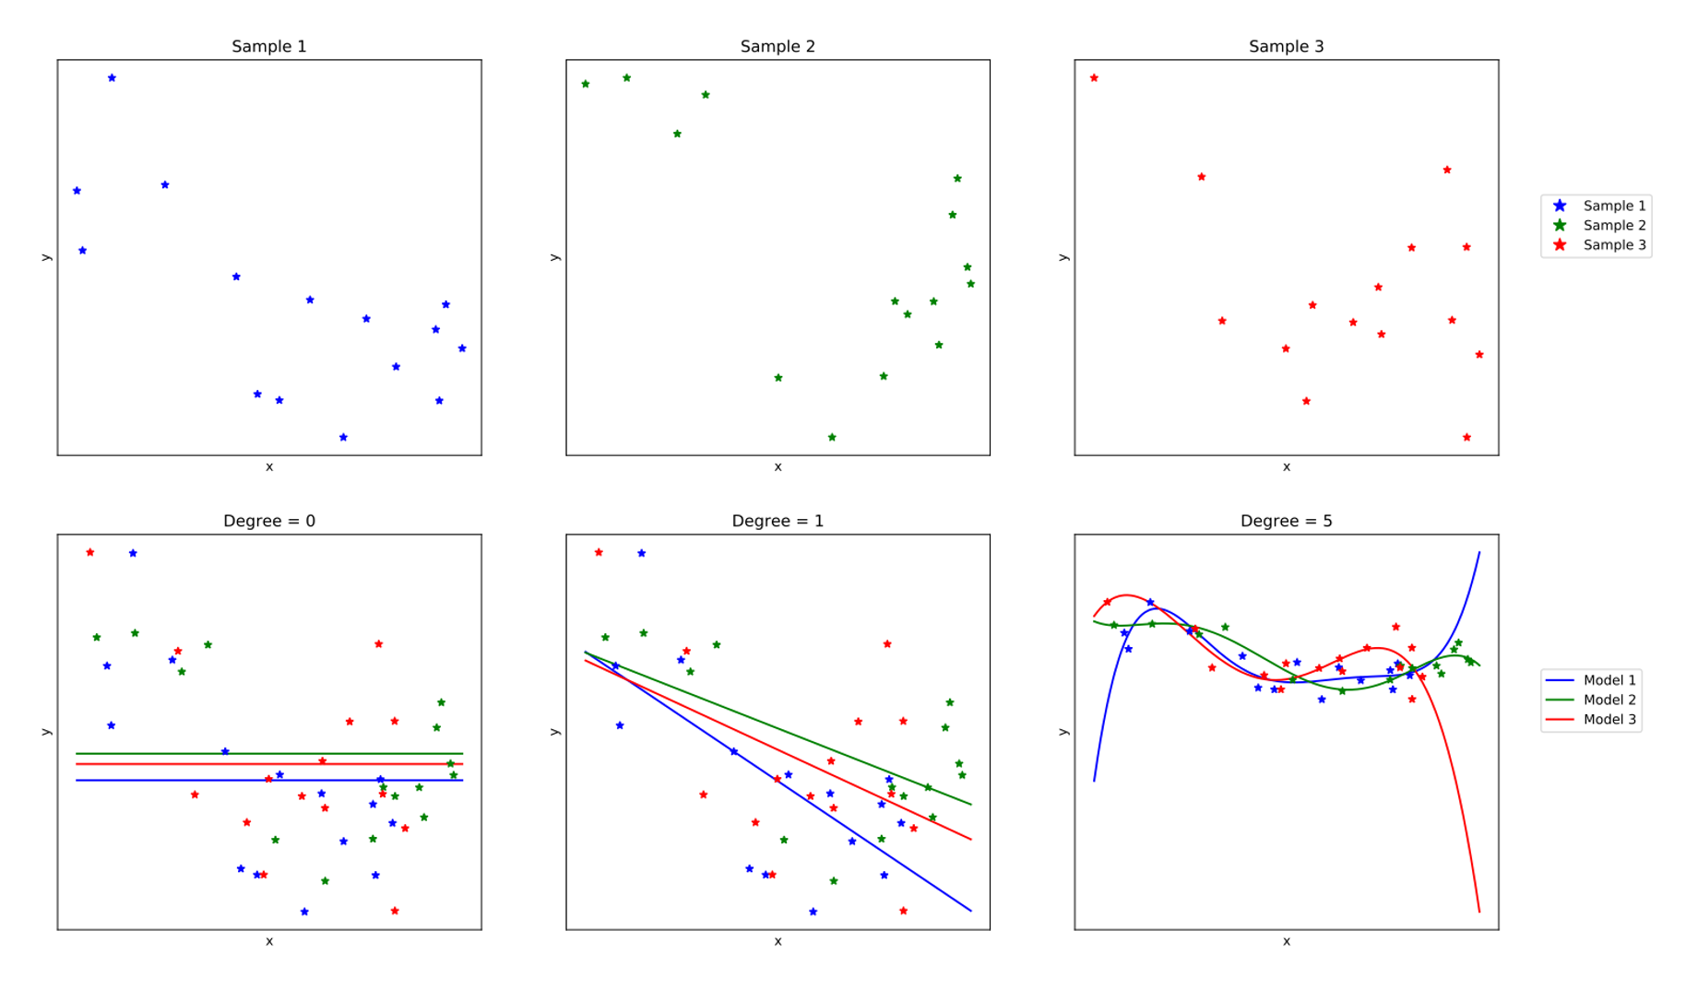
Bias-variance and Model Performance
Bias and Variance have great impact on ML model performance.
Bias: Systematic prediction error due to model selection and assumptions.
Variance: Measures the variability of an estimator when fit over selected dataset.

Slide 15
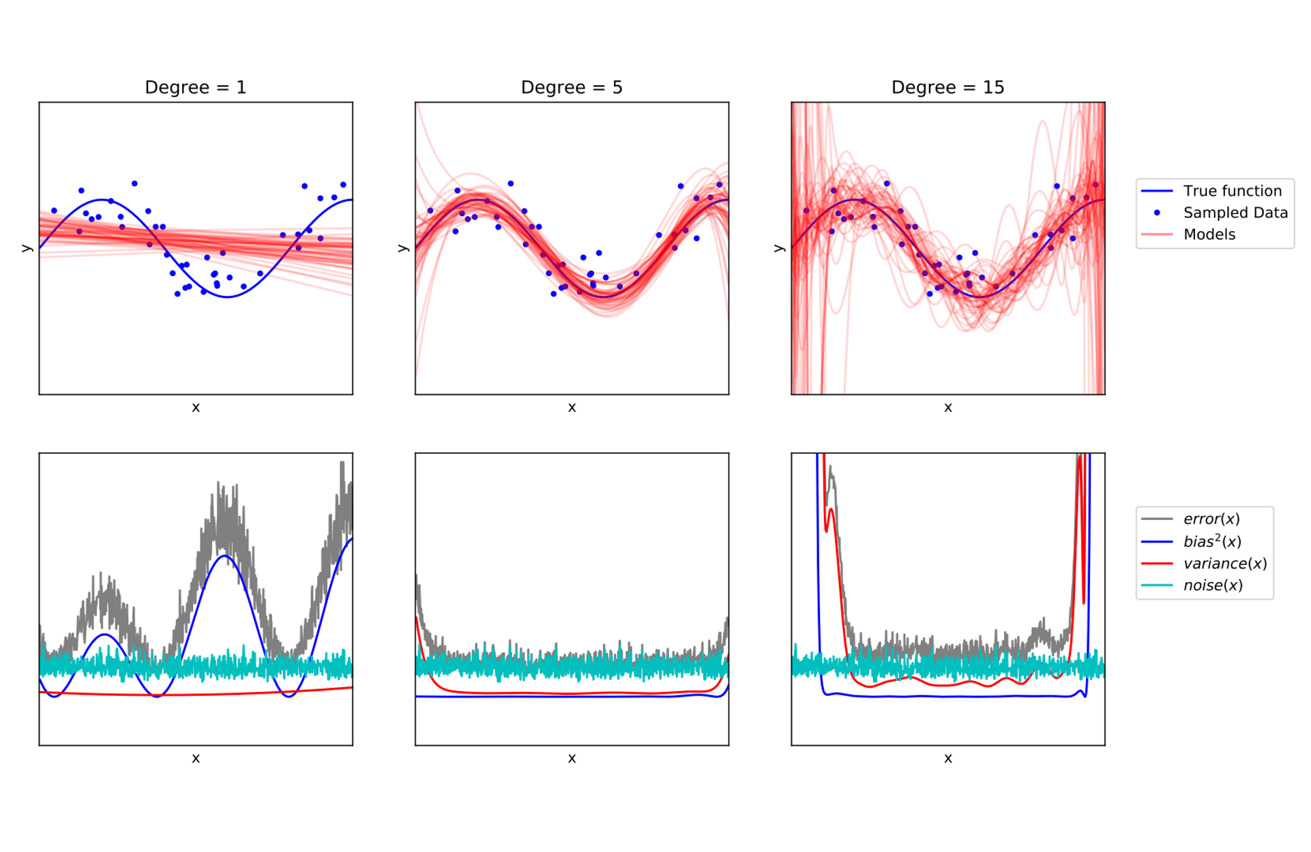
Bias-variance and Model Performance
Underfitting: Low model complexity. Corresponds to high bias and low variance.
Overfitting: Over-complex model and it doesn’t generalize well. Corresponds to low bias and high variance.

Slide 16
Bias-variance and Model Performance
Underfitting: Low model complexity. Corresponds to high bias and low variance.
Overfitting: Over-complex model and it doesn’t generalize well. Corresponds to low bias and high variance.
Example: Fitting multiple polynomials to a set of data points. We are using an example from here: Understanding Random Forests, p.58

Slide 17
Bias-variance and Model Performance
Example: Fitting multiple polynomials to a set of data points. We are using an example from here: Understanding Random Forests, p.58
Blue line is the true function. Red lines are multiple polynomials (in top figures).
Understanding Random Forests, p.58

Slide 18
Bias-variance and Model Performance
Example: Fitting multiple polynomials to a set of data points. We are using an example from here: Understanding Random Forests, p.58
Blue line is the true function. Red lines are multiple polynomials (in top figures).
Polynomial with degree=1: Underfits with high bias, low variance
Polynomial with degree=15: Overfits with low bias, high variance
Understanding Random Forests, p.58

Slide 19
The Bias-Variance Decomposition
Let’s write the bias-variance decomposition:
$$Error\left(\vec{x}\right)=Bias{\left(\vec{x}\right)}^{2}+Var\left[{\hat{f}}_{𝒟}\left(\vec{x}\right)\right]+Noise(\vec{x})$$
All errors can be attributed to a combination of three types of errors:
Systematic prediction error (bias)
Fluctuation of the model with the selected dataset (variance).
Inherent noise
The inherent noise can never be reduced
The bias and the variance can be controlled through model selection.

Slide 20
The Bias-Variance Decomposition
We will derive this equation:
$$Error\left(\vec{x}\right)=Bias{\left(\vec{x}\right)}^{2}+Var\left[{\hat{f}}_{𝒟}\left(\vec{x}\right)\right]+Noise(\vec{x})$$
$$𝔼_{𝒟,y}\left[{\left(y−{\hat{f}}_{𝒟}\left(\vec{x}\right)\right)}^{2}\right]={\left(f\left(\vec{x}\right)−\overline{f}\left(\vec{x}\right)\right)}^{2}+𝔼_{𝒟}\left[{\left(\overline{f}\left(\vec{x}\right)−{\hat{f}}_{𝒟}\left(\vec{x}\right)\right)}^{2}\right]+𝔼_{ε}\left[{ε(\vec{x})}^{2}\right]$$
The mean squared error: $Error\left(\vec{x}\right)=𝔼_{𝒟,y}\left[{\left(y−{\hat{f}}_{𝒟}\left(\vec{x}\right)\right)}^{2}\right]$
The bias: $Bias\left(\vec{x}\right)=f\left(\vec{x}\right)−\overline{f}\left(\vec{x}\right)$
The variance: $Var\left[{\hat{f}}_{𝒟}\left(\vec{x}\right)\right]=𝔼_{𝒟}\left[{\left(\overline{f}\left(\vec{x}\right)−{\hat{f}}_{𝒟}\left(\vec{x}\right)\right)}^{2}\right]$
The noise: $Noise(\vec{x})=𝔼_{ε}\left[{ε(\vec{x})}^{2}\right]$
Error is made up of bias, variance and noise

Slide 21
The Setup I
Suppose I have a regression problem where I take in vectors $\left({\vec{x}}_{i}\right)$ and try to make predictions of a single value $y_{i}$. Suppose for the moment that we know the absolute true answer up to an independent random noise:
$$y=f\left(\vec{x}\right)+ε(\vec{x})$$
The noise should be independent from any randomness inherent in $\vec{x}$, and should have mean zero, so that $f$ is the best possible guess.
The function $f$ is deterministic. You can think of it as averaging the answer over the true distribution in the world for that input:
$$f\left(\vec{x}\right)= 𝔼[y|\vec{x}]$$

Slide 22
The Setup II
When we are given a dataset $𝒟$, we can use some machine learning technique to try to learn to predict the values of $f$ for previously unseen data. Call this learned model ${\hat{f}}_{𝒟}$.
Note that this is random and depends on the particular random sample of data.
There can be additional randomness could potentially be random itself (say it was trained via SGD from a random initialization).
Our Goal:
Given a new input $\vec{x}$,how do we understand $𝔼_{𝒟,y}\left[{\left(y−{\hat{f}}_{𝒟}\left(\vec{x}\right)\right)}^{2}\right]$
In other words: how the randomness in our dataset influence our mean squared error over previously unseen data?

Slide 23
Deriving the Relationship I
E$\left[X+Y\right]=E\left[X\right]+E\left[Y\right]$
E$\left[a X\right]=a E\left[X\right]$, a: Constant
E$\left[X Y\right]=E\left[X\right] E\left[Y\right]$, X and Y are indep.
Let us start with what we have, and remember that $y=f\left(\vec{x}\right)+ϵ(\vec{x})$:
$$𝔼_{𝒟,y}\left[{\left(y−{\hat{f}}_{𝒟}\left(\vec{x}\right)\right)}^{2}\right]=𝔼_{𝒟,ε}\left[{\left(f\left(\vec{x}\right)−{\hat{f}}_{𝒟}\left(\vec{x}\right)+ϵ(\vec{x}) \right)}^{2}\right]$$
$$=𝔼_{𝒟}\left[{\left(f\left(\vec{x}\right)−{\hat{f}}_{𝒟}\left(\vec{x}\right)\right)}^{2}\right]+𝔼_{ε}\left[{ε(\vec{x})}^{2}\right]+{2⋅𝔼}_{𝒟,ε}\left[ε(\vec{x})(f\left(\vec{x}\right)−{\hat{f}}_{𝒟}\left(\vec{x}\right))\right]$$
Since $ϵ\left(\vec{x}\right)$is independent of everything else, and has mean zero by our assumptions, we can see
$$𝔼_{𝒟,ε}\left[ϵ(\vec{x})(f\left(\vec{x}\right)−{\hat{f}}_{𝒟}\left(\vec{x}\right))\right]=𝔼_{ε}\left[ε(\vec{x})\right]𝔼_{𝒟}\left[f\left(\vec{x}\right)−{\hat{f}}_{𝒟}\left(\vec{x}\right)\right]=0$$
Thus, we may simplify this to see
$$𝔼_{𝒟,y}\left[{\left(y−{\hat{f}}_{𝒟}\left(\vec{x}\right)\right)}^{2}\right]=𝔼_{𝒟}\left[{\left(f\left(\vec{x}\right)−{\hat{f}}_{𝒟}\left(\vec{x}\right)\right)}^{2}\right]+𝔼_{ε}\left[{ε(\vec{x})}^{2}\right]$$
(1)
(2)
(3)

Slide 24
Deriving the Relationship II
E$\left[X+Y\right]=E\left[X\right]+E\left[Y\right]$
E$\left[a X\right]=a E\left[X\right]$, a: Constant
E$\left[X Y\right]=E\left[X\right] E\left[Y\right]$, X and Y are indep.
Now, let $\overline{f}(\vec{x})= 𝔼_{𝒟}[{\hat{f}}_{𝒟}\left(\vec{x}\right)]$ denote the average prediction of the ML model over every training set. We may write:
$$𝔼_{𝒟}\left[{\left(f\left(\vec{x}\right)−{\hat{f}}_{𝒟}\left(\vec{x}\right)\right)}^{2}\right]=𝔼_{𝒟}\left[{\left(f\left(\vec{x}\right)−\overline{f}\left(\vec{x}\right)+\overline{f}\left(\vec{x}\right)−{\hat{f}}_{𝒟}\left(\vec{x}\right)\right)}^{2}\right]$$
= $𝔼_{𝒟}\left[{\left(f\left(\vec{x}\right)−\overline{f}\left(\vec{x}\right)\right)}^{2}\right]+𝔼_{𝒟}\left[{\left(\overline{f}\left(\vec{x}\right)−{\hat{f}}_{𝒟}\left(\vec{x}\right)\right)}^{2}\right]$
$$+2⋅𝔼_{y,𝒟}\left[\left(f\left(\vec{x}\right)−\overline{f}\left(\vec{x}\right)\right)\left(\overline{f}\left(\vec{x}\right)−{\hat{f}}_{𝒟}\left(\vec{x}\right)\right)\right]$$
Thus the last term is zero.
Also note $f\left(\vec{x}\right)−\overline{f}\left(\vec{x}\right)$ is not random, so the expectation does nothing on the left.
(2)
Doesn’t depend on the dataset
Mean zero when averaged over $𝒟$

Slide 25
Deriving the Relationship II
E$\left[X+Y\right]=E\left[X\right]+E\left[Y\right]$
E$\left[a X\right]=a E\left[X\right]$, a: Constant
E$\left[X Y\right]=E\left[X\right] E\left[Y\right]$, X and Y are indep.
Now, let $\overline{f}(\vec{x})= 𝔼_{𝒟}[{\hat{f}}_{𝒟}\left(\vec{x}\right)]$ denote the average prediction of the ML model over every training set. We may write:
$$𝔼_{𝒟}\left[{\left(f\left(\vec{x}\right)−{\hat{f}}_{𝒟}\left(\vec{x}\right)\right)}^{2}\right]=𝔼_{𝒟}\left[{\left(f\left(\vec{x}\right)−\overline{f}\left(\vec{x}\right)+\overline{f}\left(\vec{x}\right)−{\hat{f}}_{𝒟}\left(\vec{x}\right)\right)}^{2}\right]$$
= $𝔼_{𝒟}\left[{\left(f\left(\vec{x}\right)−\overline{f}\left(\vec{x}\right)\right)}^{2}\right]+𝔼_{𝒟}\left[{\left(\overline{f}\left(\vec{x}\right)−{\hat{f}}_{𝒟}\left(\vec{x}\right)\right)}^{2}\right]$
$$+2⋅𝔼_{y,𝒟}\left[\left(f\left(\vec{x}\right)−\overline{f}\left(\vec{x}\right)\right)\left(\overline{f}\left(\vec{x}\right)−{\hat{f}}_{𝒟}\left(\vec{x}\right)\right)\right]$$
Thus the last term is zero.
Also note $f\left(\vec{x}\right)−\overline{f}\left(\vec{x}\right)$ is not random, so the expectation does nothing on the left.
(2)
$$2⋅(f\left(\vec{x}\right)−\overline{f}\left(\vec{x}\right))⋅𝔼_{𝒟}\left[\left(\overline{f}\left(\vec{x}\right)−{\hat{f}}_{𝒟}\left(\vec{x}\right)\right)\right]$$
Doesn’t depend on the dataset
Mean zero when averaged over $𝒟$

Slide 26
Deriving the Relationship II
E$\left[X+Y\right]=E\left[X\right]+E\left[Y\right]$
E$\left[a X\right]=a E\left[X\right]$, a: Constant
E$\left[X Y\right]=E\left[X\right] E\left[Y\right]$, X and Y are indep.
Now, let $\overline{f}(\vec{x})= 𝔼_{𝒟}[{\hat{f}}_{𝒟}\left(\vec{x}\right)]$ denote the average prediction of the ML model over every training set. We may write:
$$𝔼_{𝒟}\left[{\left(f\left(\vec{x}\right)−{\hat{f}}_{𝒟}\left(\vec{x}\right)\right)}^{2}\right]=𝔼_{𝒟}\left[{\left(f\left(\vec{x}\right)−\overline{f}\left(\vec{x}\right)+\overline{f}\left(\vec{x}\right)−{\hat{f}}_{𝒟}\left(\vec{x}\right)\right)}^{2}\right]$$
= $𝔼_{𝒟}\left[{\left(f\left(\vec{x}\right)−\overline{f}\left(\vec{x}\right)\right)}^{2}\right]+𝔼_{𝒟}\left[{\left(\overline{f}\left(\vec{x}\right)−{\hat{f}}_{𝒟}\left(\vec{x}\right)\right)}^{2}\right]$
$$+2⋅𝔼_{y,𝒟}\left[\left(f\left(\vec{x}\right)−\overline{f}\left(\vec{x}\right)\right)\left(\overline{f}\left(\vec{x}\right)−{\hat{f}}_{𝒟}\left(\vec{x}\right)\right)\right]$$
Thus the last term is zero.
Also note $f\left(\vec{x}\right)−\overline{f}\left(\vec{x}\right)$ is not random, so the expectation does nothing on the left.
(2)
$$2⋅(f\left(\vec{x}\right)−\overline{f}\left(\vec{x}\right))⋅𝔼_{𝒟}\left[\left(\overline{f}\left(\vec{x}\right)−{\hat{f}}_{𝒟}\left(\vec{x}\right)\right)\right]$$
$2⋅(f\left(\vec{x}\right)−\overline{f}\left(\vec{x}\right))⋅(𝔼_{𝒟}\left[\overline{f}\left(\vec{x}\right)\right]−$ $𝔼_{𝒟}\left[{\hat{f}}_{𝒟}\left(\vec{x}\right)\right])$
Doesn’t depend on the dataset
Mean zero when averaged over $𝒟$

Slide 27
Deriving the Relationship II
E$\left[X+Y\right]=E\left[X\right]+E\left[Y\right]$
E$\left[a X\right]=a E\left[X\right]$, a: Constant
E$\left[X Y\right]=E\left[X\right] E\left[Y\right]$, X and Y are indep.
Now, let $\overline{f}(\vec{x})= 𝔼_{𝒟}[{\hat{f}}_{𝒟}\left(\vec{x}\right)]$ denote the average prediction of the ML model over every training set. We may write:
$$𝔼_{𝒟}\left[{\left(f\left(\vec{x}\right)−{\hat{f}}_{𝒟}\left(\vec{x}\right)\right)}^{2}\right]=𝔼_{𝒟}\left[{\left(f\left(\vec{x}\right)−\overline{f}\left(\vec{x}\right)+\overline{f}\left(\vec{x}\right)−{\hat{f}}_{𝒟}\left(\vec{x}\right)\right)}^{2}\right]$$
= $𝔼_{𝒟}\left[{\left(f\left(\vec{x}\right)−\overline{f}\left(\vec{x}\right)\right)}^{2}\right]+𝔼_{𝒟}\left[{\left(\overline{f}\left(\vec{x}\right)−{\hat{f}}_{𝒟}\left(\vec{x}\right)\right)}^{2}\right]$
$$+2⋅𝔼_{y,𝒟}\left[\left(f\left(\vec{x}\right)−\overline{f}\left(\vec{x}\right)\right)\left(\overline{f}\left(\vec{x}\right)−{\hat{f}}_{𝒟}\left(\vec{x}\right)\right)\right]$$
Thus the last term is zero.
Also note $f\left(\vec{x}\right)−\overline{f}\left(\vec{x}\right)$ is not random, so the expectation does nothing on the left.
(2)
$$2⋅(f\left(\vec{x}\right)−\overline{f}\left(\vec{x}\right))⋅𝔼_{𝒟}\left[\left(\overline{f}\left(\vec{x}\right)−{\hat{f}}_{𝒟}\left(\vec{x}\right)\right)\right]$$
$2⋅(f\left(\vec{x}\right)−\overline{f}\left(\vec{x}\right))⋅(𝔼_{𝒟}\left[\overline{f}\left(\vec{x}\right)\right]−$ $𝔼_{𝒟}\left[{\hat{f}}_{𝒟}\left(\vec{x}\right)\right])$
Doesn’t depend on the dataset
Mean zero when averaged over $𝒟$
$$2⋅(f\left(\vec{x}\right)−\overline{f}\left(\vec{x}\right))⋅(\overline{f}\left(\vec{x}\right)−\overline{f}\left(\vec{x}\right))$$
$$0$$

Slide 28
Deriving the Relationship III
We now can summarize:
$$𝔼_{𝒟,y}\left[{\left(y−{\hat{f}}_{𝒟}\left(\vec{x}\right)\right)}^{2}\right]={\left(f\left(\vec{x}\right)−\overline{f}\left(\vec{x}\right)\right)}^{2}+𝔼_{𝒟}\left[{\left(\overline{f}\left(\vec{x}\right)−{\hat{f}}_{𝒟}\left(\vec{x}\right)\right)}^{2}\right]+𝔼_{ε}\left[{ε(\vec{x})}^{2}\right]$$
The mean squared error: $Error\left(\vec{x}\right)=𝔼_{𝒟,y}\left[{\left(y−{\hat{f}}_{𝒟}\left(\vec{x}\right)\right)}^{2}\right]$
The bias: $Bias\left(\vec{x}\right)=f\left(\vec{x}\right)−\overline{f}\left(\vec{x}\right)$
The variance: $Var\left[{\hat{f}}_{𝒟}\left(\vec{x}\right)\right]=𝔼_{𝒟}\left[{\left(\overline{f}\left(\vec{x}\right)−{\hat{f}}_{𝒟}\left(\vec{x}\right)\right)}^{2}\right]$
The noise: $Noise(\vec{x})=𝔼_{ε}\left[{ε(\vec{x})}^{2}\right]$
Bias²
Variance
Error

Slide 29
Agenda
Class review
The Bias-Variance Trade-off
Generalizations of the Bias-Variance Trade-off
The ExtraTrees Algorithm
Interface in sklearn
Conclusions

Slide 30
What about classification?
We’ve discussed what happens in the case of regression problems, but what about classification?
The story is not fully settled, there are many decompositions, but none quite as nice.
This is the best one I know, but it is much harder to interpret.
This is only slightly a lie: Consider the observed value: $y$, the true value: $f\left(\vec{x}\right)$, the prediction of the vote of many models: $\overline{f}\left(\vec{x}\right)$, and the prediction of one model: ${\hat{f}}_{𝒟}\left(\vec{x}\right)$. Noise arises when the true and observed value do not match, bias is when the true and vote do not match, variance is when the vote and the single model do not match.

Slide 31
Randomized Algorithms
This generalization will be key to the entire rest of our class.
Suppose that ${\hat{f}}_{𝒟}$ does not depend only on the data, but some additional independent randomness that we add in ourselves, call it $ℛ$.
If you follow through additional work, you can further decompose:
$$Var\left[{\hat{f}}_{𝒟}\left(\vec{x}\right)\right]=𝔼_{𝒟}\left[{Var}_{ℛ}\left[{\hat{f}}_{𝒟,ℛ}\left(\vec{x}\right)|𝒟\right]\right]+{Var}_{𝒟}\left[𝔼_{ℛ}\left[{\hat{f}}_{𝒟,ℛ}\left(\vec{x}\right)|𝒟\right]\right]$$
The first term is the average variance due to the added randomness, and the second term is the variance in the average prediction due to the dataset.
$$Var\left(Y\right)=E[Var\left(Y | X\right)]+Var(E[Y|X])$$

Slide 32
Why is this so fundamental?
Imagine training $M$ such random models, and make them vote (or take average) in the final prediction.
The noise in unchanged
The bias is unchanged since
$$𝔼\left[\frac{1}{M}\sum_{i=1}^{M}{{\hat{f}}_{𝒟,ℛ_{i}}\left(\vec{x}\right)}\right]=\frac{1}{M}\sum_{i=1}^{M}{𝔼\left[{\hat{f}}_{𝒟,ℛ_{i}}\left(\vec{x}\right)\right]}=𝔼\left[{\hat{f}}_{𝒟,ℛ_{i}}\left(\vec{x}\right)\right]$$
The variance due to the dataset is unchanged (for the same reason)
The variance due to added randomness is
$$𝔼_{𝒟}\left[{Var}_{ℛ}\left[\left.\frac{1}{M}\sum_{i=1}^{M}{{\hat{f}}_{𝒟,ℛ}\left(\vec{x}\right)}\right|𝒟\right]\right]=\frac{1}{M}𝔼_{𝒟}\left[{Var}_{ℛ}\left[{\hat{f}}_{𝒟,ℛ}\left(\vec{x}\right)|𝒟\right]\right]→0$$

Slide 33
Key Idea
If we can transform some of the variance due to the dataset into variance due to added randomness without making the bias much worse, we can make a model with overall lower error by having them vote (Ensembling)!

Slide 34
Agenda
Class review
The Bias-Variance Trade-off
Generalizations of the Bias-Variance Trade-off
The ExtraTrees Algorithm
Interface in sklearn
Conclusions

Slide 35
Motivating The ExtraTrees Algorithm
Decision trees Decision trees generally low bias models
Why? Just keep cutting you space until you have (for example) $\sqrt{N}$ many points in each leaf. As you add more data, both the location of the splits and the error of the average will be decreased leading to zero bias in the limit.
When it comes to variance, we’ve already seen one way we can counteract it, which is by controlling the complexity of the tree directly, but even then there is overfitting due to the optimization of the cut points.

Slide 36
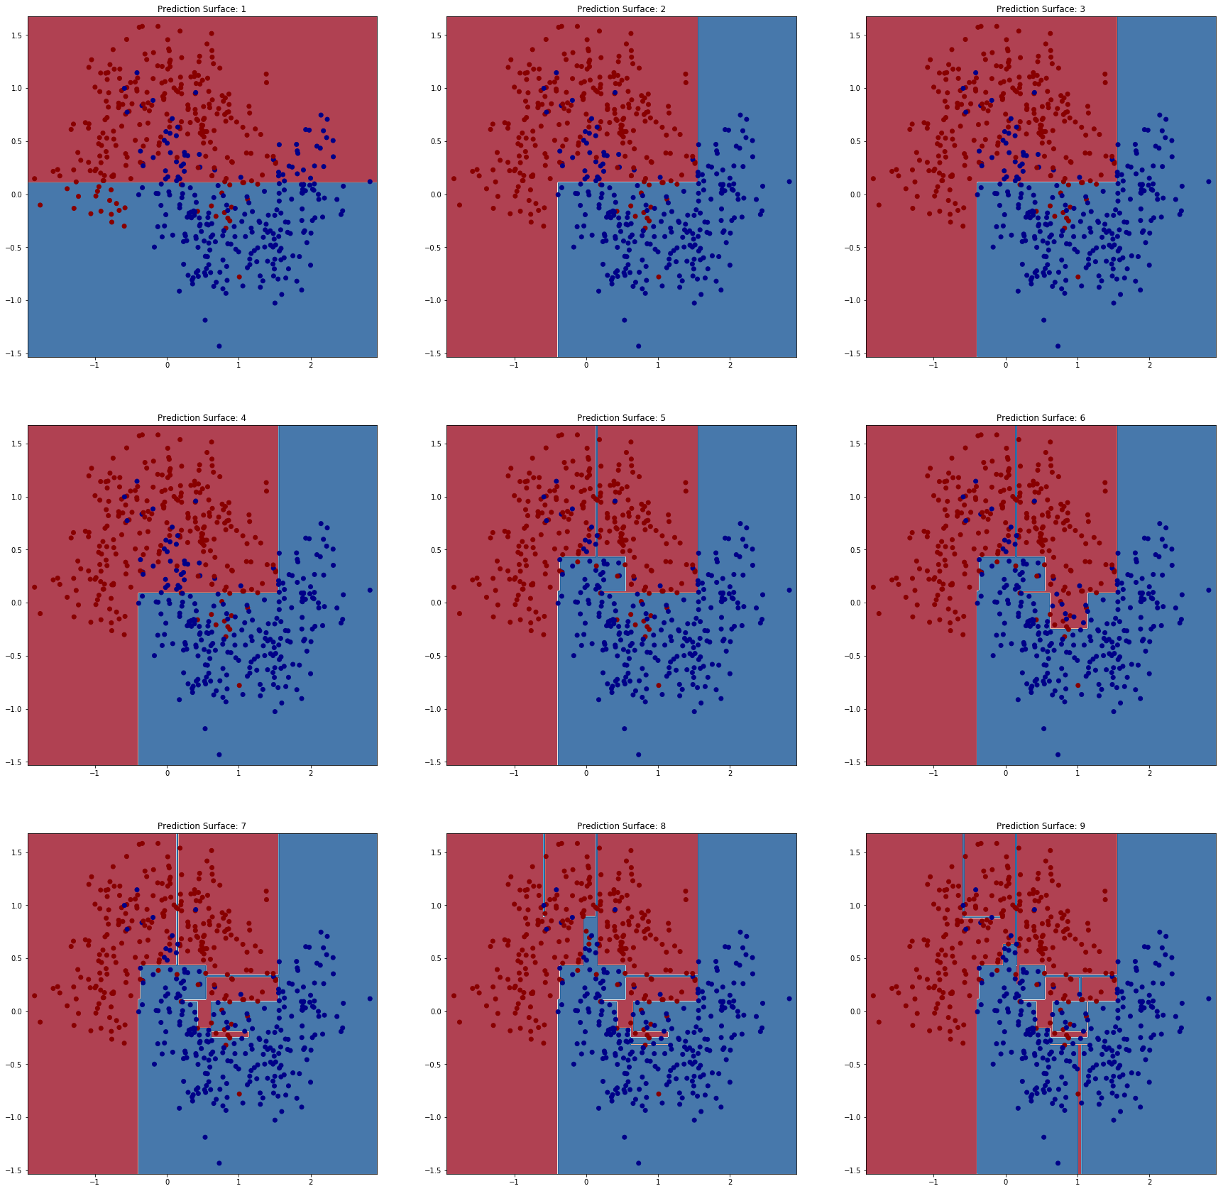
Motivating the ExtraTrees Algorithm
If we plot the prediction surface in your last homework assignment, we will see some strange narrow tendrils.
These areas occur as a result of overfitting on single nodes. This is called the end-cut preference.
Can we avoid it?

Slide 37
ExtraTrees Algorithm
Since it can overfit directly during the optimization of a single node, what if we restrict the degree to which it can look at a single node?
Rather than try all splits on all variables, let us add a new parameter $K$ which is the number of splits to try (Original paper here).
Each of those splits is done on a randomly chosen feature, with a randomly chosen cut-point.
For an ordinal variable pick uniformly in the range $\left[\min\left(x_{⋅,i}\right),\max\left(x_{⋅,i}\right)\right]$
For a nominal variable pick one of the categories at random
Only optimize over the $K$ random splits
In sklearn they make another common choice, which is they try a single split for every feature, and pick amongst those.

Slide 38
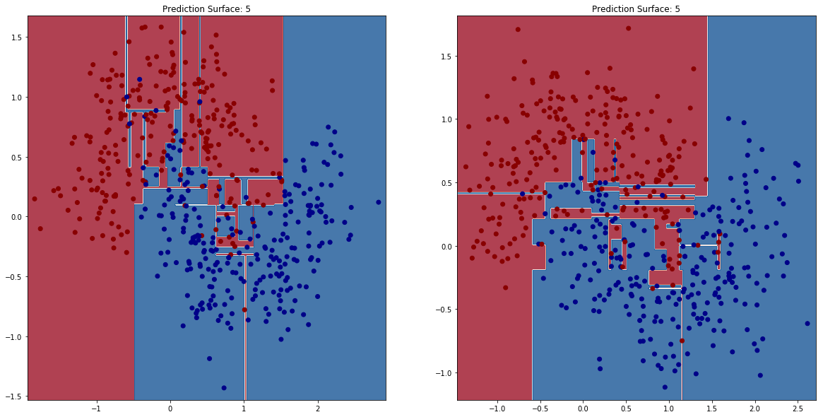
Two Independent Datasets, Depth 5
Notice narrow prediction surfaces
DTE-LECTURE-2-TREE-VARIANCE.ipynb

Slide 39
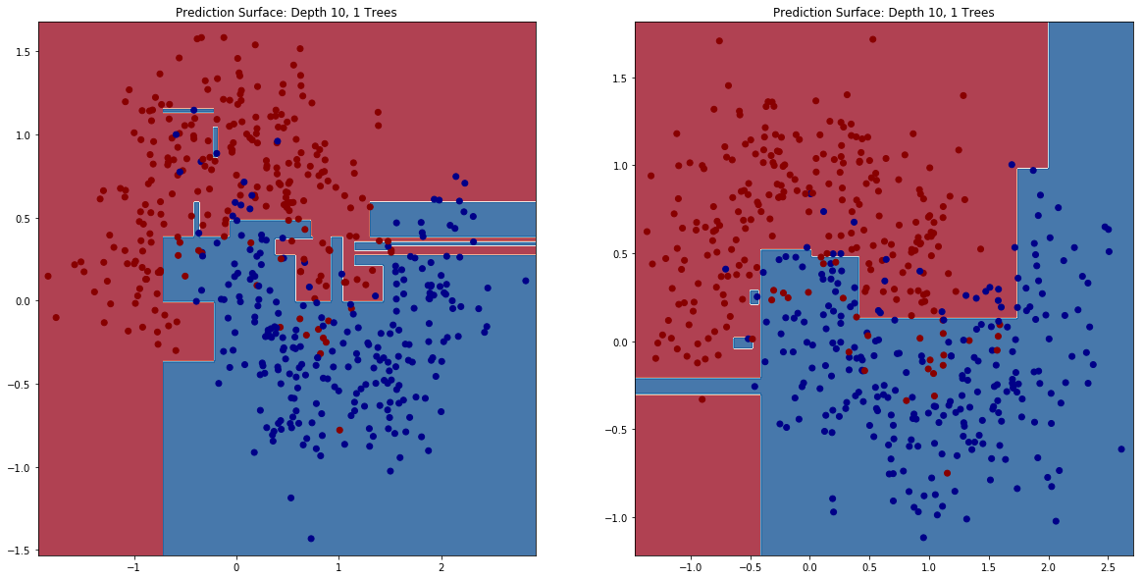
1 ExtraTrees on Two Datasets, Depth 10
Reduced narrow prediction surfaces, overall more uniform shapes

Slide 40
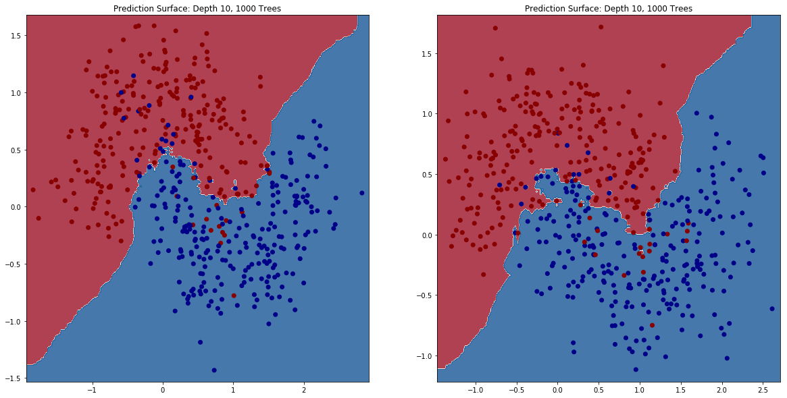
1000 ExtraTrees on Two Datasets, Depth 10
Smooth prediction surfaces coming from averaging many Extra trees.
Total variance is reduced

Slide 41
A few Observations
We have improved the computational complexity somewhat (although not as much as you’d like) of our algorithm since fewer splits need to be considered.
When going from standard decision tree to a single ExtraTree:
There is an increase in bias for a fixed depth (Indeed, the models produced by a depth 10 ExtraTree were still simpler than the depth 5 standard decision tree)
Total variance of the tree didn’t really get better either! We shouldn’t expect it to, since we are in fact adding in more randomness.
The problem with the end-cut preference is a bit improved.
Multiple ExtraTrees: Averaging many trees lead to a vastly improved prediction surface!

Slide 42
Understanding what we observed
Let’s discuss an analysis of the bias/variance decomposition of the ExtraTrees compared to standard decision trees.
var_{LS}E_{ε|LS} is the variance with respect to the learning set randomness of the average prediction according to ε. It measures the dependence of the model on the learning sample, independently of ε
E_{LS}var_{ε|LS} is the expectation over all learning sets of the variance of the prediction with respect to ε. It measures the strength of the randomization ε
From Original Paper.

Slide 43
Understanding what we observed
Let’s discuss an analysis of the bias/variance decomposition of the ExtraTrees compared to standard decision trees.
Var due to dataset fluct.
Var due to added randomness.
var_{LS}E_{ε|LS} is the variance with respect to the learning set randomness of the average prediction according to ε. It measures the dependence of the model on the learning sample, independently of ε
E_{LS}var_{ε|LS} is the expectation over all learning sets of the variance of the prediction with respect to ε. It measures the strength of the randomization ε
From Original Paper.

Slide 44
Understanding what we observed
This can indeed be seen to be the case in practice (and you’ll do so on the homework)
If you deal with synthetic data (which is practically infinite, notice that you can actually estimate all these components of bias and variance directly!

Slide 45
Agenda
Class review
The Bias-Variance Trade-off
Generalizations of the Bias-Variance Trade-off
The ExtraTrees Algorithm
Interface in sklearn
Conclusions

Slide 46
Sklearn ExtraTrees
The interface in sklearn for ExtraTrees matches with everything else you’ve seen before
ExtraTreesClassifier(n_estimators=10, criterion=‘gini’, max_depth=None, random_state=None)
I’ve suppressed most of the options, but I wanted to point out a few:
n_estimators controls the number of random trees you learn
All of the standard options like the splitting criterion and the max_depth are still included.
Now you can specify a random_state for repeatability of the learned model.
Note: there is no control on the number of random choices, they do one per feature.

Slide 47
Agenda
Class review
The Bias-Variance Trade-off
Generalizations of the Bias-Variance Trade-off
The ExtraTrees Algorithm
Interface in sklearn
Conclusions

Slide 48
Conclusions
Today we have seen how to further control overfitting by explicitly adding randomness into our model, and then training many models to average out the new randomness.
This is a bit counterintuitive! However, it makes sense once you think, the new randomness forces it to not memorize the data as effectively.
This can be even taken to the extreme to produce totally random trees, ones where you get one random split and that’s it!
A careful examination of the bias-variance trade-off reveals that this is indeed a reasonable thing to do.

Slide 49
Next Time
This is one way to introduce randomness so we may ensemble the models, but it isn’t the only way!
Next time, we’ll learn about bagging, a general purpose ensembling method that lets us inject randomness into any ML technique, and then average it out at the end.

Slide 50
Final Project – Predict Pet Adoption Time
You will working with pet adoption data from Austin Animal Center.
We joined two datasets that cover intake and outcome of animals. Intake data is available from here and outcome is from here.
We want you to predict whether a pet is adopted within the 30 days stay time in the animal center.
We give you a starter notebook: DTE-FINAL-PROJECT.ipynb
Dataset schema:
Pet ID - Unique ID of pet
Outcome Type - State of pet at the time of recording the outcome
Sex upon Outcome - Sex of pet at outcome
Name - Name of pet
Found Location - Found location of pet before entered the center
Intake Type - Circumstances bringing the pet to the center
Intake Condition - Health condition of pet when entered the center
Pet Type - Type of pet
Sex upon Intake - Sex of pet when entered the center
Breed - Breed of pet
Color - Color of pet
Age upon Intake Days - Age of pet when entered the center (days)
Time at Center - Time at center (0 = less than 30 days; 1 = more than 30 days). This is the value to predict.

Slide 51
Libraries-tools and licenses
Numpy: BSD
Pandas: BSD
Sagemaker: Apache license 2.0
Seaborn: BSD
Sklearn: BSD
Matplotlib: BSD
CatBoost: Apache license 2.0
LightGBM: MIT
XGBoost: Apache license 2.0
MXNet: Apache license 2.0

