Slide 1



Deploying Microservices
using AWS Compute
Arun Gupta
Principal Technologist
argu@amazon.com
@arungupta
arun-gupta
Tiffany Jernigan
Developer Advocate
tfj@amazon.com
@tiffanyfayj
tiffanyfj

Slide 2
Agenda
Introduction
Build Your Application
Microservices using Amazon ECS and AWS Fargate
Microservices using Kubernetes
Microservices using AWS Lambda

Slide 3
Introduction

Slide 4
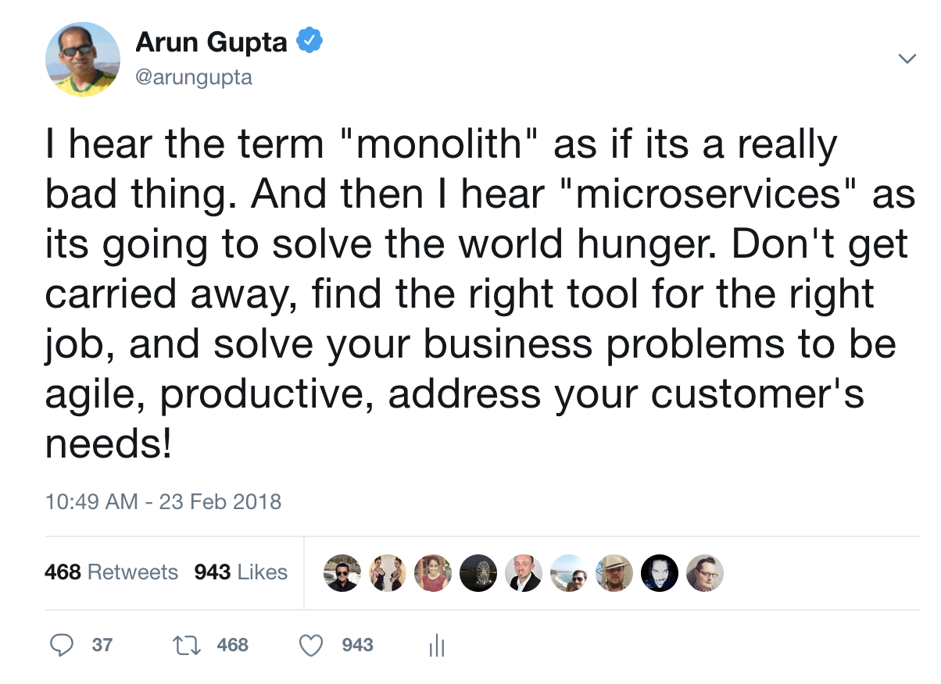

Slide 5












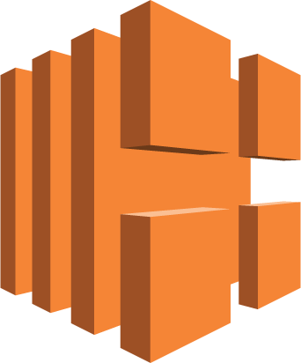







Building Blocks for Microservices on AWS
Compute
Storage & Database
Amazon ECS
AWS Fargate
AWS Elastic Beanstalk
Amazon DynamoDB
Amazon S3
AWS Lambda
Amazon ElastiCache
Amazon RDS
Amazon ECR
Amazon EKS
Application Integration
Networking & API Proxy
Amazon SQS
Amazon SNS
Amazon MQ
AWS Step Functions
Elastic Load Balancing
Amazon Route 53
Amazon API Gateway
Developer Tools
Logging & Monitoring
AWS Cloud9
AWS CodeBuild
AWS CodePipeline
Amazon CloudWatch
AWS CloudTrail
AWS X-Ray

Slide 6
A Typical Application with Microservices
Client
Webapp
Webapp
Webapp
Greeting
Name
Greeting
Name
Greeting
Name

Slide 7
Build Your Application

Slide 8

WildFly Swarm
Leverage Java EE expertise
Open standard
Microservices focus
Super Lightweight
Uber-jar and WAR support
My Svc
JAX-RS
java -jar my_microservice.jar
Notes:
WildFly Swarm wants to enable organizations to leverage their Java EE knowledge when moving to cloud native development. It does so by re-thinking of the execution environment - containerized applications in an orchestrated (Kubernetes) environment. Many of the management features typically offered by application servers are now provided by containerized environments. WildFly Swarm replaces traditional appserver features and instead exposes features and capabilities that enable the container environment to more easily manage and monitor applications.
As an open source project that supports Java EE and MicroProfile specifications, WildFly Swarm maintain's Red Hat's core values in open source and industry standards, enabling customers to improve customer choice while simultaneously reducing risk.
WildFly Swarm supports both Uber jars and traditional war file deployments. The uber-jar approach includes both application and just enough of the appserver to run the application. This is ideal for organizations that prefer a self-contained distributed "executable". Traditional war file deployment are for those that prefer to optimize for containerized environments.

Slide 9
Application Code and
Run using Maven

Slide 10
Microservices and Containers

Slide 11
Microservices and Containers
Do one thing, really well
Any app, any language
Test and deploy same artifact
Self-contained services
Isolated execution environment
Faster startup
Scaling and upgrading
Notes:
Single entry point, single cmd
Microservices encourage polyglot culture. Containers enable them.
No impedance mismatch
Dependencies are totally packaged together
Containers can’t affect each other and that’s how we like microservices to be
Compare VM to containers. Faster to spin up in a container

Slide 12

Running Container
Notes:
Getting started with containers is rather easy, you could even spin up one locally without much effort

Slide 13
Docker Deployment
Notes:
docker swarm init
cd apps/docker
docker stack deploy --compose-file docker-compose.yaml myapp
curl http://localhost:8080
docker stack rm myapp

Slide 14


Running Containers
EC2 Instance
EC2 Instance
EC2 Instance
EC2 Instance
EC2 Instance
Notes:
Or if you want to run containers in the cloud, you spin up some EC2 instances, launch containers on them and get going in minutes. This would work even if you are using dozens of containers. But as you think about scaling this, managing hundreds of such instances, monitoring their health, scaling them and launching your containers on them and the whole lifecycle around them…how do you scale for that?

Slide 15
Running Containers at Scale
Scheduling and Orchestration
Cluster Manager
Placement Engine
Availability Zone #1
Availability Zone #2
Availability Zone #3
Notes:
So lets say you plan to run several highly available applications across 3 different availability zones.
[CLICK]
ECS enables you to be able to operationalize your containerized workloads at very high scales. No management software to install or worry about its high availability.
The cluster management piece enabled you to be able to monitor the cluster, scale it using autoscaling groups and be able to manage state of the instances in the cluster.
The placement engine enables you to be able to set rules to target landing your containers on the right instances based on your preferences.
And then finally, the advanced scheduling features help maintain the desired state of the application, spawn new containers to automatically respond to scaling needs and maintain resiliency by deploying across multiple availability zones while being resource aware of the underlying compute.

Slide 16

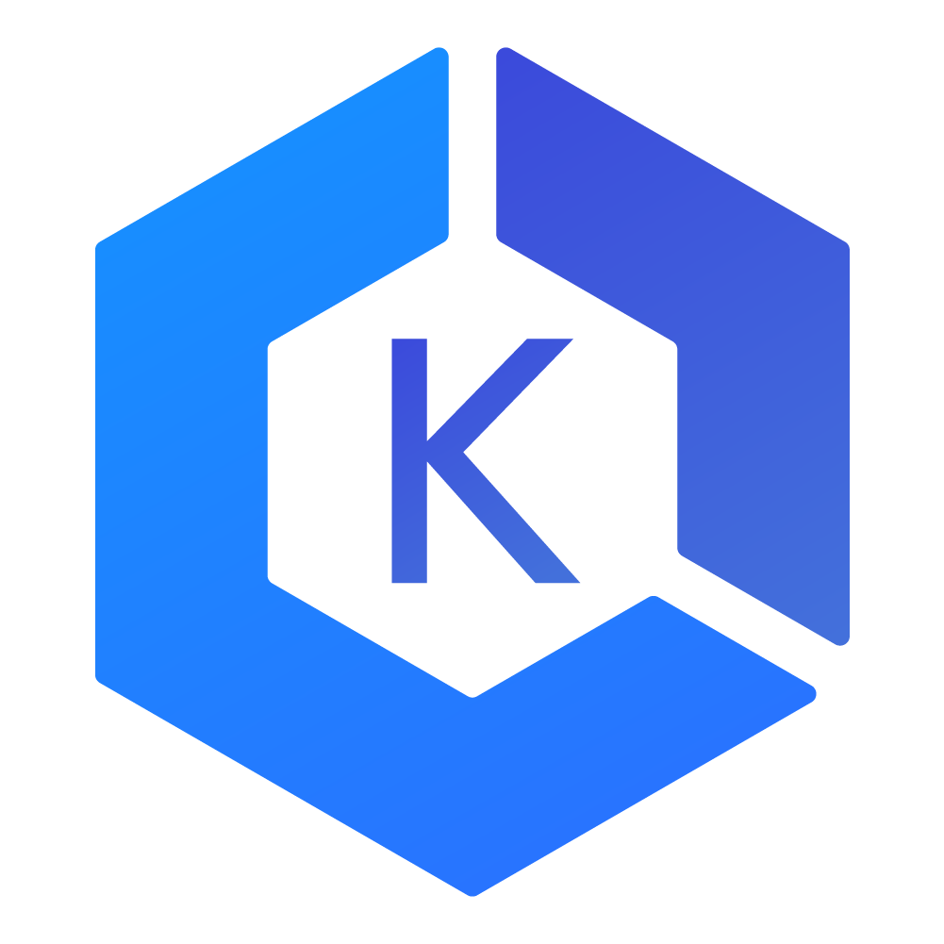
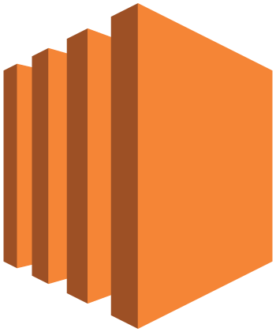

AWS Container Services Landscape
MANAGEMENT
Deployment, Scheduling, Scaling & Management of containerized applications
Preview!
Amazon Elastic
Container Service
Amazon Elastic
Container Service for Kubernetes
HOSTING
Where the containers run
Amazon EC2
AWS Fargate
IMAGE REGISTRY
Container Image Repository
Amazon Elastic
Container Registry
Notes:
Have cluster mgmt layer where we talked about ECS as the option there. Now you can now choose at the hosting layer if you want to run your containers on EC2 or on Fargate for a more hands off managed experience. And recently we also announced EKS which is our managed k8s offering. Removes need to host k8s master.
In preview right now to be used with ec2 worker nodes.
At hosting can use EC2 and Fargate. Run containers without hosting ec2 instances. Can pick at each layer. EKS + Fargate is also coming soon. We also have a registry service to store container images: ECR

Slide 17
Amazon ECS and AWS Fargate

Slide 18

Amazon ECS
Scheduling and Orchestration
Cluster Manager
Placement Engine
Availability Zone #1
Availability Zone #2
Availability Zone #3
Notes:
So lets say you plan to run several highly available applications across 3 different availability zones.
[CLICK]
ECS enables you to be able to operationalize your containerized workloads at very high scales. No management software to install or worry about its high availability.
The cluster management piece enabled you to be able to monitor the cluster, scale it using autoscaling groups and be able to manage state of the instances in the cluster.
The placement engine enables you to be able to set rules to target landing your containers on the right instances based on your preferences.
And then finally, the advanced scheduling features help maintain the desired state of the application, spawn new containers to automatically respond to scaling needs and maintain resiliency by deploying across multiple availability zones while being resource aware of the underlying compute.

Slide 19
Production Workloads on AWS
  AWS VPC networking mode
  Advanced task
  placement
  Deep integration
  with AWS services
  ECS CLI
  Global footprint
  Powerful scheduling engines
  Auto scaling
  CloudWatch metrics
  Load balancers
…
{
}
Notes:
To ensure we can support every workload, we’ve provided containers running on Amazon ECS deep integration with the breadth of AWS platform features and capabilities to make it easier to run container-based applications in production. These integrations include support for AWS VPC task networking, IAM roles and Security Groups for tasks, Load Balancer support (ELB, ALB, NLB), Task Auto Scaling for clusters and Tasks, and CloudWatch Metrics and Logs.
We also provide a rich set of developer tools to make it easier to build complex applications on AWS, including integration with AWS CodePipeline and the ECS CLI which offers a simplified, yet powerful, user experience for getting started with ECS.
With ECS and Auto Scaling, customers can run applications that can grow to support cloud-scale applications.

Slide 20


EC2 Instance
ECSTask
ECSTask
ECSTask
ECSTask
ECS
agent
Docker
agent
ECS
AMI
Notes:
If you double click on the instances it reveals that there is additional supporting software that you need to run, maintain and patch on ALL your virtual machines to support your containers like the Docker daemon and ECS Agent.

Slide 21
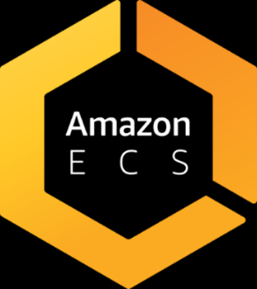

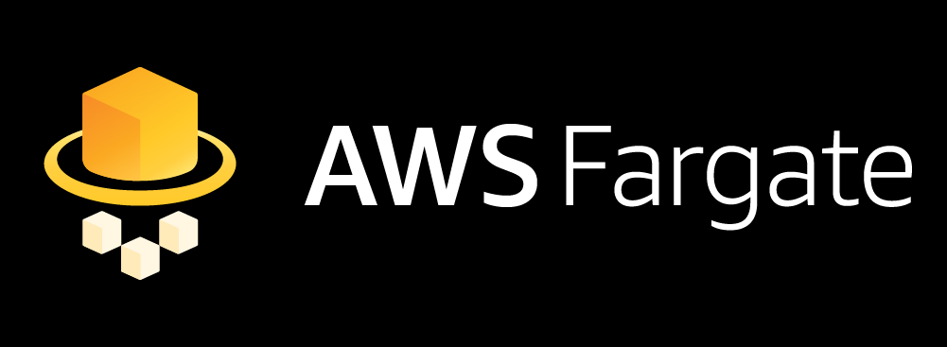
Scheduling and Orchestration
Cluster Manager
Placement Engine
EC2 Instance
EC2 Instance
EC2 Instance
ECS
agent
Docker
agent
ECS
AMI
ECS
agent
Docker
agent
ECS
AMI
ECS
agent
Docker
agent
ECS
AMI
Notes:
So the real picture looked something like this. There are these additional layers of management you need to be aware of when all you wanted to do was run containers!
[CLICK]
Fargate support for ECS enables you to do just that – fully managed orchestration as well as data plane experience bringing your focus to only containers.

Slide 22
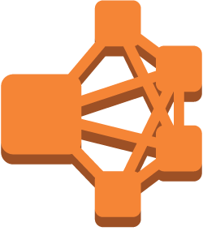


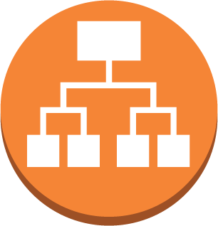
ECS Constructs
Elastic Load Balancer
run
Task
create
Service
A running instantiation of a task definition
Use FARGATE launch type
Maintain n running copies
Integrated with ELB
Unhealthy tasks automatically replaced
register
Task Definition
Define application containers: Image URL, CPU & Memory requirements, etc.
create
Cluster
Infrastructure Isolation boundary
IAM Permissions boundary
Notes:
Task definition is like a blueprint to the recipe of your task. It includes all the relevant parameters for the container set that you want to run.
Cluster serves as logical abstraction to organize your tasks together, as well as administrative boundary for permissions and isolations. For example, you can setup IAM policies to prevent particular users to be able to run, or not, in a cluster. You can also permission it down to a limited set of resources.
Task is an instantiation of the task definition. This is where you specify runtime parameters such as Fargate or EC2.
Tasks are great, but often you want multiple copies of a task running. And a task may fail as well. That’s why we’ve the concept of Service. This is like ASG in EC2. You can ELB, ALB and NLB to load balance your tasks running in the service.

Slide 23
AWS Console &
Task Definitions
Notes:
In AWS Console, show Create Cluster, Create Taskdef, Repository
Show taskdefs from https://github.com/aws-samples/aws-microservices-deploy-options/tree/master/apps/ecs/ec2/taskdefs

Slide 24
Running Fargate Containers with ECS
Same Task Definition schema
Use ECS APIs to launch Fargate Containers
Easy migration – Run Fargate and EC2 launch type tasks in the same cluster
Notes:
So you continue to define your applications as you do for ECS today and use the SAME Apis. Running containers as Fargate or EC2 is really a launch time decision. There is no additional plugin to be added to run your containers as Fargate.
And because you can continue to leverage the same constructs and APIs, not only is your migration between EC2 and Fargate easy but you can run a Fargatized service and one that runs on your EC2 instances side by side within the same cluster. So you get flexibility in picking the launch type for your purposes without breaking the model of co-location of your apps.

Slide 25
Run Fargate Services

Slide 26
AWS Fargate Visibility and Monitoring
CloudWatch Logs
CloudWatch Events supported
Service-level metrics available
Notes:
All application logs are sent to the CWL and CWE available in customer account.
Amazon ECS event stream for CWE can be used to receive near real-time notifications regarding the current state of your Amazon ECS clusters.
In addition when you want to setup scaling rules for your services, you can monitor the ServiceCPU and ServiceMemory utilization.

Slide 27
Logging for
AWS Fargate Services
Notes:
Select webapp-service, show Metrics and Logs tab in the Cluster
Highlight integrated CloudWatch

Slide 28
Rightsize your microservices with AWS Fargate

Slide 29
Pricing Dimensions
{
”cpu": “1 vCPU”,
”memory": “2 gb”,
"networkMode": ”AWSVPC",
"compatibilities": [”FARGATE", ”EC2"],
"placementConstraints": [],
"containerDefinitions": [
{
<snip>…....
Dimensions: Task level CPU and memory
Task Level Resources
Per-second billing
Task level resources
  Configurable independently (within a range)
Notes:
Running the ECS orchestration in itself continues to be at no additional charge, you only pay for what you request at the Task Level. Here we have defined Task level CPU and Memory at 1vCPU and 3GB respectively. You get what you define at the Task level and are charged on a per second basis and only for the time your task is in use. This CPU and memory is applied to all the containers in the task. These are the only required resource parameters when creating a task meant for Fargate. Container-level resources are still available but are now optional.
The billing is on a per second granularity and you configure and pay for the task level dimensions independently. In other words, you pay per CPU-second and per GB second for memory. The billing starts from when the Docker image starts to download.

Slide 30

© 2017, Amazon Web Services, Inc. or its Affiliates. All rights reserved.
Notes:
So you may ask, with Fargate and EC2 launch types available, which one should I pick for workloads? Or if you say that I like the simplicity of Fargate but when should I when should I think about using the EC2 launch type?
How much you want to manage? Do you want to use OD or Spot Instances? Do you have specific memory/compute requirements? The key to understanding is that it is not a one-way door, you can go back and forth as the schemas are compatible and the administrative boundary is still the same ECS cluster.

Slide 31

Amazon ECS CLUSTER
Subnet 1
Subnet 2
Subnet 3
172.31.1.0/24
172.31.2.0/24
172.31.3.0/24
Web
FARGATE
Shopping Cart
ECS Instance
ECS Instance
ECS Instance
ECS Instance
ECS Instance
ECS Instance
Notifications
EC2
Availability Zone #1
Availability Zone #2
Availability Zone #3
Notes:
Fargate clusters are heterogeneous.
Say you have different requirements where the notifications app team would like to be able to move to Fargate but has a different timeline planned to do so but are ready to use Fargate for your Shopping cart and web apps.
[CLICK]
As you notice, you can run the Web and shopping cart apps as ECS services with launch type Fargate and you only see your tasks across the various subnets and AZs. You can continue to run Shopping Cart and Notifications apps as EC2 Launch Types within the same cluster as the Fargate powered Web app and network boundaries thereby applying uniform set of policies in terms of IAM permissions as well as network access rules.
Notice, how the containers are spread across different subnets across AZ. This gives high resiliency and fault tolerance to your microservices.

Slide 32
Deployment Pipelines with
AWS CodePipeline
Notes:
Amazon.com had the same problem as our customers and developers. Amazon.com is built as a set of 100s of microservices, we needed tools to automate the deployments. How do we do frequent deployments, like 50m changes (1.5 deployment/sec, i.e. 4k deployments during our 45 min talk) a year in 2014. Internal tools have inspired the CodeStar family.

Slide 33
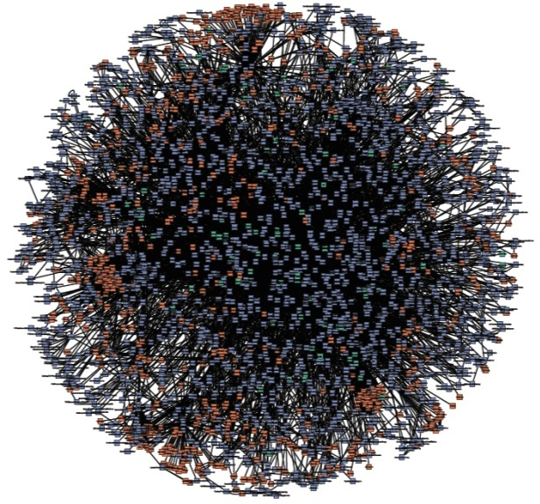
Single-purpose
Connect only through APIs
Connect over HTTPS
Largely “black boxes” to each other
“Microservices”

Slide 34
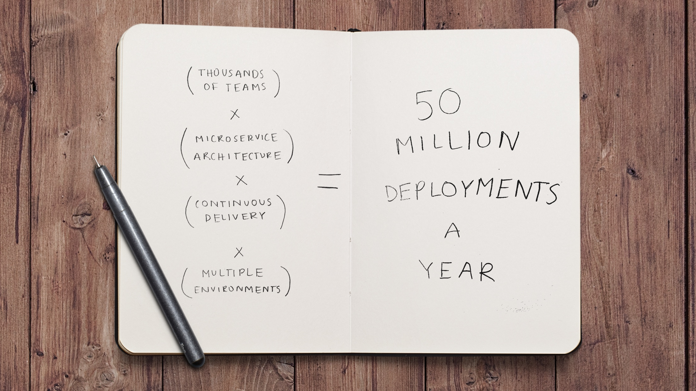

Notes:
Code Pipeline was created because of this requirement.

Slide 35




Deployment Pipeline with AWS Fargate
5
1
Developers continuously integrate changes into a main branch hosted within a repo
Amazon ECR
2
Triggers an execution of the pipeline when a new version is found, builds
a new image with build ID
3
4
3
Pushes the newly built image
tagged with build ID to ECR repo
4
Creates a new taskdef revision using the image built
1
2
Developer
GitHub
AWS CodeBuild
5
Fetches new container image
and updates the deployment
AWS CodePipeline
Notes:
https://aws.amazon.com/blogs/compute/continuous-deployment-to-amazon-ecs-using-aws-codepipeline-aws-codebuild-amazon-ecr-and-aws-cloudformation/
https://github.com/aws-samples/aws-microservices-deploy-options#deployment-pipeline-fargate-with-aws-codepipeline

Slide 36
Deployment Pipeline for
Fargate Tasks with
AWS CodePipeline
Notes:
https://github.com/aws-samples/aws-microservices-deploy-options#deployment-pipeline-fargate-with-aws-codepipeline

Slide 37
Canary Deployment for Amazon ECS
Route 53 weights to adjust traffic flows
Blue service created with a new ALB
ECS event stream to trigger deployment
Step Functions transition from blue to green
https://github.com/aws-samples/ecs-canary-blue-green-deployment

Slide 38
Microservices using Kubernetes

Slide 39

57%
of Kubernetes workloads run on AWS today
—CNCF survey
Notes:
Our customers believe that there are tremendous advantages to running Kubernetes on AWS. According to a CNCF survey this year, over 60% of Kubernetes workloads run on AWS today. This is entirely organic growth fueled by strong community of developers, customers, and partners.
Let’s take a quick look at what your typical Kubernetes on AWS deployment looks like.

Slide 40


Master
Master
Master
Etcd
Etcd
Etcd
Availability
Zone 1
Availability
Zone 2
Availability
Zone 3
Notes:
You then need to run the actual worker nodes- this is where your applications run. Worker nodes are generally deployed in autoscaling groups, across multiple Azs….you can choose OD or RI instances, spot instances, whatever instance type makes sense for you...

Slide 41
“Run Kubernetes for me.”
Notes:
Our customers told us, “Hey, running Kubernetes isn’t trivial work, and we think we can better spend our cycles focusing on our applications.” “if we had things our way, we wouldn’t have to think about the nuances of kubernetes deployments or configuration, we wouldn’t have to worry about managing etcd or the masters” In essence, “run Kubernetes for me”

Slide 42

ELASTIC CONTAINER SERVICE FOR KUBERNETES
Notes:
We listened, and that’s why we’ve built Elastic Container Service for Kubernetes- or EKS.
We know how important a Kubernetes service is to our customers. So we didn't build Amazon EKS haphazardly. An excellent way to communicate how we took your feedback and synthesized it into a service is by taking a look at the core tenets for EKS. These tenets anchored our decision-making for how Amazon EKS should work.

Slide 43
Master
Master
Master
Etcd
Etcd
Etcd
Availability
Zone 1
Availability
Zone 2
Availability
Zone 3
Notes:
So, to recap, one more snapshot of what your standard Kubernetes distribution looks like today. Masters, Etcd, Worker nodes, all running in your acount and under your supervision.

Slide 44
AWS Managed
Master
Master
Master
Customer Account
Workers
Workers
Workers
Availability
Zone 1
Availability
Zone 2
Availability
Zone 3
Notes:
So, to recap, one more snapshot of what your standard Kubernetes distribution looks like today. Masters, Etcd, Worker nodes, all running in your acount and under your supervision.

Slide 45

Kubectl
mycluster.eks.amazonaws.com
Availability
Zone 1
Availability
Zone 2
Availability
Zone 3
Notes:
Now, with EKS, the complexity of standing up your own Kubernetes control plane is simplified. Instead of running the Kubernetes control plane in your account, you connect to a managed Kubernetes endpoint in the AWS cloud. This endpoint abstracts the complexity of the Kubernetes control plane- your worker nodes can check into a cluster, and you can interact with your Kubernetes cluster through the tooling you already know and love.

Slide 46
EKS Cluster

Slide 47
Kubernetes Application Concepts
Pods: Co-located group of containers that share IP, etc
Deployment: Declarative state for pod
Service: Logical set of pods, accessible by a name
Label: Key/value pairs attached to objects, such as pods

Slide 48
Kubernetes Application Manifest

Slide 49
Kubernetes
Application Packaging using Helm

Slide 50
Helm – Package Manager for Kubernetes
Templating and packaging tool for Kubernetes apps
Chart: Bundle to represent k8s applications
  Packaged into archive files
Apt, yum, homebrew for k8s
Manage the chart and release

Slide 51
Helm Client
gRPC
Tiller Server
MyApp 1
MyApp 1
MyApp 1
ConfigMap
ConfigMap
chart files
ConfigMap
chart
configuration
Kubernetes API Server
release
Helm Repository
MyApp 1
MyApp 1
MyApp 1
Client manages charts
Server manages releases
chart packages
Notes:
Helm has two parts – client (Helm) and server (Tiller).
Tiller runs inside of your Kubernetes cluster, and manages releases (installations) of your charts.
Helm runs on your laptop, CI/CD, or wherever you want it to run.
Charts are Helm packages that contain at least two things:
A description of the package (Chart.yaml)
One or more templates, which contain Kubernetes manifest files
Charts can be stored on disk, or fetched from remote chart repositories (like Debian or RedHat packages)
The Helm client is written in the Go programming language, and uses the gRPC protocol suite to interact with the Tiller server.
The Tiller server is also written in Go. It provides a gRPC server to connect with the client, and it uses the Kubernetes client library to communicate with Kubernetes. Currently, that library uses REST+JSON. The Tiller server stores information in ConfigMaps located inside of Kubernetes. It does not need its own database.
Configuration files are, when possible, written in YAML.
A chart repository is an HTTP server that houses an index.yaml file and optionally some packaged charts. When you're ready to share your charts, the preferred way to do so is by uploading them to a chart repository. Index.yaml is an index of all of the charts in the repository. It is not required that a chart package be located on the same server as the index.yaml file. However, doing so is often the easiest. Make sure the index.yaml file can be accessed with no authentication requirement
Tiller gets info via the client, when you use stable/spinnaker as the chart it will get the latest bits from one of the repos in your local helm config and sends the interpolated configs to tiller which handles the rest. Repo doesn't need to be configured with tiller, client only do.
Because a chart repository can be any HTTP server that can serve YAML and tar files and can answer GET requests, you have a plethora of options when it comes down to hosting your own chart repository. For example, you can use a Amazon S3 bucket, Github Pages, or even create your own web server.

Slide 52
Helm Chart

Slide 53
Kubernetes Deployment Pipeline with AWS CodePipeline

Slide 54
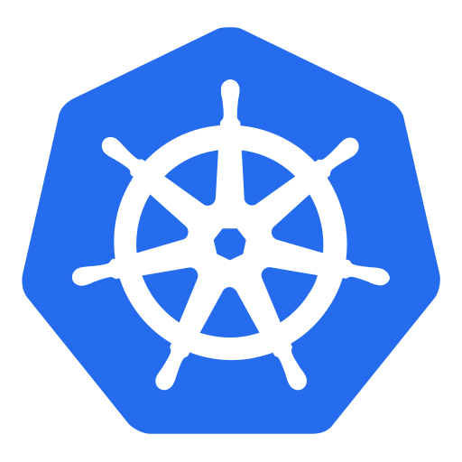
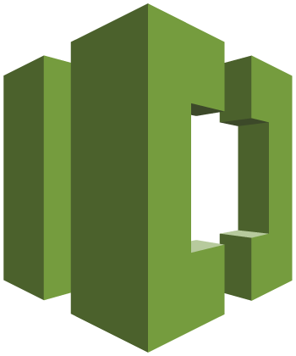
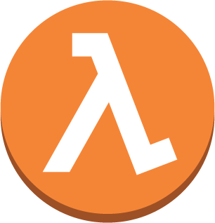
Deployment Pipeline with Kubernetes
6
1
Developers continuously integrate changes into a main branch hosted within a repo
Amazon ECR
2
Triggers an execution of the pipeline when a new version is found, builds
a new image with build ID
3
5
3
Pushes the newly built image
tagged with build ID to ECR repo
4
Invokes a Lambda function to
trigger application deployment
1
2
4
5
Leverages Kubernetes Python SDK
to update a deployment
Developer
AWS CodeCommit
AWS CodeBuild
AWS Lambda
6
Fetches new container image
and performs a rolling update
of deployment
AWS CodePipeline
https://github.com/aws-samples/aws-kube-codesuite

Slide 55



Logging using EKS
AWS
CloudTrail
Amazon CloudWatch
Master
Notes:
We’ll provide access to our EKS API logs through cloudtrail, Kubernetes control plane logs through cloudwatch like
/var/log/kube-apiserver.log - API Server, responsible for serving the API
/var/log/kube-scheduler.log - Scheduler, responsible for making scheduling decisions
/var/log/kube-controller-manager.log - Controller that manages replication controllers
and, finally, we’ll provide access to the metrics server, which aggregates cluster wide metrics, for consumption via your favorite mechanism.

Slide 56
Kubernetes Logging in EKS
Notes:
Show CloudTrail at https://us-west-2.console.aws.amazon.com/cloudtrail/home?region=us-west-2#/events
Show CW logs at

Slide 57
Canary Deployment using Service Mesh
Platform to connect, manage and secure microservices
Any language, any framework
Deployed as “sidecar”
Decouple applications from operational aspects
  Service discovery, circuit breakers, routing, tracing, telemetry, etc
  No changes to microservices
Fleet-wide policy enforcement
Notes:
Control traffic between services with dynamic route configuration, conduct A/B tests, release canaries, and gradually upgrade versions using blue/green deployments.
Increase reliability by shielding applications from flaky networks and cascading failures in adverse conditions.
Apply organizational policy to the interaction between services, ensure access policies are enforced and resources are fairly distributed among consumers. Policy changes are made by configuring the mesh, not by changing application code.
Understand the dependencies between services, the nature and flow of traffic between them, and quickly identify issues with distributed tracing.
Sidecar proxies enable the decoupling of your applications from the operational aspects of managing service communication effectively and reliably.

Slide 58
Canary Deployment using Request Routing
apiVersion: config.istio.io/v1alpha2
kind: RouteRule
metadata:
name: greeting-default
spec:
destination:
name: greeting
route:
- labels:
greeting: hello
weight: 90
- labels:
greeting: howdy
weight: 10
Notes:
Dynamically configured based on weights and HTTP headers

Slide 59
Canary Deployment using Istio

Slide 60
Fault Injection
Can inject delays
Force timeouts of your services
Configure latency and spikes
Other undesirable effects

Slide 61
5 seconds delay in 10% of requests
apiVersion: config.istio.io/v1alpha2
kind: RouteRule
metadata:
name: greeting-delay
spec:
destination:
name: greeting
route:
- labels:
greeting: hello
httpFault:
delay:
percent: 10
fixedDelay: 5s

Slide 62
apiVersion: config.istio.io/v1alpha2
kind: RouteRule
metadata:
name: greeting-delay-abort
spec:
destination:
name: greeting
match:
source:
name: webapp
labels:
version: v2
route:
- labels:
greeting: howdy
httpFault:
delay:
fixedDelay: 5s
abort:
percent: 10
httpStatus: 400
Delay all requests from "webapp v2" to "greeting howdy" by 5s
Abort 10% of requests

Slide 63
Monitoring

Slide 64
Metrics
Visualizer
Grafana, Kibana, Dashboard
Alerting
AlertManager, Kapacitor
Cluster-wide Aggregator
Prometheus, Heapster
Nodes
Node exporter
Pod/Container
Kube-state-metrics
cAdvisor
Application
/metrics
JMX
Data Model
InfluxDB, Graphite
Notes:
Tune the Docker logs in different manner
System logs
Docker logs
Pod has a PID
PID writes to STDOUT
Docker picks it up and dumps to file
Debian: daemon.log
System log (systemd logs): Kernel panics, messages from Docker, kubelet, API server
Why my pod is not scheduling? - Kubectl events, kubectl describe will help
Basic is throw Prometheus – aggregator for events, not a long term persistent store – Actually InfluxDB comes with scaling and clustering only in the commercial version. The open source version like Prometheus has to be manual sharded and scaling has to be figured out based on how much data is gathered.

Slide 65
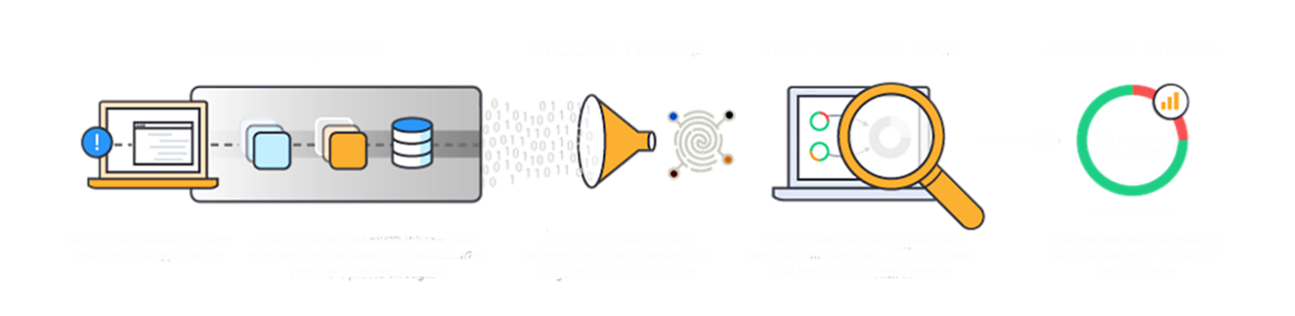
X-Ray Service
Notes:
X-Ray helps you with tracing requests, record the traces in the X-Ray service, view service map of your distributed application in the X-Ray console and analyze specific issues that are affecting your application within a specific time frame.

Slide 66
X-Ray SDK
Available for Java, .NET, .NET Core, Python, Ruby, Go, Node.js
Adds filters to automatically capture metadata for calls:
  AWS Services using the AWS SDK
  Non-AWS services over HTTP and HTTPS
  Database (MySQL, PostgreSQL, Amazon DynamoDB)
  Queues (Amazon SQS)
Enables you to get started quickly
Source: https://github.com/aws?q=xray-sdk
Notes:
X-Ray SDK is available for Java, .NET, .NET Core, Python, Ruby (beta), Go (RC1) and Node.js.
AWS services called using AWS SDK can be automatically instrumented.
Non-AWS services over HTTP and HTTPS can be instrumented
Driver available for MySQL and Postgres
It enables you to quickly instrument your application code to index data using annotations and log data using metadata.

Slide 67
Monitoring Kubernetes Applications using AWS X-Ray

Slide 68
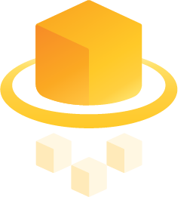


EKS Support for Fargate in 2018
Notes:
We also plan to extend AWS Fargate to support EKS, our fully managed Kubernetes offering, in 2018.

Slide 69
Microservices using AWS Lambda

Slide 70
Serverless Key Concepts

Slide 71




Serverless Tenets
No servers to provision
or manage
Scales with usage
Never pay for idle
Availability and fault tolerance built in
Notes:
AWS builds its data centers in multiple geographic regions as well as across multiple Availability Zones within each region to offer maximum resiliency against system disruptions.
Start with Availability (spread across 3 AZs in a region) by default.
Scale with usage. Today a sample application and becomes popular, then it’ll scale with the usage. If the application needs to be launched across the world, then you can add regions.

Slide 72












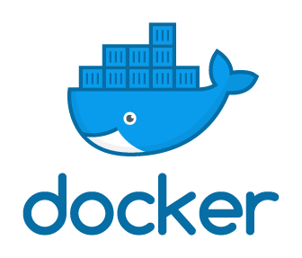


Spectrum of AWS offerings
“On EC2”
Managed
Serverless
Amazon EMR
Amazon ES
AWS
Lambda
Amazon Cognito
Amazon Kinesis
Amazon EC2
Amazon
S3
Amazon
DynamoDB
Amazon
SQS
Amazon
ElastiCache
Amazon
Redshift
Microsoft SQL Server
Amazon
RDS
Amazon API Gateway
Amazon CloudWatch
AWS IoT
Notes:
Provide context on Region & AZ – 18 regions & 53 AZ
To make HA, On EC2, you need to deploy across different AZ. On Managed, there is an option for multi-AZ. In Serverless, everything (HA & Fault tolerance) is taken care of for you.
First service was S3 and SQS – Serverless services. Lambda was added as Compute to S3 because of customer feedback. And then we added other sources to Lambda.
Provides a wide spectrum of services from Chatbot, IT automation, web application, Alexa and many others. We’ll look at a few of those today.

Slide 73
Lambda Basics

Slide 74

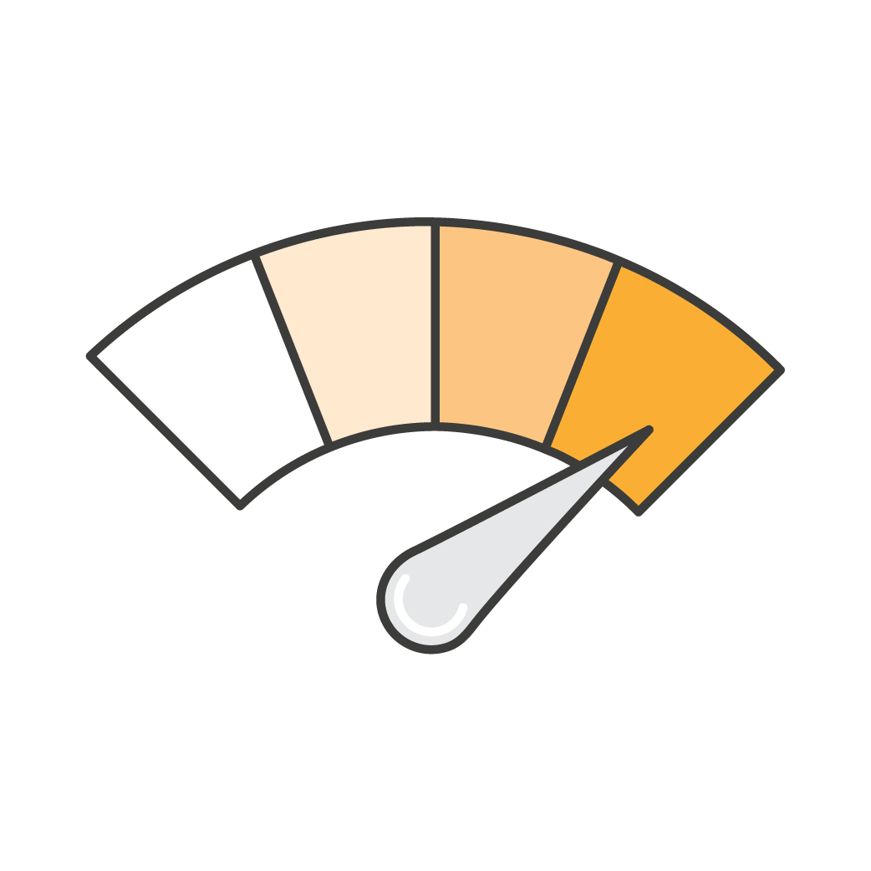

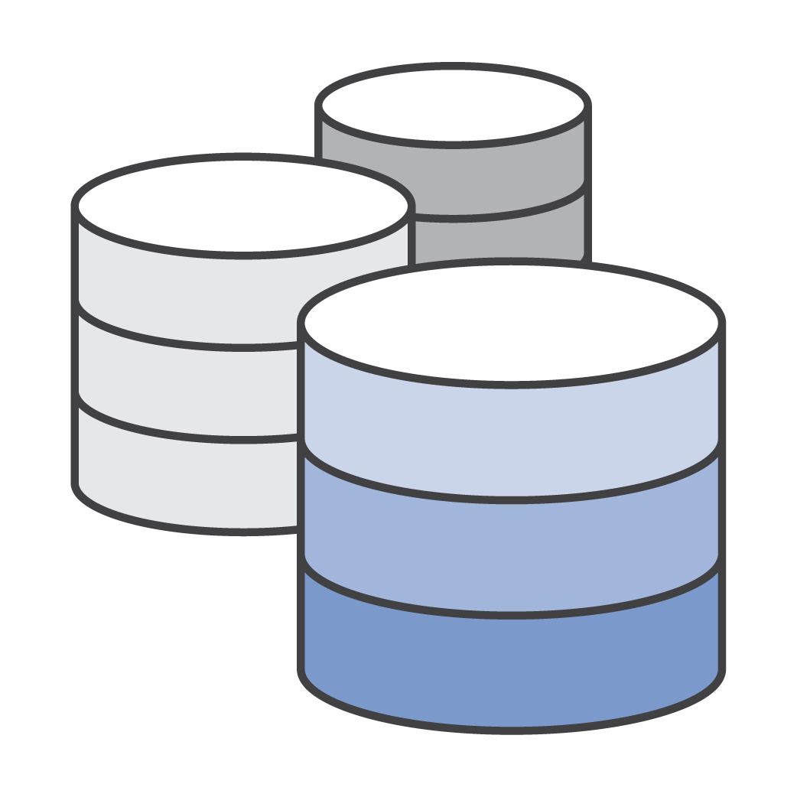





Using AWS Lambda
Bring your own code
Node.js, Java, Python, C#, Go
Bring your own libraries (even native ones)
Simple resource model
Select power rating from 128 MB to 3 GB
CPU and network allocated proportionately
Flexible use
Synchronous or asynchronous
Integrated with other AWS services
Flexible authorization
Securely grant access to resources and VPCs
Fine-grained control for invoking your functions
Notes:
Customers were running Go on Lambda before we added support. Likewise, customers have tested Fortran on Lambda. Can bring native libraries of your language.
Simple resource model – like a power button. One dial to get memory, CPU and network.

Slide 75
Anatomy of a Lambda function
Handler() function
Function to be executed upon invocation
Event object
Data sent during Lambda Function Invocation
Context object
Methods available to interact with runtime information (request ID, log group, etc.)
public String handleRequest(Book book, Context context) {
saveBook(book);
return book.getName() + " saved!";
}
Notes:
Highlight the difference between JSON payload and runtime context information.

Slide 76
Lambda Functions Packaging

Slide 77

Meet SAM!

Slide 78
Serverless Application Model
CloudFormation extension optimized for serverless
New serverless resource types: functions, APIs, and tables
Supports anything CloudFormation supports
Open specification (Apache 2.0)
https://github.com/awslabs/serverless-application-model
Notes:
DSL on top of CFN
Done to simplify deployment of Serverless application

Slide 79
SAM Template
AWSTemplateFormatVersion: '2010-09-09'
Transform: AWS::Serverless-2016-10-31
Description: Simple CRUD webservice.
Resources:
GetFunction:
Type: AWS::Serverless::Function
Properties:
Handler: org.aws.samples.compute.greeting.GreetingHandler::handleRequest
Runtime: java8
CodeUri: ./target/greeting.zip
Policies: AmazonDynamoDBReadOnlyAccess
Timeout: 30
Tracing: Active
Environment:
Variables:
TABLE_NAME: !Ref Table
Events:
GetResource:
Type: Api
Properties:
Path: /books
Method: get
Table:
Type: AWS::Serverless::SimpleTable
}

Slide 80
SAM Commands
Package
Takes a deployment package (.zip file)
Uploads to an S3 bucket
Updates a CodeUri property with S3 URI
Deploy
Creates CloudFormation resources

Slide 81
SAM Local
Local testing of Serverless apps
Works with Lambda functions
Response object and function logs on local machine
Java, Node.js, Python, Go
  C# coming
PRs welcome!
  https://github.com/awslabs/aws-sam-local
Notes:
Uses opensource docker-lambda Docker image to mimic Lambda’s runtime environment. Emulates timeout, memory limits and runtimes. Does not emulate CPU limits. Partial API Gateway emulation (proxy calls).
Before proxy-style, developers have to transform the input/output formats using Velocity Template Language in order to be able to invoke Lambda functions. Amazon is a customer-obsessed company, so we listened to feedback and added a simple proxy-style.

Slide 82
Microservices using AWS Lambda
/greeting
/webapp
greeting
webapp
/names/1
name

Slide 83
Lambda Functions with SAM

Slide 84
Test and Debug Lambda

Slide 85
Lambda Best Practices

Slide 86
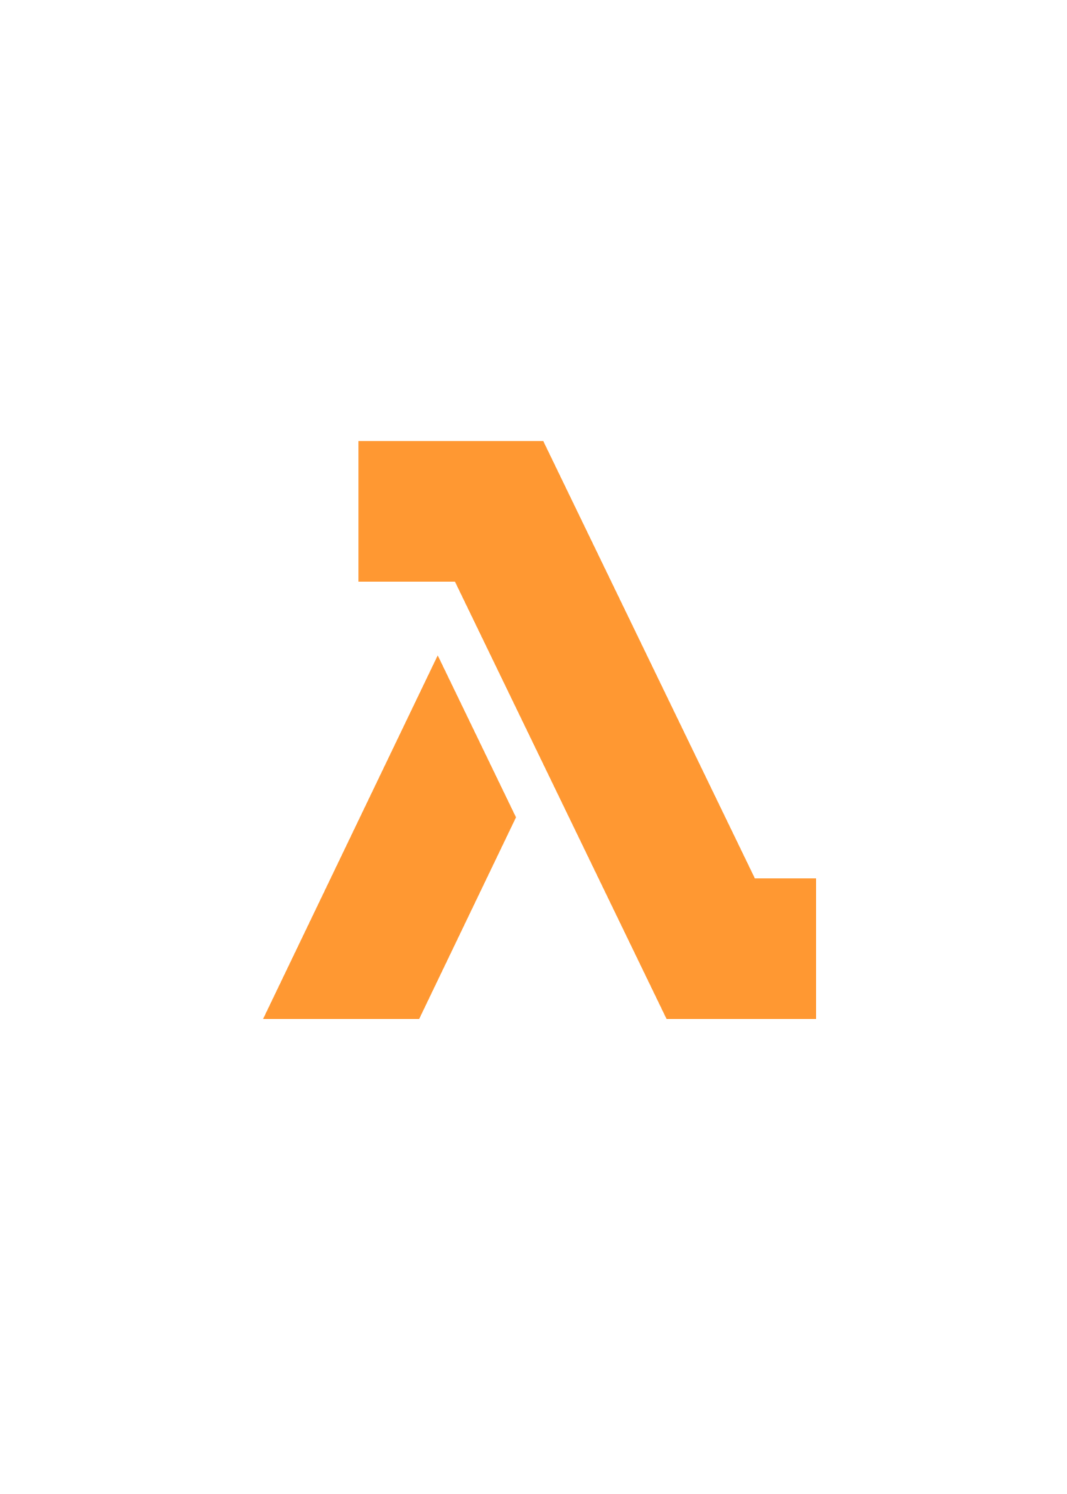

Lambda based “monoliths”
EVENT DRIVEN
ONE LARGE LAMBDA FUNCTION
GET /pets
PUT /pets
DELETE /pets
GET /describe/pet/$id
PUT /describe/pet/$id

Slide 87
Lambda based “monoliths”
EVENT DRIVEN
ONE LARGE LAMBDA FUNCTION
GET /pets
PUT /pets
DELETE /pets
GET /describe/pet/$id
PUT /describe/pet/$id

Slide 88

Lambda based “nano-services”
EVENT DRIVEN
ONE LAMBDA PER HTTP METHOD
GET /pets
PUT /pets
DELETE /pets
GET /describe/pet/$id
PUT /describe/pet/$id

Slide 89
Lambda Best Practices
Do handlers share code?
  Split them into their own Lambda functions
  Use language-specific packages to share code
Do functions share event sources?
  Split them in own code repos, with own SAM files
Locally validate SAM files before commit
  Again in CI/CD process

Slide 90
Lambda Best Practices
Separate the Lambda handler from core logic
public class BookPostHandler implements RequestHandler<Book, String> {
static DynamoDBMapper mapper = DDBUtil.getMapper();
public String handleRequest(Book book, Context context) {
System.out.println("Adding book: " + book);
saveBook(book);
return book.getName() + " saved!";
}
private void saveBook(Book book) {
mapper.save(book);
}
}
Notes:
This allows you to make a more unit-testable function.
Talk about 1000 concurrent execution and your database may not be able to handle this.

Slide 91
Lambda Best Practices
Minimize package size to necessities
<dependencies>
<!-- https://mvnrepository.com/artifact/com.amazonaws/aws-lambda-java-core -->
<dependency>
<groupId>com.amazonaws</groupId>
<artifactId>aws-lambda-java-core</artifactId>
<version>1.1.0</version>
</dependency>
<!-- https://mvnrepository.com/artifact/com.amazonaws/aws-java-sdk-dynamodb -->
<dependency>
<groupId>com.amazonaws</groupId>
<artifactId>aws-java-sdk-dynamodb</artifactId>
<version>1.11.127</version>
</dependency>
</dependencies>
Notes:
This will reduce the amount of time that it takes for your deployment package to be downloaded and unpacked ahead of invocation. For functions authored in Java or .NET Core, avoid uploading the entire AWS SDK library as part of your deployment package. Instead, selectively depend on the modules which pick up components of the SDK you need (e.g. DynamoDB, Amazon S3 SDK modules and Lambda core libraries).

Slide 92
Lambda Best Practices
Use Environment Variables to modify operational behavior
String region = System.getenv("AWS_REGION");
. . .
String bucket = System.getenv("S3_BUCKET");
Notes:
Environment variables for Lambda functions enable you to dynamically pass settings to your function code and libraries, without making changes to your code. This allows a Lambda function to behave differently as it moves through lifecycle stages from development to deployment. Total set cannot exceed 4kb.
EC2 metadata API provides several environment variables, for example AWS_REGION.
For example, if you are writing to an Amazon S3 bucket, instead of hard-coding the bucket name you are writing to, configure the bucket name as an environment variable.
Environment variables are encrypted using AWS Key Management Service. Decrypted when accessed in the application.

Slide 93
Lambda Best Practices
Self-contain dependencies in your function package
<plugin>
<groupId>org.apache.maven.plugins</groupId>
<artifactId>maven-shade-plugin</artifactId>
<version>3.1.0</version>
<executions>
<execution>
<phase>package</phase>
<goals>
<goal>shade</goal>
</goals>
</execution>
</executions>
</plugin>
Notes:
Several versions of libraries are available but we may change and would not like customer’s applications to break

Slide 94
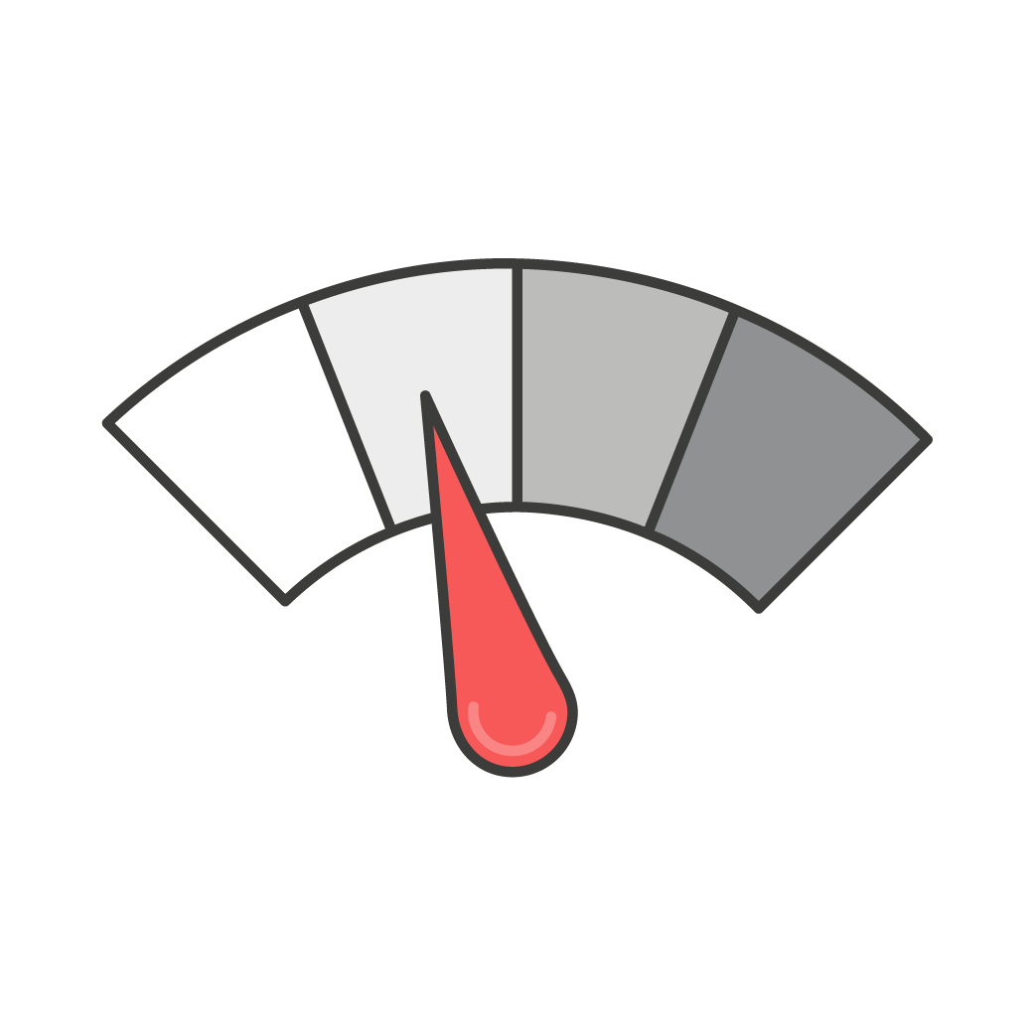
How much memory/CPU?
> Memory > Cores
Only a memory control, also affects the % of CPU core
Is your code CPU, Network or memory-bound? it could be cheaper to give more memory

Slide 95
Lambda Best Practices
Leverage “Max Memory Used” to right-size your functions
  Calculate 1000x all prime numbers < 1m
Memory | Compute time | Cost
128 MB | 11.722965 secs | $0.024628
256 MB | 6.678945 secs | $0.028035
512 MB | 3.194954 secs | $0.026830
1024 MB | 1.465984sec | $0.024638
https://github.com/jconning/lambda-cpu-cost
Notes:
This is an example of what happens when you give more memory to a function: you also get more CPU and I/O capacity. This is a CPU-bound function (computing primes) so if you give more memory, it’ll be faster and finish earlier. Since you pay by the hundreds of milliseconds, if you give more memory and CPU you’ll get the results quicker, and pay almost the same!
Analogy of power button
Any increase in memory size triggers an equivalent increase in CPU available to your function. The memory usage for your function is determined per-invoke and can be viewed in AWS CloudWatch Logs. By analyzing the Max Memory Used: field, you can determine if your function needs more memory or if you over-provisioned your function's memory size.
The following table shows the average execution time and effective cost for a function executed with different memories, where each one was invoked 1,000 times. As we see, the effective cost goes down as CPU power increases, while the execution time at the highest memory size is aboutone tenth than at the lowest memory size.
Increasing the CPU power of a CPU-bound Lambda function reduces the duration without increasing the cost. Faster is cheaper in this case.

Slide 96
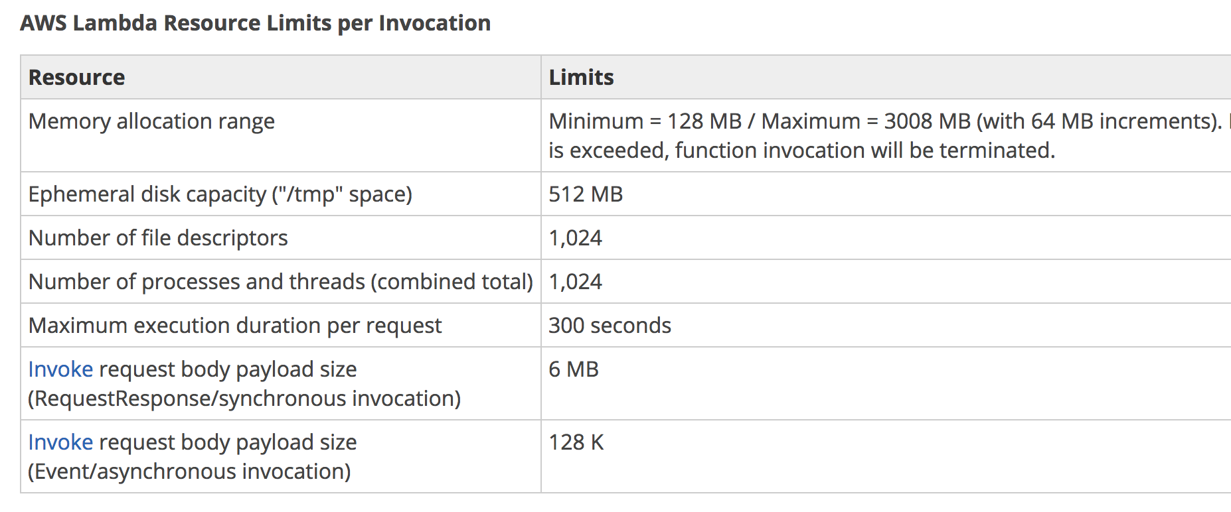
Lambda Best Practices
Delete large unused functions (75GB limit per region)
Notes:
Concurrent execution of 1000 functions, soft limit, can be increased by request

Slide 97
API Gateway Stages and Lambda Aliases
Manage a single API configuration and Lambda function for multiple environment stages
myLambdaFunction
myAPI
1
2
3 = prod
4
5
6 = beta
7
8 = dev
Prod
lambdaAlias=prod
Beta
lambdaAlias=beta
Dev
lambdaAlias=dev

Slide 98
Canary Deployment using Lambda Aliases
Apply a “weight” to Lambda function aliases to shift traffic between two versions
Create “canary” deploys
Do blue/green deployments between versions
See different metrics and logs
Test new functionality and rollback quickly

Slide 99
Canary Deployment Preference
CanaryXPercentYMinutes: X% traffic to new function, wait for Y minutes, shift all traffic
  X = 10, Y = 5, 10, 15, 30
LinearXPercentEveryYMinutes: X% traffic every Y minutes
  X = 10, Y = 1, 2, 3, 10
AllAtOnce: all traffic at one
Notes:
https://github.com/awslabs/serverless-application-model/blob/develop/docs/safe_lambda_deployments.rst
https://docs.aws.amazon.com/lambda/latest/dg/automating-updates-to-serverless-apps.html

Slide 100
Canary Deployments using SAM

Slide 101
Logging and Metrics are a universal right!
CloudWatch Metrics:
6 Built in metrics for Lambda
  Invocation Count, Invocation duration, Invocation errors, Throttled Invocation, Iterator Age, DLQ Errors
  Can call “put-metric-data” from your function code for custom metrics
7 Built in metrics for API-Gateway
  API Calls Count, Latency, 4XXs, 5XXs, Integration Latency, Cache Hit Count, Cache Miss Count
  Error and Cache metrics now support averages and percentiles

Slide 102
App Monitoring with AWS X-Ray and Serverless
Lambda instruments incoming requests for all supported languages
Lambda runs the X-Ray daemon on all languages with an SDK
var AWSXRay = require(‘aws-xray-sdk-core‘);
AWSXRay.middleware.setSamplingRules(‘sampling-rules.json’);
var AWS = AWSXRay.captureAWS(require(‘aws-sdk’));
S3Client = AWS.S3();
Notes:
Monitoring was kinda left out. Lambda got really popular, Lambda started with S3, added API Gateway. Customers had a lot of trouble debugging such applications, particularly with multiple functions. X-Ray is an instrument to debug your application at scale.
AWS X-Ray helps developers analyze and debug production, distributed applications, such as those built using microservices architecture. X-Ray provides an end-to-end view of requests as they travel through your application. and show a map of your underlying application component.
A request id is added to each request that is sent to the application, and is used for tracing and debugging.

Slide 103
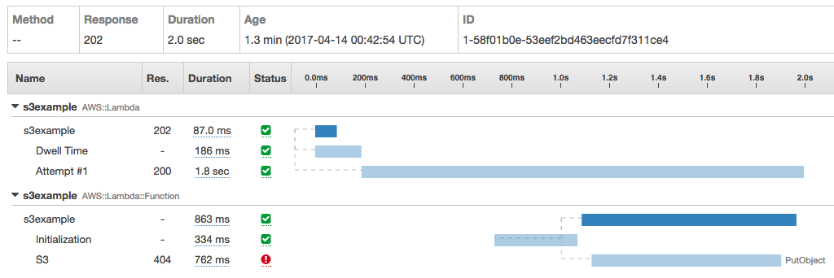
X-Ray Trace Example
Notes:
Create a Node.js application from X-R
This allows you to identify cold and warm start times for your application. For example, for Python it takes about 3 seconds and 10-12 seconds for a Java-based Lambda.

Slide 104
Composing Lambda Functions

Slide 105

Event Processing
Event A on B triggers C
A
B
C
Invocation
Action
Lambda functions

Slide 106



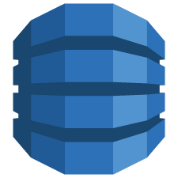







Event-driven platform
Invoked in response to events
Changes in data
Changes in state
Access any service, including your own
Any custom
S3 event notifications
DynamoDB Streams
Kinesis events
Such as…
SNS
DynamoDB
Lambda
SNS events
CloudTrail events
Cognito events
Lambda functions
Redshift
Kinesis
S3
Custom events
CloudWatch
events

Slide 107






Event-driven actions
S3:
Source Bucket
Lambda:
Resize Images
S3:
Destination Bucket
Triggered on
PUTs
Users upload photos
Notes:
A few years ago it was quite common for media companies to use FFMpeg to extract metadata from an image, resize, add more metadata, rename, and store it again. It was quite painful. It was one of the first usecases why Lambda came to life.

Slide 108
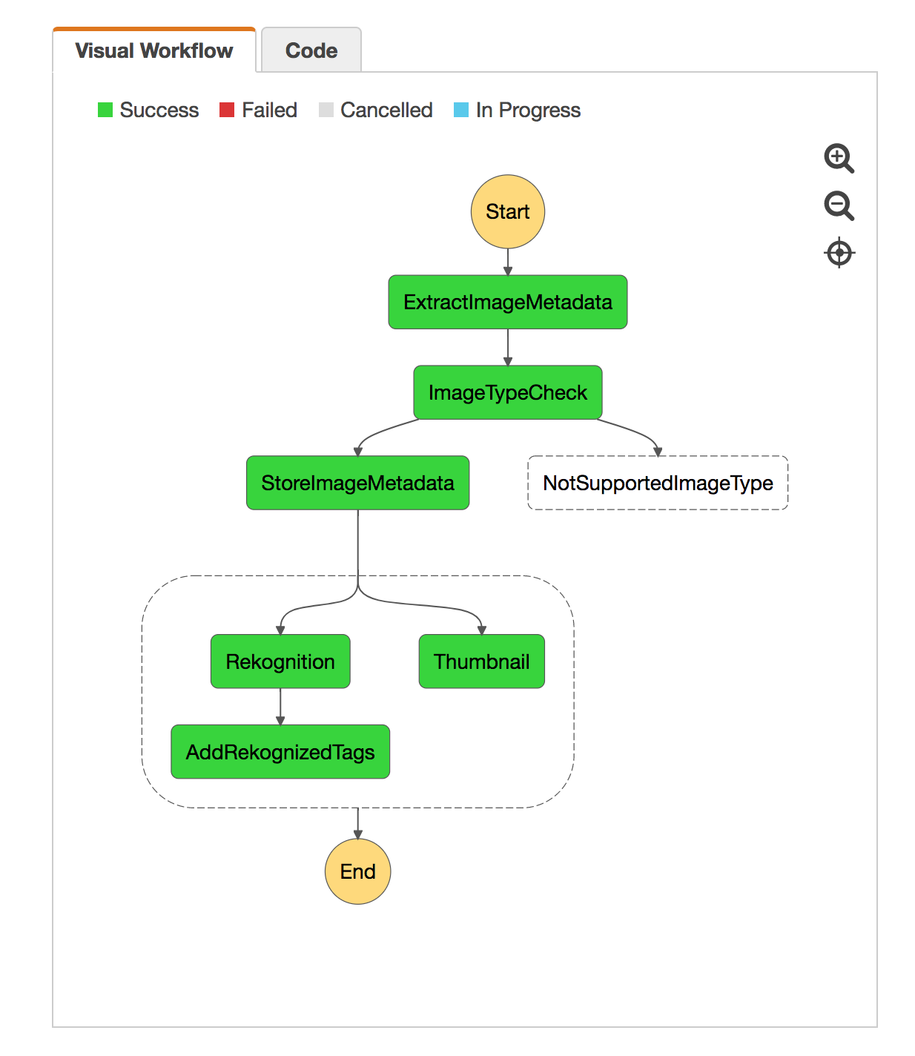
AWS Step Functions:
Orchestrate a Serverless processing workflow using AWS Lambda
Notes:
Once the basic usecase was working, customers wanted to use Lambda in multiple ways. They would create different functions for different microservices, so to say. Now they needed a way to coordinate these functions together. So, if you’re triggering a Lambda function when a document is uploaded to S3 and that should trigger a series of other Lambda functions, then this requires a lot of custom wiring. So, we listen to customers and introduced Step Functions. Think of it as a state machine running in the cloud that you can control through an API.
Rekognition is very useful for customers that have very large media library and want to index it.
AWS Step Functions makes it easy to coordinate the components of distributed applications and microservices using visual workflows. It provides a graphical console to arrange and visualize the components of your application as a series of steps. This makes it simple and easy to run multistep applications. Step Functions automatically triggers and tracks each step, and retries when there are errors, so your application executes as expected.
Demo: https://github.com/awslabs/lambda-refarch-imagerecognition

Slide 109
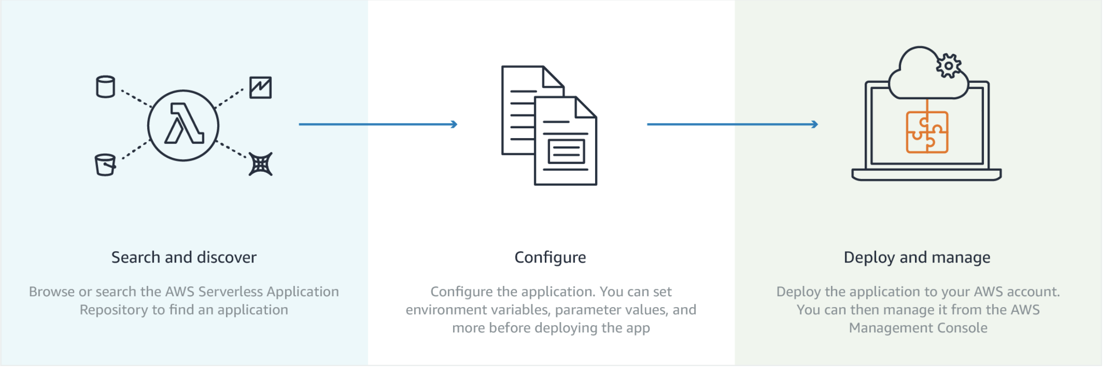
Serverless Application Repository

Slide 110
Serverless Application Repository

Slide 111
Further Reading
AWS Fargate & Amazon ECS
https://aws.amazon.com/ecs
https://aws.amazon.com/fargate
Serverless
https://aws.amazon.com/serverless/
Kubernetes
https://aws.amazon.com/eks

Slide 112
github.com/ aws-samples/ aws-microservices-deploy-options

