Slide 1
AWS Modernization Workshop
Observability with AWS & Epsagon
Ran Ribenzaft, CTO & Co-Founder
AWS Serverless Hero
ran@epsagon.com

Slide 2
Epsagon Brings order to Distributed Environments
Dedicated monitoring & troubleshooting platform for cloud microservices
Automated SaaS solution
Lightweight instrumentation
Fast implementation
Containers & Serverless
No manual work needed
End-to-end visibility
Value within minutes
With Epsagon’s insights, we can solve issues before they happen. We see a reduction of 70% in error rates thanks to their data”.

Slide 3
What we’ll discuss today
Best practices for observability in Modern Applications
Observability How to obtain observability in distributed environments
Value of end-to-end Observability
Hands-on Workshop to obtain observability

Slide 4
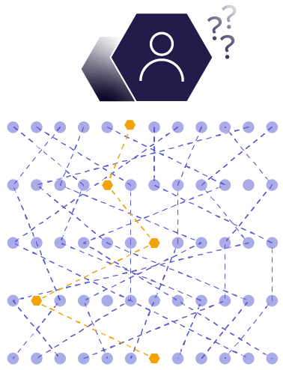
Challenges for Engineering and DevOps
Troubleshooting Are basic logs and metrics the right tool for highly distributed applications?
Monitoring “Is my application working properly”?
Development I’m not sure what’s currently running in production. How can I build new services?

Slide 5
Traditional Monitoring Solutions are Limited
Logs & Metrics are NOT Enough | Bytecode is NOT Scalable | Manual Monitoring Kills Agility
Distributed tracing is crucial in order to find the root-cause efficiently Traces are needed on top of metrics and logs | Bytecode provides limited value on distributed apps and lacks visibility in managed services Bytecode comes with significant overhead in microservice environments | Getting distributed traces require manual instrumentation Metrics, logs and traces are correlated manually

Slide 6
Best Practices for Observability

Slide 7
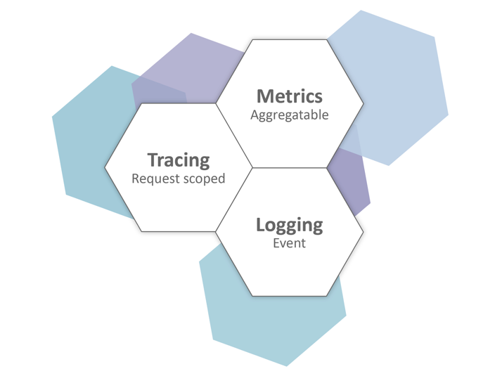
The Three Pillars of Observability

Slide 8
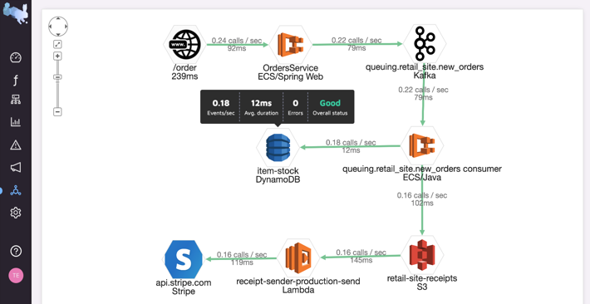
Best practices for observability
Automted setup and zero maintenance
Support any environment
(K8s, cloud, FaaS)
Connects every request in a transaction
Search and analyze your data
Helps to quickly pinpoint problems

Slide 9
Values of End-to-End Observability
75%
90%
50%
Reduction in error rates
Reduction in troubleshooting time
DevOps & engineering improvement

Slide 10
Today’s Workshop
https://epsagon.awsworkshop.io/

Slide 11
Workshops Objectives
Deploy a fully working serverless retail store, including frontend and backend.
Setup and connect the application to Epsagon.
Troubleshoot some real-life scenarios using Epsagon’s distributed tracing.
Monitor the health of the application with simple visualizations.
Learn how to tag traces for pinpoint and aggregation.

Slide 12
Workshops Key Takeaways
How to deploy a fully working serverless application
How to quickly and efficiently troubleshoot exceptions and errors in your distributed applications
How to visualize and understand the performance of your applications
How to leverage metrics, logs and traces to gain observability using Epsagon

Slide 13
The Journey to Observability
Identify your business goals and architecture model
Determine your approach: DIY or managed
Trial observability solutions
Make sure the new service integrates to your ecosystem
Evaluate the benefit and influence decision-makers

Slide 14
Thank you!
Get Started for free: https://epsagon.com/
Workshop: https://epsagon.awsworkshop.io/

