Slide 1
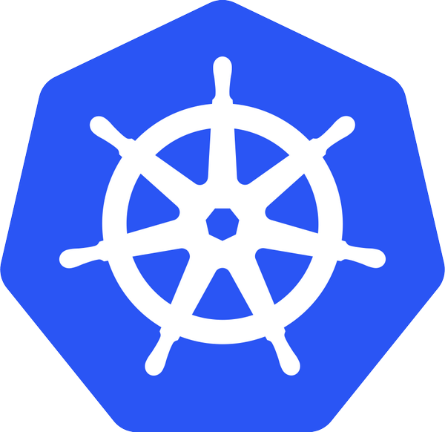
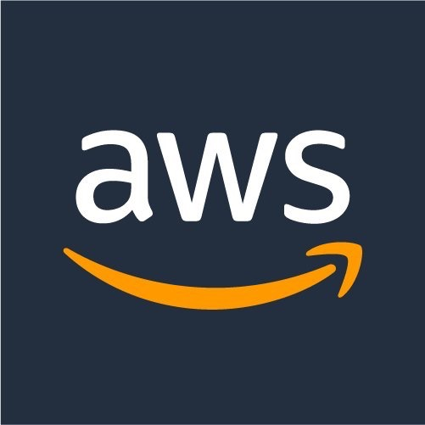
Kubernetes on AWS Workshop
Presenter’s:
-- Peter Dalbhanjan
-- Omar Lari
-- Chris Hein
Date: 11-03-17

Slide 2
Agenda
Title
Introduction to Kubernetes [Concepts, Cluster Deployments]
Beginners tutorials [Setup Dev Environment, Install K8s Cluster, Deployment Concepts]
Kubernetes Ecosystem - 1 (Networking, Storage)
Mid-level tutorials [Service Discovery, Cluster-* (Monitoring, Logging, Upgrades, Scaling), Helm Charts, App Scaling, Configuration and Secrets Management)
Kubernetes Ecosystem - 2 (Service Discovery, Service Mesh, Distributed Tracing)
Advanced tutorials (Network policies with Calico, IAM roles with kube2iam, Statefulsets with EBS, Service mesh with Linkerd)
Notes:
Goal is to educate the community, this ecosystem from developer, operations perspective or just generally around k8s.
Its designed to be very informative and educational, to drive the learning in iterative fashion.
If you have basic understanding of Docker and AWS in general, you are good to get started with this workshop
All of the content is available on github. So you can try it out yourself, whether you are remote or here in person, you can follow the timeline and go home and continue working on these tutorials

Slide 3
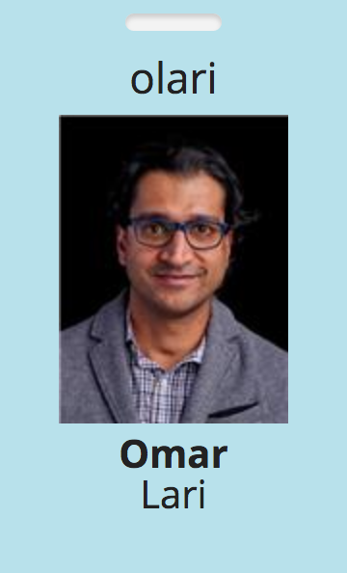
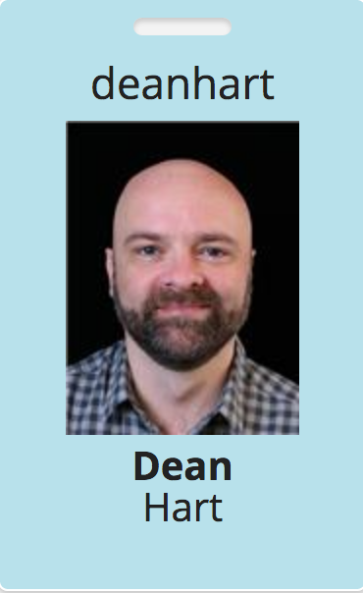
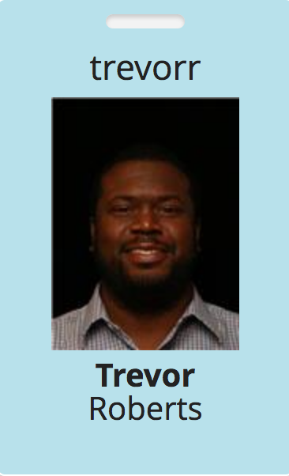
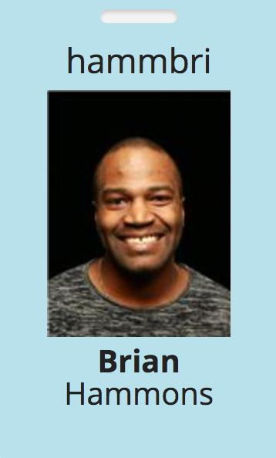
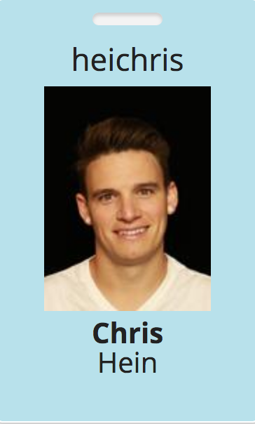
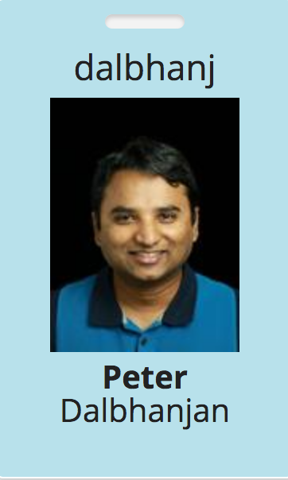
Github Contributors

Slide 4
What is Kubernetes?
Ancient greek for “Helmsman”. Root of the word “Governor”, “Cybernetics”
Open source orchestration system for containers
Docker, rkt, OCI, …
A Cloud Native Computing Foundation (CNCF) project
Active open source project and growing ecosystem
>28K stars, >1400 contributors
Written in Go
Provide declarative primitives for the “desired state”
Self-healing
Horizontal scaling
Automatic binpacking
Service discovery and load balancing

Slide 5
Kubernetes Concepts - Developer
Pods: colocated group of containers that share an IP, namespace, storage volume
Service: Single, stable name for a set of pods, also acts as LB
Replication Set: manages the lifecycle of pods and ensures specified number are running
Label: used to organize and select group of objects
Node
Docker
Pod
Containers
“web”
port 8080
port 8080
Notes:
Pods: think about loose coupling, scaling concerns before you package them as Pods. They share IP, namespace, file system. They can talk to each other via localhost
Service: is when you want to expose your pods to other entities. You get an endpoint which doesn’t change. Pods can shuffle underneath but Service labels stays the same
Replication Set:

Slide 6
Kubernetes Concepts - Developer
Namespaces: Isolated workspaces for users/projects
Ingress controller: L7 load balancing
Deployments: Declarative version updates
Jobs: Run to completion
Autoscale: Automatically adjust number of Pods
Network Policies: aka Security Groups for Pods
StatefulSet: Support for long term stateful distributed systems
More …
Notes:
Namespaces:
Ingress controller:
Deployments:
Jobs:
Network policies:

Slide 7
Cluster Deployments

Slide 8
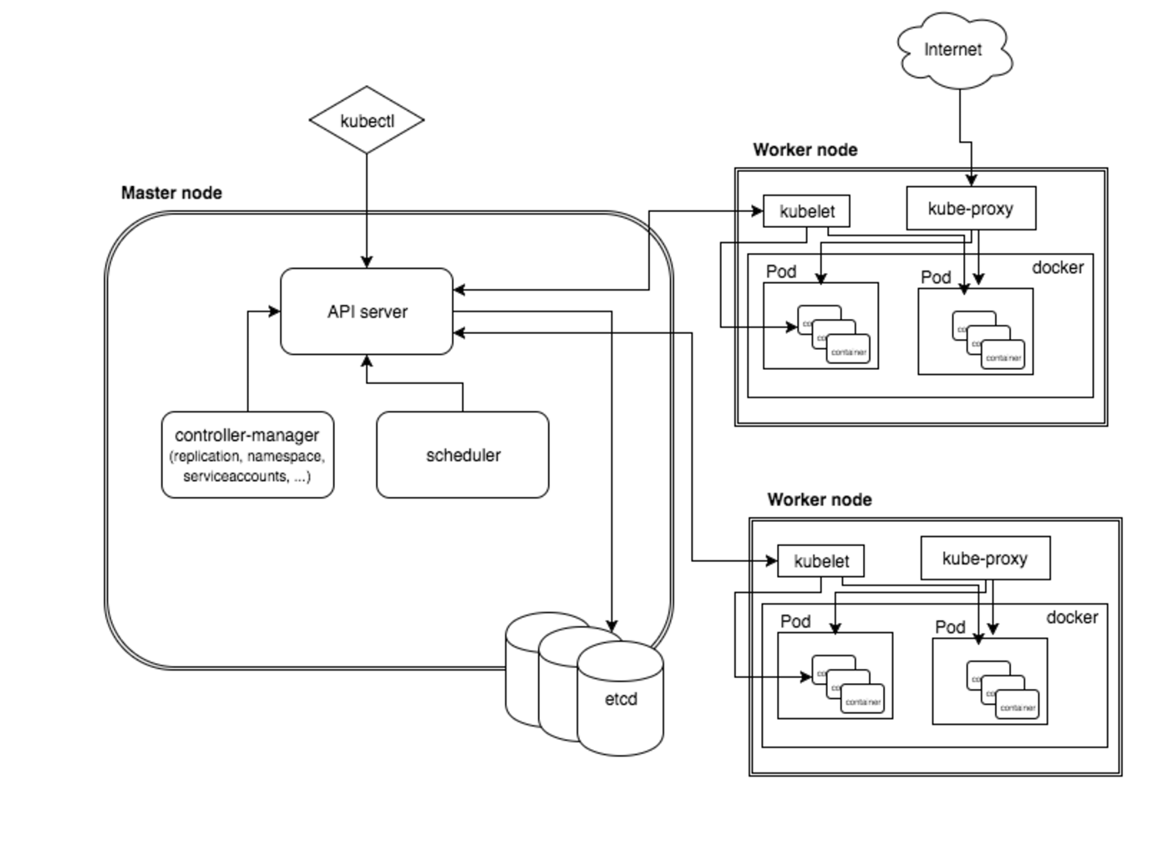
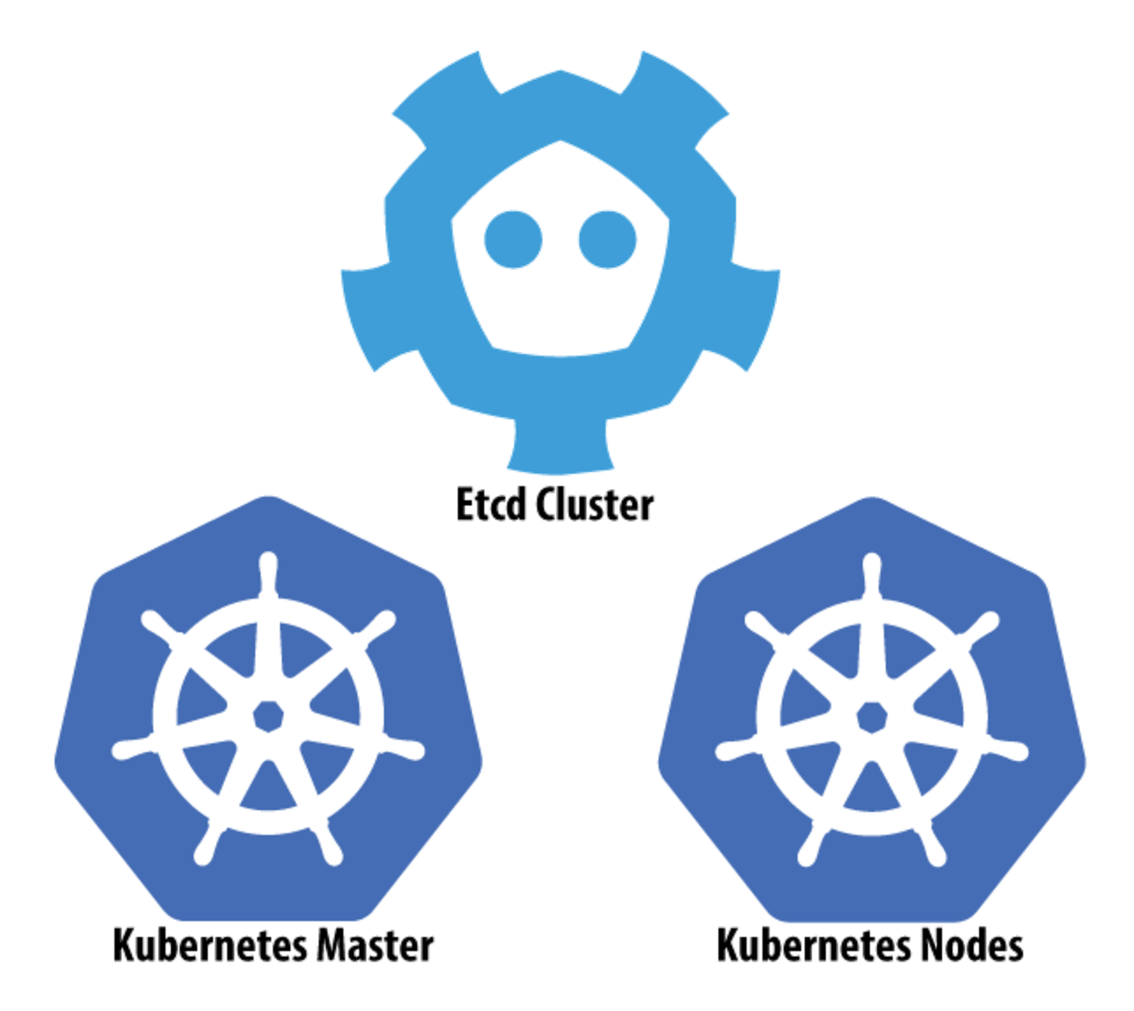
Architecture
Notes:
** Provides a series of loosely coupled and extensible components that can apply to a wide range of differing workloads
API Server is stateless and is backed by etcd, you interact via kubectrl or ajax, or libraries like python or java
Etcd provides storage behind the scenes
Scheduler is for scheduling containers on to machines
Controller manager does health maintenance – self healing, notion of reconciliation.
On each machine you have kubelet and service proxy (load balancing and services which is conceptual idea of frontend and backend)

Slide 9
KOPS (Kubernetes Ops)
Owned by Kubernetes AWS SIG; successor to kube-up.sh
CLI tool for launching and managing clusters
Can provision simple single-AZ clusters or multi-AZ production ready clusters
Provides choice of networking configuration
Manages DNS configuration in Route53
Can generate Terraform config and basic CloudFormation
Stores cluster state in S3
Notes:
Think KOPS is for managing clusters itself just like kubectl manages cluster resources

Slide 10
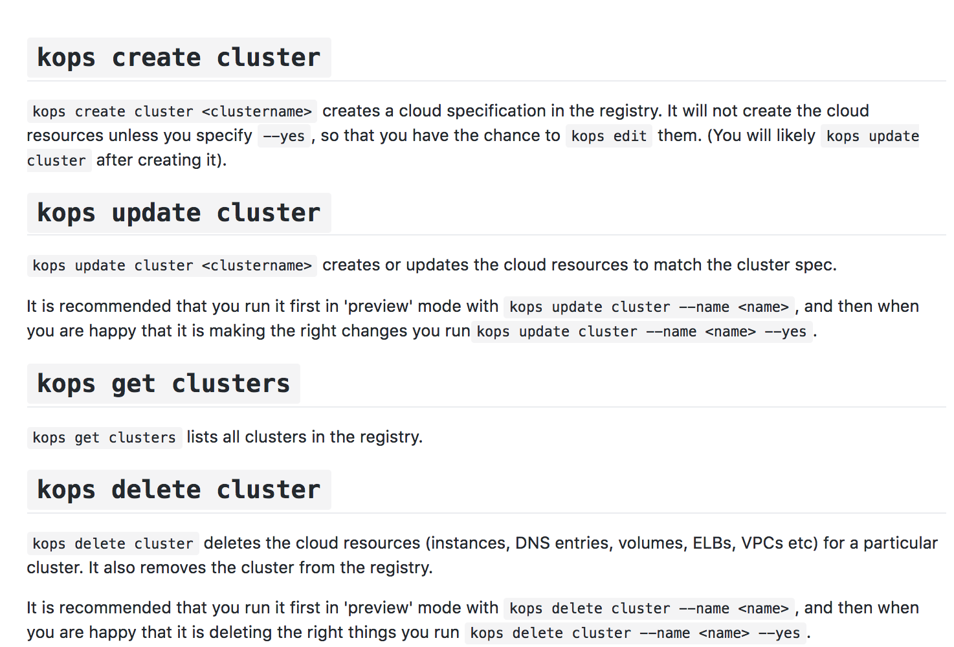
KOPS (Kubernetes Ops)

Slide 11
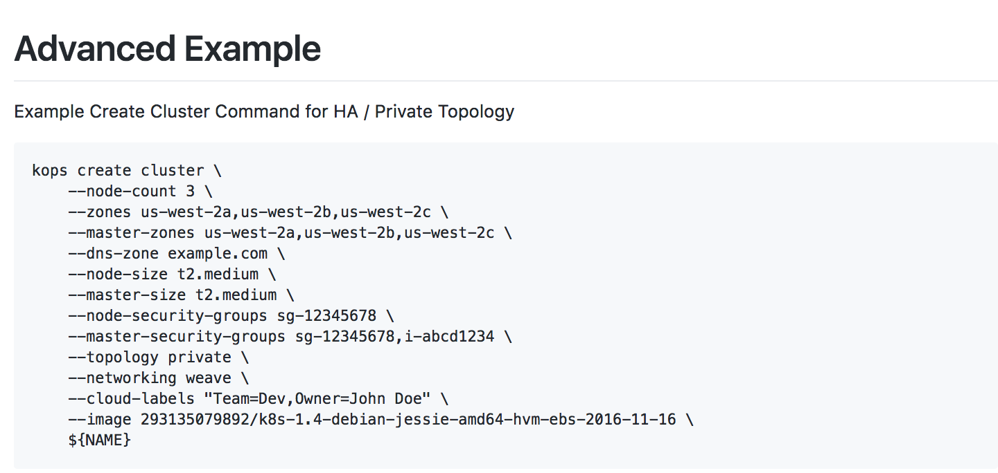
KOPS (Kubernetes Ops)

Slide 12
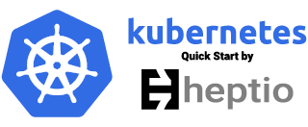
Heptio: Open Source “knowledge base” company founded by Joe Beda + Craig McLuckie
Heptio quick start uses CloudFormation to automate deployment.
Recommends to run one cluster per AZ and use tooling* to coordinate across Azs
Heptio’s position is that the cost and complexity to make the master node highly available isn’t always justified
Uses EC2 Auto Recovery in case of hardware failure on a singleton master
* No guidance on tooling
Notes:
-KOPS are contributing to this
-Weave are contributing to this
-New things: Elasticsearch service integration by default

Slide 13
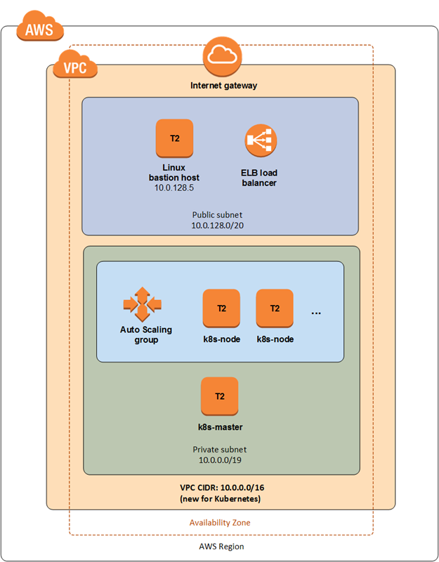
Not for Production usage
Calico and Weave networking support included
AMI config based off https://github.com/weaveworks/kubernetes-ami
Notes:
-KOPS are contributing to this
-Weave are contributing to this
-New things: Elasticsearch service integration by default
Kubernetes 1.5.2
A VPC in a single Availability Zone
2 subnets, one public and one private
1 EC2 instance acting as a bastion host in the public subnet
1 EC2 instance with automatic recovery for the master node in the private subnet
1-20 EC2 instances in an Auto Scaling Group for additional nodes in the private subnet (2 with default settings)
1 ELB load balancer for HTTPS access to the Kubernetes API
Ubuntu 16.04 LTS for all nodes; the base image is a custom AMI based on Ubuntu 16.04
kubeadm for bootstrapping Kubernetes on Linux
Docker for the container runtime, which Kubernetes depends on
Calico or Weave for pod networking
One stack-only security group that allows port 22 for SSH access from the bastion host, port 6443 for HTTPS access to the API, and inter-node connectivity on all ports

Slide 14
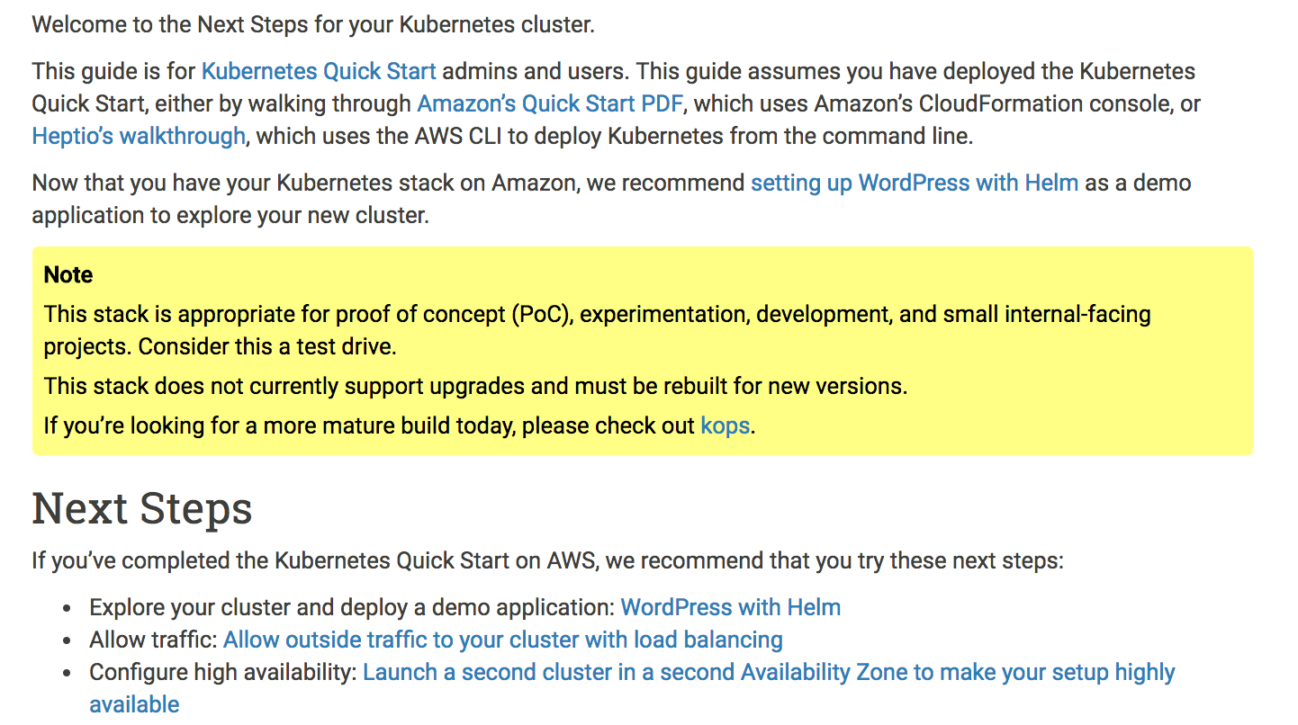
Notes:
-KOPS are contributing to this
-Weave are contributing to this
-New things: Elasticsearch service integration by default

Slide 15
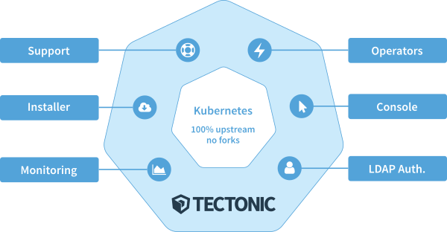
Tectonic is an “enterprise distribution” of Kubernetes produced by CoreOS
Packaged with most current upstream version of Kubernetes, commercial offering comes with features
Up to 10 nodes can be created with free account
Installed using GUI installer or Terraform scripts

Slide 16
Self-hosted: uses Kubernetes to schedule and manage its own components
Uses “Operators” to provide logic for how to manage Kubernetes and Tectonic components
Zero-downtime upgrades of Container Linux and the Cluster itself
Generates and manages all TLS components
LDAP integration + RBAC

Slide 17
AWS Integrations:
KMS to encrypt secrets sent to the control plane
Intelligent distribution of components across three AZs
Etcd + S3 backup and restore
Route 53 zone configuration
ELBs for API server and Nodes

Slide 18
Others: Kube-AWS
github.com/coreos/kube-aws
kube-aws is a templating engine for AWS Cloudformation templates
All assets (CloudFormation, userdata for instances) are declarative templates that can be checked into git and version controlled
Uses Amazon KMS to encrypt all secrets before putting them into assets files. Secrets are unlocked once the machines boot into their IAM roles
Spreading of workers and control plane nodes across AZs
Notes:
- Supported by CoreOS
- Orchestration layer on top of CFn

Slide 19
Others: KubeADM
OS level tool for bootstrapping a cluster
Does not manage any underlying infrastructure
Intended to be used as part of another provisioning tool, i.e. in userdata, cloudformation, terraform, etc
Requires installation of docker, kubelet, kubectl
`Kubeadm init` initializes a master, `kubeadm join` joins the cluster
Notes:
-

Slide 20
Minikube
Runs a single node cluster in a VM
OSX: xhyve, VirtualBox or VMWare Fusion
Linux: VirtualBox or kvm
Windows: VirtualBox or Hyper-V
Targeted for local development
Flow
brew cask install minikube
minikube start
kubectl create –f <file>
https://github.com/kubernetes/minikube

Slide 21
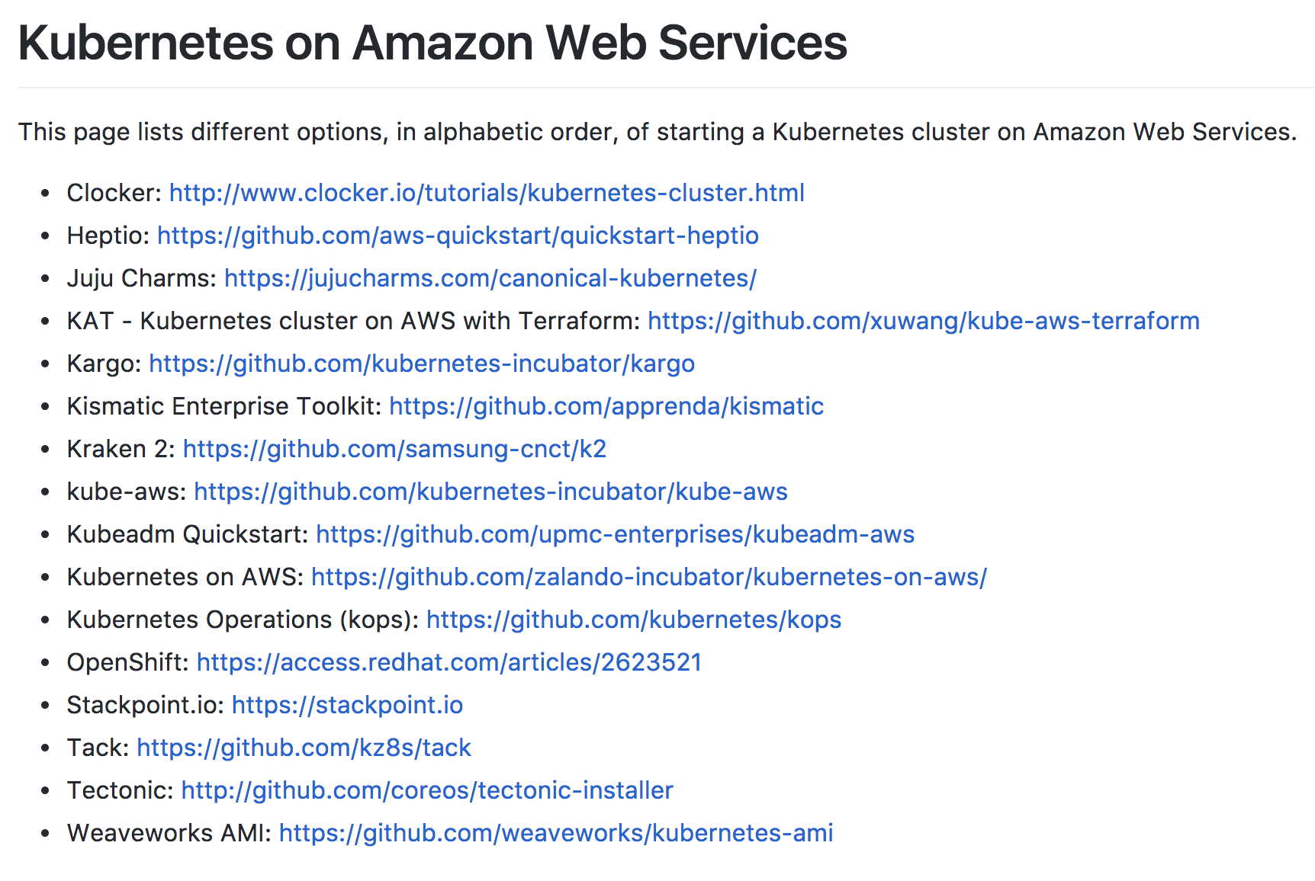
Kubernetes on AWS – Getting Started
kubernetes-aws.io

Slide 22
Kubernetes on AWS – Workshop
https://github.com/arun-gupta/kubernetes-aws-workshop

Slide 23
Networking

Slide 24
CNI Plugins
The Container Network Interface is a set of specs and libs for writing networking plugins
Handles standards around namespace and interface configuration
Configured by passing “—networking CNI” flag in cluster spec; then installing the desired plugin as a daemonset (run once on all hosts)
CNI standards have allowed for a number of networking approaches in Kubernetes, each with their own advantages and disadvantages
https://github.com/containernetworking/cni/blob/master/SPEC.md ← you should read this
Notes:
Each CNI plugin is implemented as an executable that is invoked by the container management system (e.g. rkt or Docker).
A CNI plugin is responsible for inserting a network interface into the container network namespace (e.g. one end of a veth pair) and making any necessary changes on the host (e.g. attaching other end of veth into a bridge). It should then assign the IP to the interface and setup the routes consistent with IP Address Management section by invoking appropriate IPAM plugin.
The intention is for the container runtime to first create a new network namespace for the container. It then determines which networks this container should belong to and for each network, which plugin must be executed. The network configuration is in JSON format and can easily be stored in a file. The network configuration includes mandatory fields such as "name" and "type" as well as plugin (type) specific ones.

Slide 25
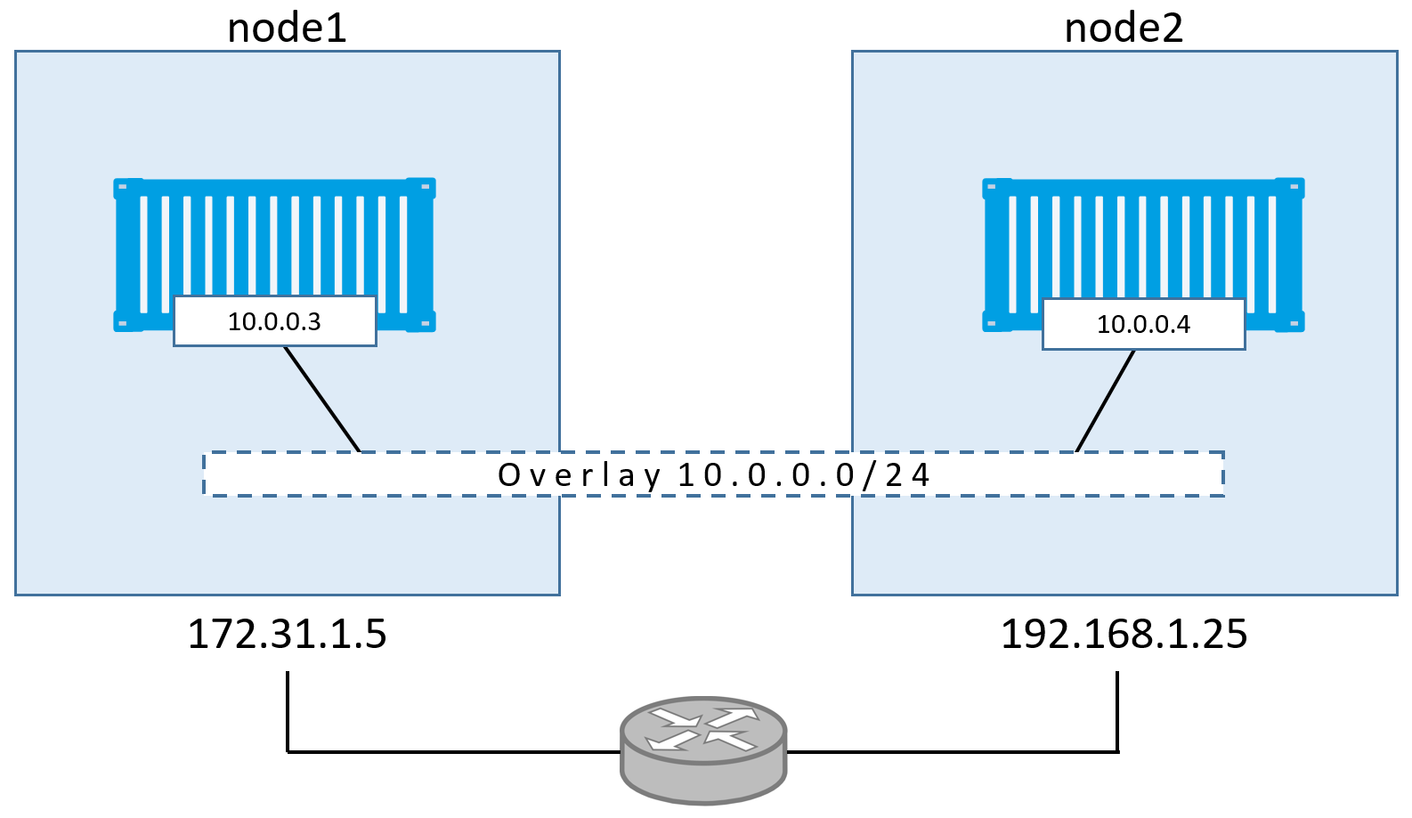
Overlay Networks
http://blog.nigelpoulton.com/demystifying-docker-overlay-networking/
Notes:
Overlay networks implement a common network address space across the entire cluster on which containers can communicate. Most overlays use the Docker0 bridge interface, but they “extend” the bridge network by providing information about the Docker0 network on other hosts, and coordinate IP addressing to prevent conflicts. Information about the network is commonly stored in a backing key/value datastore like Etcd, with the one exception being Weave Net, in which information about the overlay is stored in-memory and replicated across the cluster.
One advantage of overlay networks is that the container orchestration platform maintains complete control over the networking functionality and feature set. This makes overlay networks platform agnostic, and doesn’t require custom integration development when workloads are deployed across networks with different features and capabilities.

Slide 26
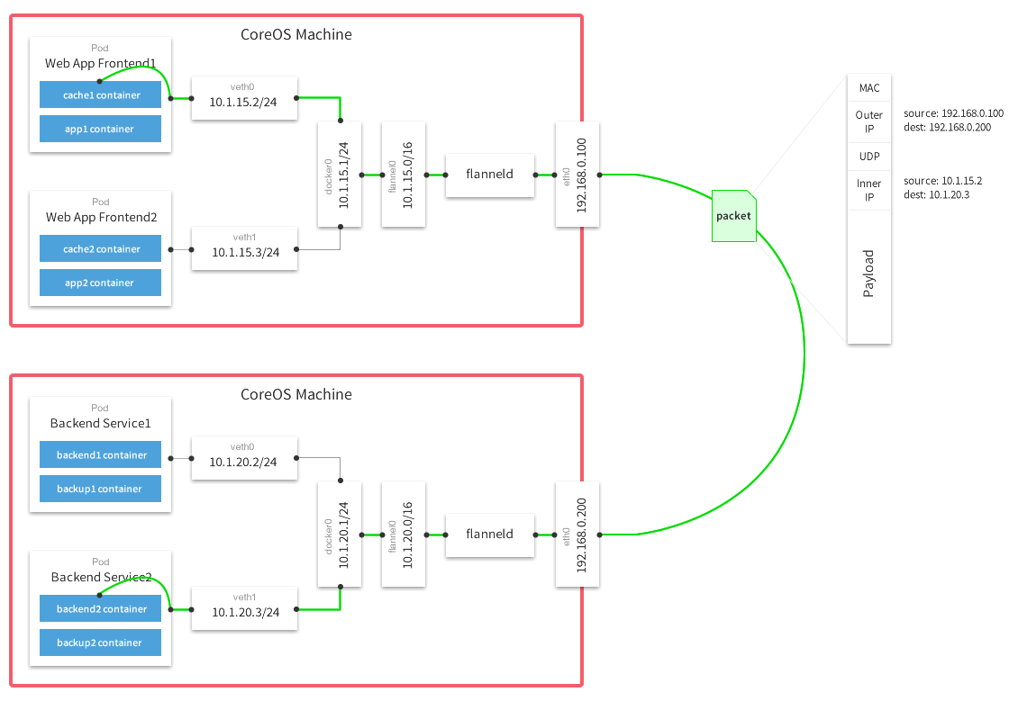
CoreOS project
Stores configuration data in etcd
VXLan for L2 encap (default)
Each pod gets a /24 subnet on the flannel /16 overlay

Slide 27
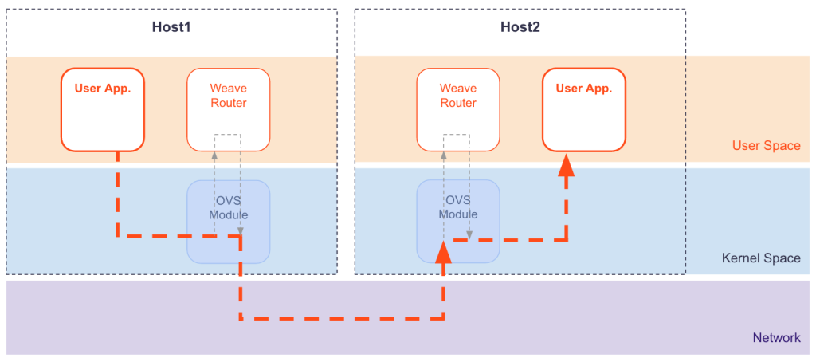
Open source project owned by Weaveworks
No backing k/v store required; cluster state replicated in memory
Supports multicast + NaCL encryption
Has DNS service discovery and load balancing built in
Notes:
https://github.com/weaveworks/weave/issues/2045

Slide 28
Overlay Networks
Pros:
Cons:
Agnostic to underlying topology and platform
Can easily span networks and platforms
Some offer cool functionality (encryption, multicast)
No cluster size limitations due to routes or hosts
Can be difficult to troubleshoot due to encapsulation
Require port mapping on host or load balancers for access from other networks
Performance overhead
Can’t use security groups
Notes:
Overlay networks implement a common network address space across the entire cluster on which containers can communicate. Most overlays use the Docker0 bridge interface, but they “extend” the bridge network by providing information about the Docker0 network on other hosts, and coordinate IP addressing to prevent conflicts. Information about the network is commonly stored in a backing key/value datastore like Etcd, with the one exception being Weave Net, in which information about the overlay is stored in-memory and replicated across the cluster.
One advantage of overlay networks is that the container orchestration platform maintains complete control over the networking functionality and feature set. This makes overlay networks platform agnostic, and doesn’t require custom integration development when workloads are deployed across networks with different features and capabilities.

Slide 29
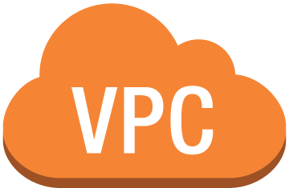
Calico Subnet – 172.16.1.0/16
172.16.0.1/24
172.16.0.2/24
Src/dst disabled
instance1
instance2
10.0.0.10
10.0.0.12
Calico BGP daemon
IF on Calico Subnet –
172.16.0.2/24
Calico IPIP tunnel across subnets
instance3
Instance2 route table:
172.16.0.1/24 via 10.0.0.10
10.0.1.20
instance4
10.0.1.22
instance2
10.0.0.12
172.16.0.3/24
172.16.0.4/24
Calico Subnet – 172.16.1.0/16
VPC – 10.0.0.0/16

Slide 30
Layer 3 networking (Calico)
Pros:
Cons:
No encap/decap overhead*
Easier debugging, well known tools/protocols (iptables, BGP)
Uses BGP for routing - supports large clusters
No cluster size limitations due to routes or hosts
Limited to UDP/ICMP/TCP protocol support
Uses BGP for routing - complexity
Can’t use security groups*
*except across subnets

Slide 31
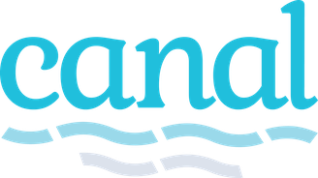
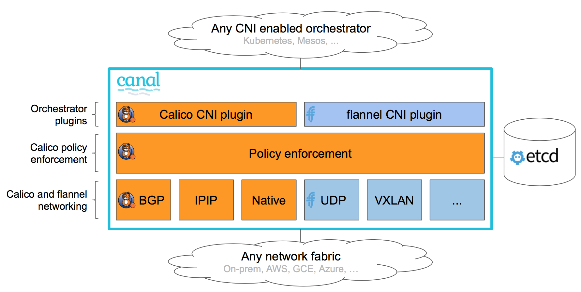

Slide 32
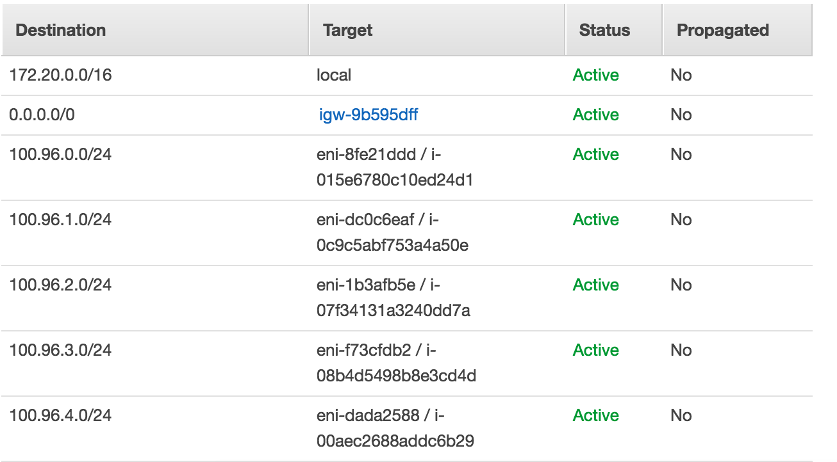
VPC Networking (Kubenet)
Default networking mode for KOPS
--network-plugin=kubenet
Creates a bridge called cbr0; connects a Veth pair to each pods
Manages an out-of-band subnet across the cluster (like Calico, so src/dst = disabled is required)

Slide 33
VPC Networking (Kubenet)
Pros:
Cons:
Interacts directly with the VPC
No encap/decap overhead
Easier debugging
Uses VPC routing tables*
Cluster size limited to number of routes per subnet
Can’t use security groups
Doesn’t automatically update routes on scaling events (userdata/lifecycle hooks?)
Is recommended to be used in its own subnet to prevent route table conflicts
*maybe also a negative

Slide 34
Service Discovery
Notes:
Some of you have already gotten through the mid level slides so this will be a good follow up \
Those that haven’t this will help give a primer for running through those

Slide 35
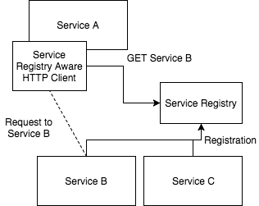
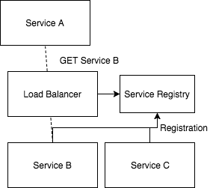
Service Discovery
Refers to the dynamic association of host & port mappings in a dynamic architecture
Two Types of Service Discovery
Client Side
Server Side
Notes:
Service discovery is best described by giving a very simple example \
Take that you are an developer and you have a 3 node clusters each node is assigned one application \
Networking is very simple here \ When service A needs to talk to Service B you point to that static host and port combination and make the request \
In Dynamic system where you don’t know which host (or port) is running a particular service you add a Service Discovery Mechanism \
These come in multiple flavors \
Client Side \
Using a REST client which communicates with a central registry that all services are “registered” to
Server Side \
Using a Load Balancer (or DNS) that all services are registered to

Slide 36
Client Side
Benefits
Beyond the registry no additional Infra
Service can implement unique load balancing strategies
Drawbacks
Couples the client to the Service Registry
Intelligent clients need to be implemented for each language
Notes:
Client Side \
Refers to a local service by service load balancing \
Beyond running the registry you need to create client libraries that handle \
load balancing, retries etc
The key issues that you’ll run into and why I personally don’t recommend this is
You are coupling your service together
Each service needs to implement these intelligent http frameworks

Slide 37
Server Side
Benefits
Applications & Clients only need to speak to a HTTP/Thrift/gRPC, etc.
Provided by some platforms such as Kubernetes & DC/OS
Drawbacks
Another component that needs to be maintained
Additional network hop is required for each request
Notes:
Server Side
This is where you run a separate infrastructure component \
This is meant to handle all the communication \
In a mircoservices world this fits really well \
All you need is a single HA component \
Point all your traffic through the proxy \
and it will handle things like load balancing,
Drawbacks:
Beyond the extra component which you can treat it as any other service
There is an extra network hop
So how do these work in k8s

Slide 38
Service Discovery | DNS
Built in support for Service Discovery in k8s using the DNS Cluster Addon
This means each service can be accessed via a FQDN like
[service].[namespace].svc.cluster.local
Each node runs the DNS addon and configures the host file dynamically
Notes:
There are two key mechanism without bringing in external providers like consul \
You can do this via KubeDNS which is getting replaced by CoreDNS \
As you can see here each service gets an FQDN \
You can deploy this as an addon to the kops cluster

Slide 39
Service Discovery | Service
You can also do this using Kubernetes Services
By referencing a pod in a service you are creating a routable FQDN
http://products-svc:8080
apiVersion: v1
kind: Service
metadata:
name: products-svc
spec:
selector:
app: products-pod
ports:
- port: 8080
Notes:
The other and perferrable mechanism is to use Services to declare and interface that you can communicate with \
So like Omar showed you with Type LoadBalancer \
If you deploy some like you see on the right with a corresponding pod \
You will expose an endpoint like http://products-svc:8080 that any service can communicate with \
These are again built in components \
Can be version controlled and managed with your other confs

Slide 40
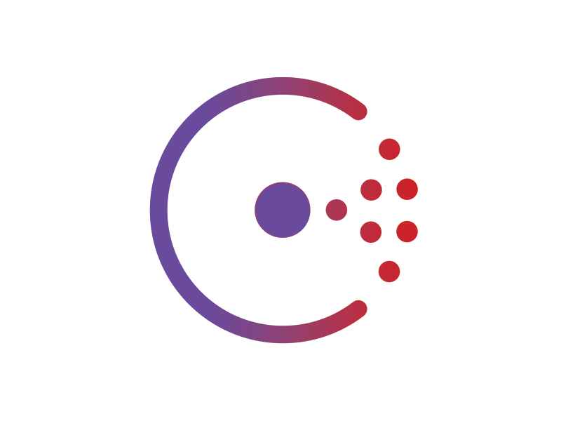
Service Discovery Mechanisms | Consul
External tool, needs to be deployed into the K8s infra
Use gossip protocol to track what is going on in a cluster
Rich health checking beyond native k8s (Nagios-style plugins)

Slide 41
Service Mesh
Notes:
Next really important component to talk about is a service mesh \
If you haven’t heard of this concept let me give you the the quick run down

Slide 42
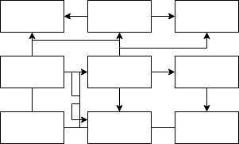
Service Mesh
“dedicated infrastructure layer for making service-to-service communication safe, fast, and reliable.”
– William Morgan from Buoyant
Separates the connection management (load balancing), request retries/timeouts, circuit breaking, routing rules.
Notes:
Service Mesh is basically a way to abstract out the layer 7 traffic \
Allowing you to add special capabilities like circuit breaking \
blue green deployments \ load balancing \ and dynamic routing rules
There are a couple key players in this space that help this \
If you take a look at the diagram on the right \
You can see a small segment of the complexity here

Slide 43
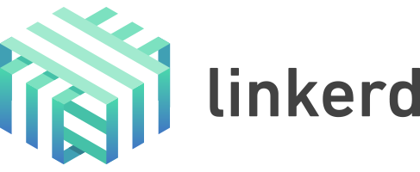
Service Mesh | linkerd
Runs as a standalone or sidecar proxy
Expects the Layer 3/4 Networking to be in a healthy state
Route your network traffic HTTP/Thrift/gRPC calls through the proxy
Adds retries mechanisms, load balancing, circuit breaking, and dynamic routing rules
Notes:
First we want to talk about is linkerd \
They were one of the first providers for a service mesh \
Linkerd is written by the team at Buoyant \
They expect that your underlaying networking stack is in order \
Then they add on top all the components of a service mesh by using a sidecar \
Or standalone proxy \
It currently supports http, thrift, and grpc calls and has ways of handling automatic \
Retries of requests \ internal load balancing \ and dynamic routing rules
This means if you’d like to do a canary deployment you can roll out a new service and then have your service mesh \
Shift traffic and monitor

Slide 44
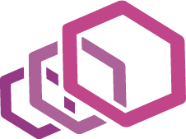
Service Mesh | Istio & Envoy
Highly portable service mesh
Built using exchangeable components like envoy, pilot, mixer
Envoy (from lyft) - L7 proxy
Pilot – Manages the lifecycle of the Envoy Instances
Mixer - Abstraction layer for the state of the service below
+
Notes:
The other key player in this space is Istio and Envoy \
Istio was written by the team at google they built it in a very kubernetes way \
They everything is highly portable, they use three key components \
Envoy – is the L7 proxy for network traffic
Pilot - which is there to manage the life cycle
Mixer - which is an abstraction layer for the state of the services below \
Just like linkerd it supports load balancing, circuit breaking, retires of request and dynamic routing
It has a lot of steam behind it right now and people are writing more plugins to extend istio \
In fact you can actually run linkerd and istio together

Slide 45
Distributed Tracing

Slide 46
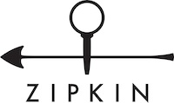
Distributed Tracing
Allows you to track, analyze, and optimize your requests throughout k8s
AWS X-Ray === Distributed Tracing
Two common Mechanisms in Kubernetes
Zipkin
Jaeger

Slide 47
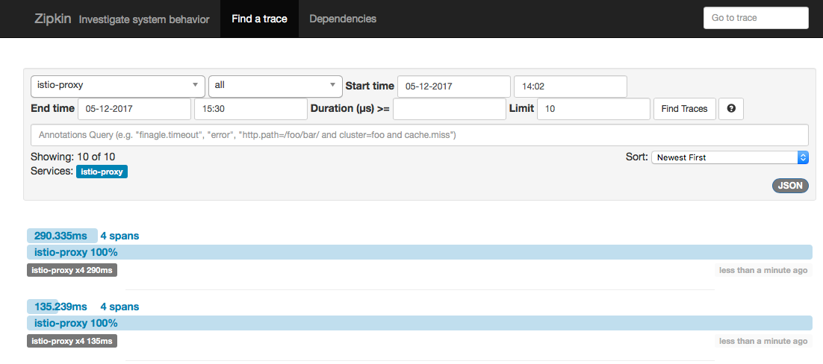
Distributed Tracing | Zipkin
Built toward OpenTracing Standards
Deployable with linkerd or istio
Uses client libraries and service mesh backend to record response times
Allows you to visualize and analyze where there are discrepancies in your architecture

Slide 48
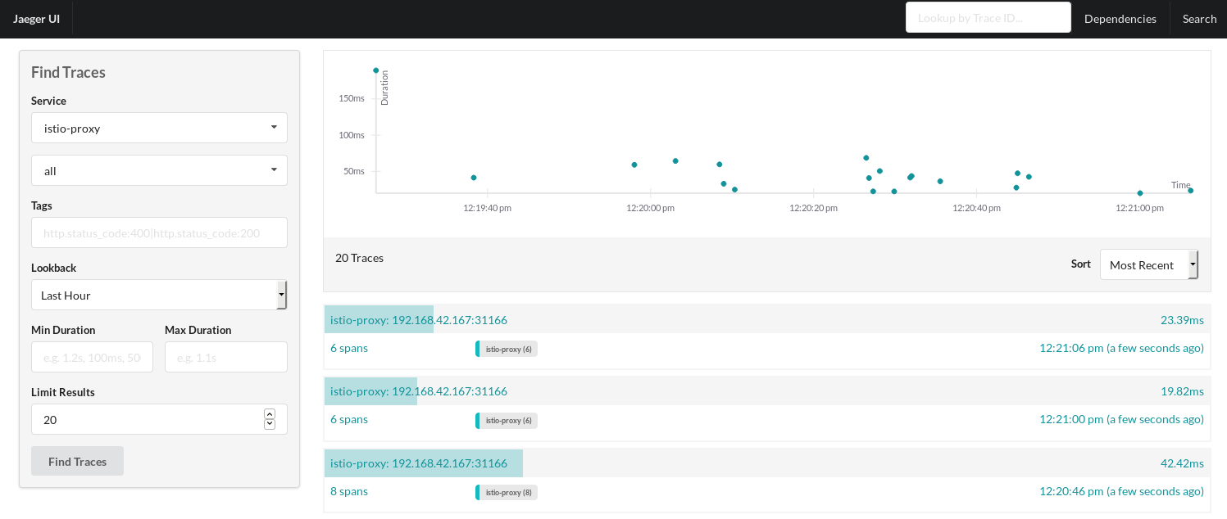
Distributed Tracing | Jaeger
Built for Istio
Uses client libraries and service mesh backend to record response times
Allows you to visualize and analyze where there are discrepancies in your architecture
Written by Uber

