Slide 1
CQRS Practice & Lab
AWS EAST SA 田大鹏 汤哲

Slide 2
Agenda
What, Why & How？
Architecture Patterns
Customer Case Sharing
Common Challenges
Lab Walk Through
Summary

Slide 3
Start provisioning lab
http://git.awsrun.com/dapengt/cqrs
Notes:
Before start talk, let’s start lab as it takes roughly 15 minutes to get everything provisioned

Slide 4
What?
CQRS stands for Command Query Responsibility Segregation. It's a pattern that I first heard described by Greg Young. At its heart is the notion that you can use a different model to update information than the model you use to read information. For some situations, this separation can be valuable, but beware that for most systems CQRS adds risky complexity.
- Martin Fowler, 2011

Slide 5
Why?
Various query requirements, no one size fits all solution
SQL query for aggregation/reporting
full text searching
key-value document query
Graph based query
In the micro-services context, each service might have one or more data stores for storing service specific data, when we write, we write service or domain specific entities or models, however when read we query aggregated/joined data, however query usually span several different domain entities, we need our old friend "join"
Huge gap in query/command, namely read and write
Take classic SQL or RDBMS for example, for improving reading performance, we always consider adding indexes onto various of columns of tables for queries, however write (CUD) will be slowed down, therefore it is a balance here
Notes:
Huge gap in 读写比 电商通常20：1以上，浏览对比商品N多次才会下单

Slide 6
A typical micro services app architecture
Notes:
Diff service for persistence various of data

Slide 7
Basic CQRS Pattern
CDC (Change Data Capture) is the key and complexity.
Notes:
Common CDC approaches:
DB Triggers
Diff based on timestamps like updated_at, deleted_at;
Storage layer Block/file
Table layer
App layer etc
Log based CDC (Binlog/S3 event store => stream)
Double/multiple writes

Slide 8
Architecture Patterns

Slide 9
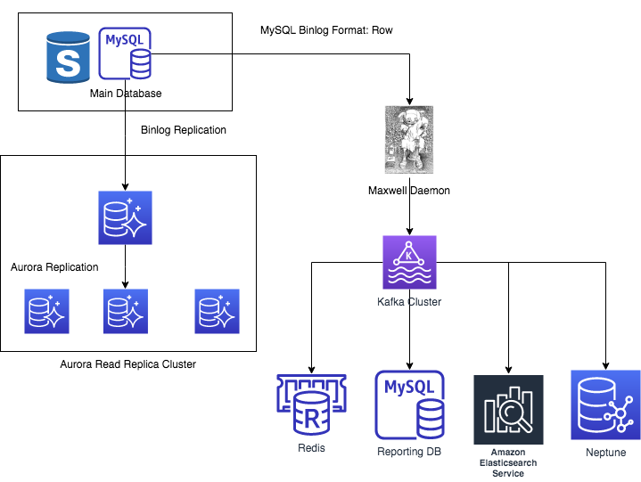
A Real Case
Notes:
客户开发和管理反馈很好，一般情况下最快秒级，慢到分钟级别，1千万条延迟15分钟，受限于Maxwell 资源和kafka吞吐
Downstream
Flush Redis Cache (Get changed keys, and read DB info and update cache) non critical cache which could tolerent seconds/minute delay
Monitor DB table change => update change to other DBS’ table
Will add more like ElasticSearch/Redshift

Slide 10
Challenges
Data Loss
Error Handling
Event Sizing/Ordering
Duplication Records
End-to-end Latency & Scalability
Multiple Downstream Query Store

Slide 11
Lab
http://git.awsrun.com/dapengt/cqrs

Slide 12
Solutions in Lab
Data Loss
Kinesis Stream sync replication across 3 AZ
Event Retry in forwarder lambda + Duplication handling in RDS sink lambda
Error Handling
Minimal code/logic for just forwarding the whole batch
Double try catch with Dead Letter Queue & CloudWatch log
IteratorAge metric for monitoring both performance/stalled shard
Event Sizing
DDB 400K (OLD/NEW images < 1MB) works w/ Kinesis 1MB limit
Batch size > 1MB, set “Split batch on error” to yes
Event Ordering
DDB stream & Kinesis stream guarantee orders even when DDB has multiple partition/multiple shards
Call put_record() with param seqNo =lastSeqNo (not used in lab as forward the whole batch as one event)
Notes:
Lambda Destinations (Just announced 26 Nov) https://aws.amazon.com/blogs/compute/introducing-aws-lambda-destinations/ doesn’t apply to sync stream event sourcing mapping
Event source mappings - Event source mappings – Event source mappings that read from streams retry the entire batch of items. Repeated errors block processing of the affected shard until the error is resolved or the items expire. To detect stalled shards, you can monitor the Iterator Age metric.
Kinesis Data Streams lets you order records and read and replay records in the same order to many Kinesis Data Streams applications. To enable write ordering, Kinesis Data Streams expects you to call the PutRecord API to write serially to a shard while using the sequenceNumberForOrdering parameter. Setting this parameter guarantees strictly increasing sequence numbers for puts from the same client and to the same partition key. 如果需要分解每个消息的话，可以将前一个消息的seqNo传入
response = kinesis.put_record(StreamName="ProductCatalog",
Data=json.dumps(ddb['NewImage']),
PartitionKey=ddb['NewImage']['ProductId']['N'],
SequenceNumberForOrdering=sequenceNumberForOrdering)
sequenceNumberForOrdering = response['SequenceNumber']

Slide 13
Solutions in Lab - continued
Duplication event
Multiple insertion: insert ignore into table
Multiple updates with dup msg is OK
Multiple deletion doesn’t really delete
End-to-end Latency
Lambda ENI creation code start issue, resolved on Sep 2019 via VPC-VPC NAT
DDB stream event sourcing mapping triggers 4 times a second for sync lambda invocation (2 at most, otherwise throttle)
From CloudWatch metric: Duration (30~200ms), IteratorAge (< 1 second)
End-to-end Scalability
Minimum one lambda per shard/per DDB partition
DDB stream/Kinesis stream split shards
High volume command/query (homework)
Multiple Downstream Query Store
EFO fanout for dedicated 2MB throughput and http2 (5 consumers at most), use cascade pattern for more than 5 down streams
Notes:
Lambda Destinations (Just announced 26 Nov) https://aws.amazon.com/blogs/compute/introducing-aws-lambda-destinations/
Event source mappings - Event source mappings – Event source mappings that read from streams retry the entire batch of items. Repeated errors block processing of the affected shard until the error is resolved or the items expire. To detect stalled shards, you can monitor the Iterator Age metric.
Kinesis Stream not identical w/ DDB stream, need KCLAdaptor

Slide 14
Lab Wrap up
Pair programming/brainstorming is fun and does help!
CDK is a great tool for SA, what if none? Cloud Arch Kit?
Python CDK is not hard, just map Typescript to Python
Data Ingestor/testing script is handy and much more efficient than curl/postman)
Notes:
Since no existing example avail, start from scratch based on Jason’s use cases/suggestions

Slide 15
Summary
Despite these benefits, you should be very cautious about using CQRS. Many information systems fit well with the notion of an information base that is updated in the same way that it's read, adding CQRS to such a system can add significant complexity. I've certainly seen cases where it's made a significant drag on productivity, adding an unwarranted amount of risk to the project, even in the hands of a capable team.
So while CQRS is a pattern that's good to have in the toolbox, beware that it is difficult to use well and you can easily chop off important bits if you mishandle it.
- Martin Fowler

Slide 16
References
Martin Fowler's bliki https://martinfowler.com/bliki/CQRS.html
Chris Richardson InfoQ Blog https://www.infoq.cn/article/microservices-aggregates-events-cqrs-part-2-richardson
DynamoDB Streams Use Cases and Design Patterns July 2018 https://aws.amazon.com/blogs/database/dynamodb-streams-use-cases-and-design-patterns/
How to perform ordered data replication between applications by using Amazon DynamoDB Streams 2017 July https://aws.amazon.com/de/blogs/database/how-to-perform-ordered-data-replication-between-applications-by-using-amazon-dynamodb-streams/
New AWS Lambda scaling controls for Kinesis and DynamoDB event sources https://aws.amazon.com/blogs/compute/new-aws-lambda-scaling-controls-for-kinesis-and-dynamodb-event-sources/
Improved VPC Network for Lambda https://aws.amazon.com/blogs/compute/announcing-improved-vpc-networking-for-aws-lambda-functions/
AWS Online Documents

