Slide 1
L’atelier AWS Step Functions
Maintenant aussi offert en français!

Slide 3
L’atelier AWS Step Functions
API201
Votre nom
Votre rôle
AWS
Notes:
Hello my name is Dan Fox and I’m a Principal Specialist Solutions Architect at AWS. Welcome to the AWS Step Functions Workshop. Thank you for participating.
In this workshop you will learn the primary features of AWS Step Functions through a series of hands on modules. Step Functions is a really exciting service, and it generates a lot of talk value among my colleagues both within AWS and outside of it. I know many of my peers in the Solution Architect community at AWS think of step functions as a paradigm shift in software development, offering a new top layer of abstraction for cloud native applications.
The duration of this session is two hours. And it’s hands on so I hope you brought your laptops!
We have an amazing workshop support team here today. Let me introduce you to them.

Slide 4
Vous pourriez avoir besoin d’un service d’orchestration si votre application …
S’étend sur plusieurs services AWS
Opère une séquence d’intégration
Gère des états entre les requêtes
Requiert une intervention ou une approbation humaine
Contient des patrons de flux de travail
Notes:
Alright let’s jump into the session material.
Let’s start by talking about signs that might indicate that you need an orchestration service.
Do you have an application that spans multiple AWS services?
Is the sequence of service interaction important?
Does your application manage state between AWS service calls?
Do you have application workflow that requires human intervention?
Does your application contain workflow patterns like decision trees, branching logic, parallel processing, retries, and error handling?

Slide 5
Patrons d’orchestration communs
Réessayer les tâches échouées
Effectuer des tâches en parallèle
Séquencer des tâches
A
B
A
A
B
C
Choisir des tâches selon les données
Utiliser le principe « try/catch/finally »
A
B
?
C
Notes:
What are some of the most common orchestration patterns that we see in applications?
You may want to sequence your tasks. For example, you need to perform fraud detection, then based on the results you can approve or deny a transaction.
You may want to retry failed tasks. For example, you may have a downstream service that occasionally fails. You may want to implement retry intervals, maximum attempts, and backoff rates.
You may want to run tasks in parallel. For example, a customer purchase could trigger services for accounting, inventory, fulfillment and shipping
You may want to select tasks based on the data you receive. For example, you may have user generated data that has different processing and storage requirements based on its country of origin.
You may want to implement a try / catch / finally flow control pattern in your application.

Slide 6
Introduction à AWS Step Functions
Service de flux de travail visuel à programmation schématisée (low-code)
Orchestration intégrée d’autres services AWS
Supporte les patrons de flux de travail communs
Simplifie la mise en route de tâches communes
Notes:
If service orchestration seems useful to you then you might benefit from AWS Step Functions.
What is the the Step Functions service?
AWS Step Functions is a low-code visual workflow service [transition] that can provide orchestration for AWS services
Step functions supports many common workflow patterns like retries, error handling, parallel processing, branching logic, service integrations, and observability.
Step Function simplifies the implementation of these common tasks so developers can focus on higher-value business logic.

Slide 7
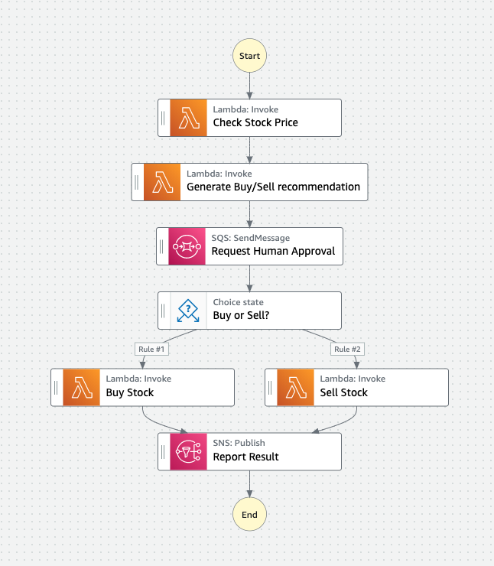
Flux de travaux AWS Step Functions
Début
Définis avec Amazon States Language (ASL)
Définis en tant que machines à états
Composés d’étapes appelées états
Peuvent orchestrer de multiples services AWS
Vérifier le prix de l’action
Générer recommandation achat/vente
Approbation humaine
Achat ou vente ?
Acheter action
Vendre action
Générer un rapport
Fin
Notes:
Let’s talk about some of the primary concepts within Step Functions. The first one we’ll cover is the concept of workflows. What is a workflow in Step Functions?
A workflow is a map of all of the logical pathways that can be executed within an application.
In step functions workflows are written using a syntax called Amazon States Language or ASL. We’ll be learning more about ASL later in this session.
Workflows often referred to as state machines.
State machines are composed of steps called states.
In a single execution, a state machine will begin at an initial state, that state will execute some kind of action, and then it will pass control to the next state in the sequence. That state will then execute its action, and then pass control forward again. And so on and so on.
The workflow will continue to progress from state to state until it reaches an end state. After which it will stop execution.

Slide 8
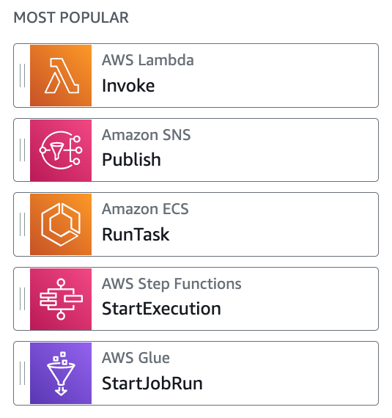
États AWS Step Functions
Exemple de tâches :
Notes:
Step Functions has 8 primary states. Each state type is designed to perform a specific kind of action.
The choice state enables branching logic within your state machine.
The parallel state enables concurrent branches of execution.
The map state enables you to create dynamic pathways based on input data.
The pass state passes the flow control onward, but it can also provide some simple data transformation.
The wait state provides a delay function.
The success or fail states stop an execution with success or failure outcomes.
And the task state is an instruction to do some work.

Slide 9
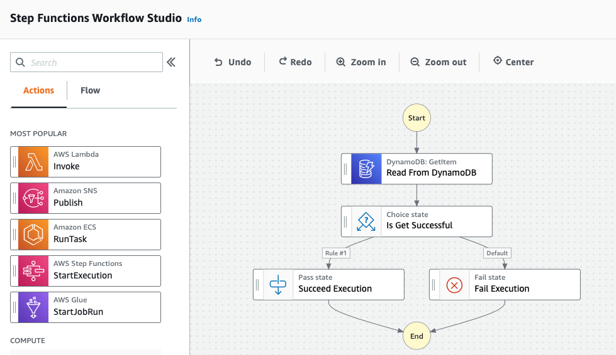
Workflow Studio
Notes:
One other interesting Step Functions feature worth learning about is the the WorkFlow Studio. Workflow Studio is a low code visual editor for designing workflows. You can find it in authoring mode when you’re creating or editing a workflow. With Workflow Studio you can drag and drop integrations and flow choices to form complex application logic. We’ll set aside some time in today’s workshop to review this useful editor.

Slide 10
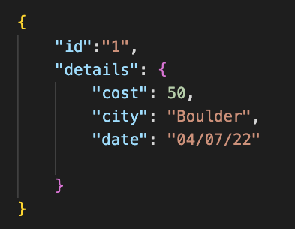
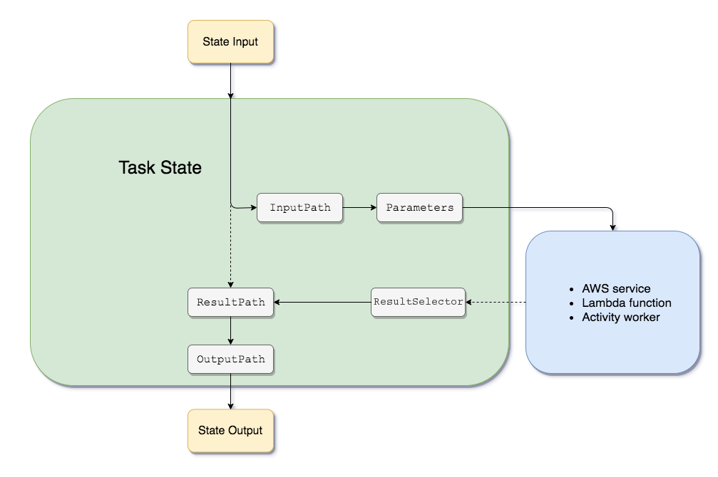
Traitement des entrées et sorties
Exemple d’entrée JSON :
Notes:
A step functions execution always receives a JSON text as input. That JSON is passed to the first state in the workflow. After that state completes processing it will typically pass JSON to the next state in the workflow.
In general, each state provides several different options for intercepting, filtering and manipulating data that is passed from state to state.
For example, in a task state you can manipulate the data that’s passed in from the previous state and sent to the task activity as parameters, and you can manipulate the data that’s returned from the task activity before it is passed to the next state in the workflow.
One of the modules in our workshop today specifically covers the topic of input output processing so you’ll have the opportunity to learn about this feature in more detail.

Slide 11
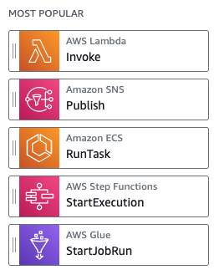
Intégrations en utilisant le AWS SDK
AWS Step Functions s’intègre avec plus de 220 services AWS
AWS Step Functions supporte plus de 10 000 actions d’APIs
Syntaxe d’intégration :
arn:aws:states:::aws-sdk:nomDuService:actionApi.[patronIntégrationService]
Exemple d’intégration :
arn:aws:states:::aws-sdk:ec2:describeInstances
Notes:
One of the most interesting features of step functions are its AWS SDK Integrations.
Step Functions integrates with other AWS services, letting you call each service's API actions from your workflow. You can use Step Functions' AWS SDK integrations to call almost any AWS service's API actions from your state machine.
Today Step Functions natively integrates with over 220 AWS Services and over 10,000 API actions.
There is a very simple syntax for integrating services and api’s which you can see here.
Prior to SDK Integrations, developers would typically use Lambda functions as a Swiss Army knife to invoke another service. With this feature you can call services directly.

Slide 12
Comparaison des flux de travaux Standard et Express
 | Standard | Express
Cas d’usage | Idéal pour les flux de travail à longue durée, avec capacités d’audit. | Idéal pour les flux de travail événementiels à haut volume.
Durée maximale | 365 jours | 5 minutes
Transitions d’états | Fonctionnement par jetons. Compartiment initial de 5 000 jetons, ajouts de 1 500 jetons par seconde | Illimité
Patrons | Supporte tous les patrons d’utilisation | Ne supporte pas les « Job-run » (.sync), ni les « Callback » (.wait)
Invocations | Invocations asynchrones seulement | Invocations asynchrone et synchrone
Tarification | $0,025 par tranche de 1 000 transitions | $1,00 par million de requêtes + $0,06 par gigaoctet-heure (au prorata)
Notes:
Step Functions has two workflow types. Standard workflows are designed to support long-running, durable and auditable workflows. These could be workflows that may need to durably take long pauses, possibly even require human interventions.
Express workflows are designed for high volume event processing such as IoT data ingestion, streaming data processing, and mobile application backends.
You can see some of the differences between the two workflow types in this table. Most notable here is that a standard workflow can continue execution for up to one year, while an express workflow is limited to 5 minutes.
With regard to state transitions, the standard workflow supports an initial bucket of 5,000 with a 1500 per second refill rate. While express workflows support a virtually unlimited amount of state transitions.
Each workflow type has differing quotas and supported features, you can explore these in the Step Functions documentation.

Slide 13
Patrons de tâches
La machine à états appelle une intégration de service et continue immédiatement sans attendre que le service complète son travail.
Requêtes et réponses
Scrutation synchrone (polling)
La machine à états appelle une intégration de service et attend que le service complète son travail.
La machine à états appelle une intégration de service avec un jeton de tâche et continue seulement une fois que le jeton est retourné.
Rappel (callback)
Notes:
When you create a task with Step Functions by calling any of over 220 integrated services, there are 3 patterns that you can use for integration. The first pattern is called request response. When you use this pattern Step Functions proceeds immediately to the next step of the workflow without waiting for the service to complete it’s job.
The second pattern is called sync polling. When you use this pattern, Step Functions will monitor the underlying service and only proceed to the next step in the workflow when the service completes it’s job.
The last pattern is the callback pattern. With this pattern step functions provides a task token to the integrated service, then only proceeds to the next step in the workflow after the token is returned. All right let’s jump in.

Slide 14
Exemples de cas d’usage
Traitement de données (fichiers, vidéo, images; ETL)
Apprentissage automatique (détection de fraude, recommandations, enrichissement des données)
Orchestration de micro-services (flux de travail synchrone, orchestration de conteneurs)
Automatisation TI et de la sécurité informatique (gestion des incidents, remédiation automatique, scénarios avec approbation manuelle)
Calcul à haute performance (HPC)
Notes:
Step Functions can be used in a wide variety of applications including data processing, machine learning, microservice orchestration and IT and security automation.
Some people even use step functions as a CI/CD pipeline.

Slide 15
Agenda de l’atelier
1. Session en groupe (couvrir les bases)
2. Session autonome (fonctions avancées)
3. Conclusion (ressources additionnelles, autres sessions d’intérêt)
Notes:
Now that you've all been introduced to Step Functions, let's talk about what you'll learn in this workshop.
We’ll start with a group session, we’ll do together which will cover some basics.
Once we’ve done that I will release you for self paced work. You’ll have the opportunity to dive into more advanced features.
At that end I’ll wrap us up with some additional resources and related sessions for you to attend.

Slide 16
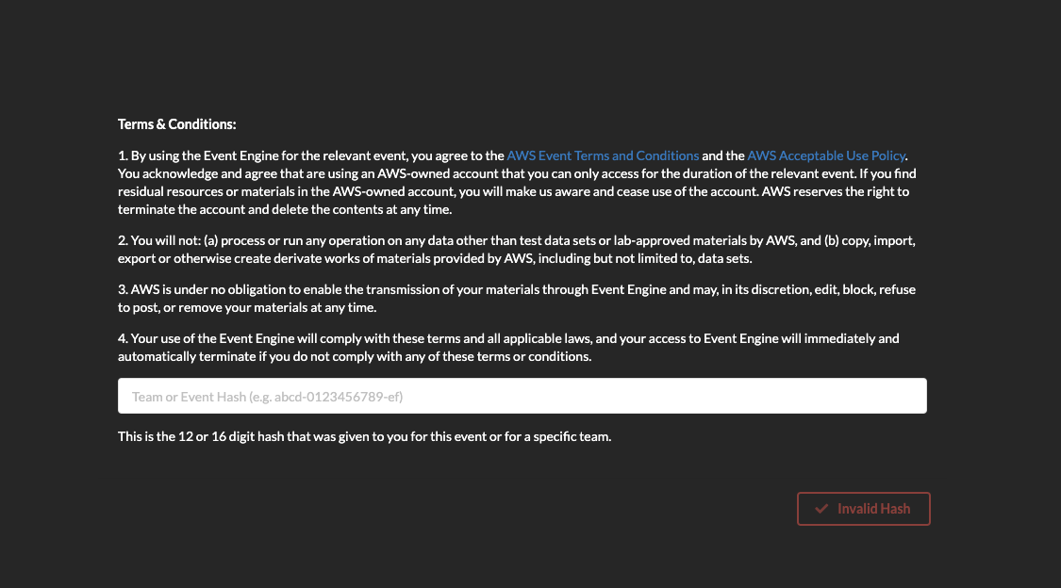
Hosted Mode Dashboard Login
https://dashboard.eventengine.run
Event Hash: 577b-1e91452a24-62

Slide 17
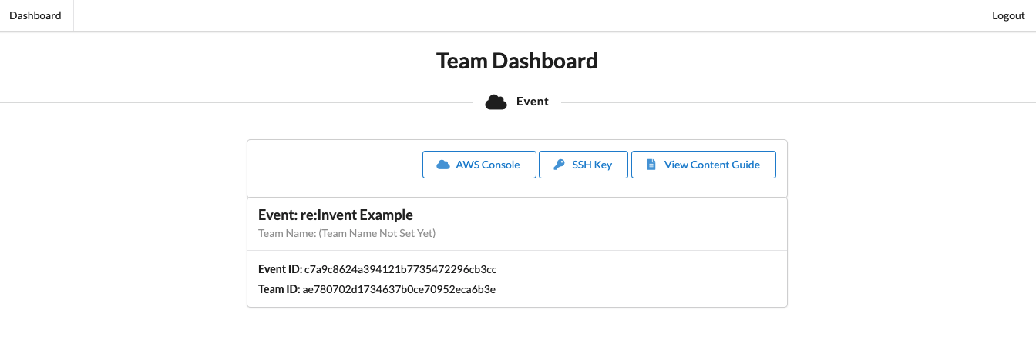
Accessing Workshop Content

