Slide 1
The AWS Step Functions Workshop

Slide 3
The Step Functions Workshop
API201
Dan Fox
Principal Specialist Solutions Architect
AWS
Notes:
Hello my name is Dan Fox and I’m a Principal Specialist Solutions Architect at AWS. Welcome to the AWS Step Functions Workshop. Thank you for participating.
In this workshop you will learn the primary features of AWS Step Functions through a series of hands on modules. Step Functions is a really exciting service, and it generates a lot of talk value among my colleagues both within AWS and outside of it. I know many of my peers in the Solution Architect community at AWS think of step functions as a paradigm shift in software development, offering a new top layer of abstraction for cloud native applications.
The duration of this session is two hours. And it’s hands on so I hope you brought your laptops!
We have an amazing workshop support team here today. Let me introduce you to them.

Slide 4
You might need an orchestration service if your application…
Spans multiple AWS services
Sequences service interaction
Manages state between calls
Requires human intervention
Contains workflow patterns
Notes:
Alright let’s jump into the session material.
Let’s start by talking about signs that might indicate that you need an orchestration service.
Do you have an application that spans multiple AWS services?
Is the sequence of service interaction important?
Does your application manage state between AWS service calls?
Do you have application workflow that requires human intervention?
Does your application contain workflow patterns like decision trees, branching logic, parallel processing, retries, and error handling?

Slide 5
Common orchestration patterns
“I want to retry failed tasks”
“I want to run tasks in parallel”
“I want to sequence tasks”
A
B
A
A
B
C
“I want to select tasks
based on data”
“I want try/catch/finally”
A
B
?
C
Notes:
What are some of the most common orchestration patterns that we see in applications?
You may want to sequence your tasks. For example, you need to perform fraud detection, then based on the results you can approve or deny a transaction.
You may want to retry failed tasks. For example, you may have a downstream service that occasionally fails. You may want to implement retry intervals, maximum attempts, and backoff rates.
You may want to run tasks in parallel. For example, a customer purchase could trigger services for accounting, inventory, fulfillment and shipping
You may want to select tasks based on the data you receive. For example, you may have user generated data that has different processing and storage requirements based on its country of origin.
You may want to implement a try / catch / finally flow control pattern in your application.

Slide 6

Introducing AWS Step Functions
Low-code visual workflow service
Provides orchestration for other AWS services
Supports common workflow patterns
Simplifies implementation of common tasks
Notes:
If service orchestration seems useful to you then you might benefit from AWS Step Functions.
What is the the Step Functions service?
AWS Step Functions is a low-code visual workflow service [transition] that can provide orchestration for AWS services
Step functions supports many common workflow patterns like retries, error handling, parallel processing, branching logic, service integrations, and observability.
Step Function simplifies the implementation of these common tasks so developers can focus on higher-value business logic.

Slide 7
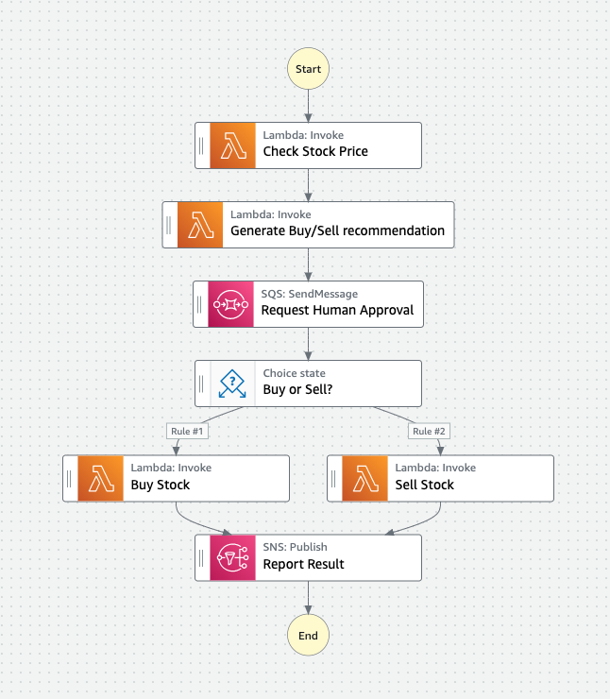
Step Function Workflows
Are written using Amazon States Language (ASL)
Are defined as state machines
Are composed of steps called states
Can be used to orchestrate multiple AWS services
Notes:
Let’s talk about some of the primary concepts within Step Functions. The first one we’ll cover is the concept of workflows. What is a workflow in Step Functions?
A workflow is a map of all of the logical pathways that can be executed within an application.
In step functions workflows are written using a syntax called Amazon States Language or ASL. We’ll be learning more about ASL later in this session.
Workflows often referred to as state machines.
State machines are composed of steps called states.
In a single execution, a state machine will begin at an initial state, that state will execute some kind of action, and then it will pass control to the next state in the sequence. That state will then execute its action, and then pass control forward again. And so on and so on.
The workflow will continue to progress from state to state until it reaches an end state. After which it will stop execution.

Slide 8


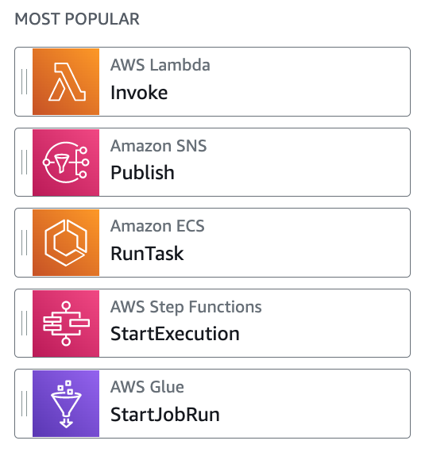




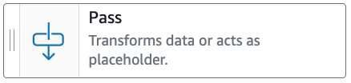
Step Function States
Example tasks:
Notes:
Step Functions has 8 primary states. Each state type is designed to perform a specific kind of action.
The choice state enables branching logic within your state machine.
The parallel state enables concurrent branches of execution.
The map state enables you to create dynamic pathways based on input data.
The pass state passes the flow control onward, but it can also provide some simple data transformation.
The wait state provides a delay function.
The success or fail states stop an execution with success or failure outcomes.
And the task state is an instruction to do some work.

Slide 9
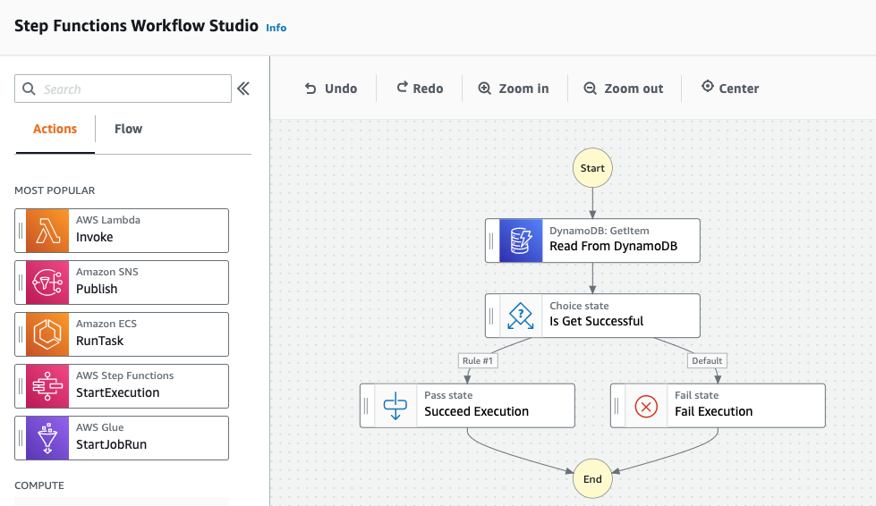
Workflow Studio
Notes:
One other interesting Step Functions feature worth learning about is the the WorkFlow Studio. Workflow Studio is a low code visual editor for designing workflows. You can find it in authoring mode when you’re creating or editing a workflow. With Workflow Studio you can drag and drop integrations and flow choices to form complex application logic. We’ll set aside some time in today’s workshop to review this useful editor.

Slide 10
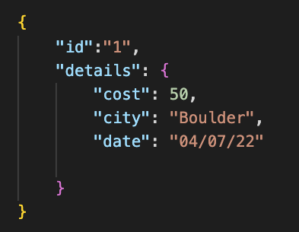
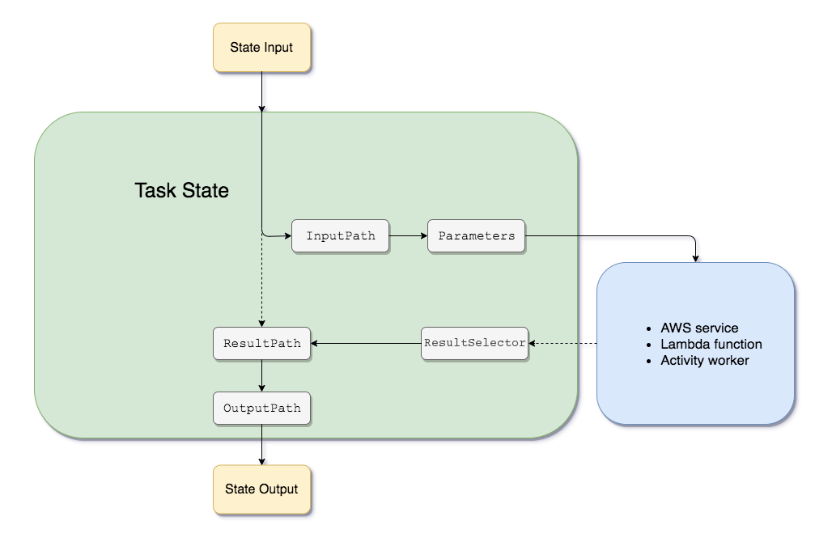
Input and Output Processing
Example JSON Input
Notes:
A step functions execution always receives a JSON text as input. That JSON is passed to the first state in the workflow. After that state completes processing it will typically pass JSON to the next state in the workflow.
In general, each state provides several different options for intercepting, filtering and manipulating data that is passed from state to state.
For example, in a task state you can manipulate the data that’s passed in from the previous state and sent to the task activity as parameters, and you can manipulate the data that’s returned from the task activity before it is passed to the next state in the workflow.
One of the modules in our workshop today specifically covers the topic of input output processing so you’ll have the opportunity to learn about this feature in more detail.

Slide 11
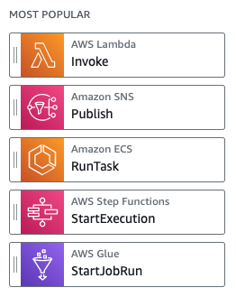
AWS SDK Integrations
Step Functions integrates with 220+ supported AWS Services
Step Functions supports 10,000+ API Actions
Integration syntax:
Example integration:
Notes:
One of the most interesting features of step functions are its AWS SDK Integrations.
Step Functions integrates with other AWS services, letting you call each service's API actions from your workflow. You can use Step Functions' AWS SDK integrations to call almost any AWS service's API actions from your state machine.
Today Step Functions natively integrates with over 220 AWS Services and over 10,000 API actions.
There is a very simple syntax for integrating services and api’s which you can see here.
Prior to SDK Integrations, developers would typically use Lambda functions as a Swiss Army knife to invoke another service. With this feature you can call services directly.

Slide 12
Standard vs. Express workflows
 | Standard | Express
Use Cases | Ideal for long-running, durable, and auditable workflows. | Ideal for high-volume event-processing workloads.
Maximum duration | 365 days | 5 minutes
State Transitions | 5,000 initial bucket with 1,500 per second refill rate | Unlimited
Patterns | Supports all patterns | Does not support Job-run (.sync) or Callback (.wait For Callback)
Invocation | Asynchronous invocation only | Asynchronous and synchronous invocation
Pricing | $0.025 per 1,000 state transitions | $1.00 per 1M requests + $0.06 per GB-hour (tiered)
Notes:
Step Functions has two workflow types. Standard workflows are designed to support long-running, durable and auditable workflows. These could be workflows that may need to durably take long pauses, possibly even require human interventions.
Express workflows are designed for high volume event processing such as IoT data ingestion, streaming data processing, and mobile application backends.
You can see some of the differences between the two workflow types in this table. Most notable here is that a standard workflow can continue execution for up to one year, while an express workflow is limited to 5 minutes.
With regard to state transitions, the standard workflow supports an initial bucket of 5,000 with a 1500 per second refill rate. While express workflows support a virtually unlimited amount of state transitions.
Each workflow type has differing quotas and supported features, you can explore these in the Step Functions documentation.

Slide 13
Task Patterns
Step Functions will call a service integration and proceed immediately without waiting for the service to complete its job.
Request Response
Step Functions will call a service integration and wait until its job is complete.
Sync Polling
Step functions will call a service with a task token and proceed after the token is returned.
Callback
Notes:
When you create a task with Step Functions by calling any of over 220 integrated services, there are 3 patterns that you can use for integration. The first pattern is called request response. When you use this pattern Step Functions proceeds immediately to the next step of the workflow without waiting for the service to complete it’s job.
The second pattern is called sync polling. When you use this pattern, Step Functions will monitor the underlying service and only proceed to the next step in the workflow when the service completes it’s job.
The last pattern is the callback pattern. With this pattern step functions provides a task token to the integrated service, then only proceeds to the next step in the workflow after the token is returned. All right let’s jump in.

Slide 14
Example Use Cases
Data processing (file, video, image; ETL)
Machine learning (fraud detection, recommendations, data enrichment)
Microservice orchestration (synchronous workflows, container orchestration)
IT and security automation (incident management, auto-remediation, human approval scenarios)
High performance computing (HPC)
Notes:
Step Functions can be used in a wide variety of applications including data processing, machine learning, microservice orchestration and IT and security automation.
Some people even use step functions as a CI/CD pipeline.

Slide 15
Workshop Agenda
1. Group Session [cover the basics]
2. Self-Paced Session [more advanced features]
3. Wrap up [additional resources, related sessions]
Notes:
Now that you've all been introduced to Step Functions, let's talk about what you'll learn in this workshop.
We’ll start with a group session, we’ll do together which will cover some basics.
Once we’ve done that I will release you for self paced work. You’ll have the opportunity to dive into more advanced features.
At that end I’ll wrap us up with some additional resources and related sessions for you to attend.

Slide 16
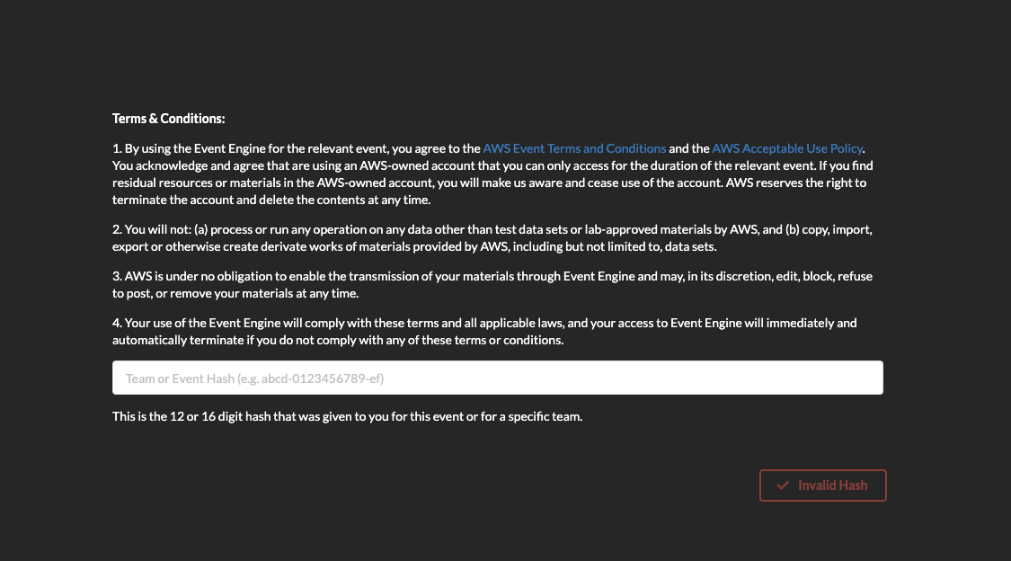
Hosted Mode Dashboard Login
https://dashboard.eventengine.run
Event Hash: 577b-1e91452a24-62

Slide 17
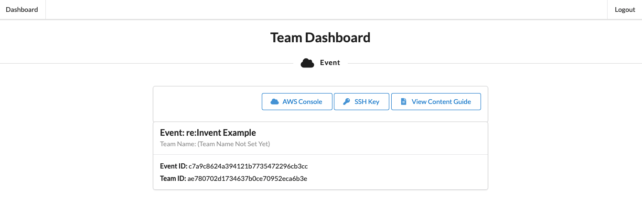
Accessing Workshop Content

Slide 26
Examples of how to use the template layouts

Slide 27
Presentation slide examples for reference
ABC229-S
Sponsored by anycompany
Ana Carolina Silva (she/her)
Alejandro Rosalez (he/him)
Senior Solutions Architect
AnyCompany
Principal Engineer
Example Corp.

Slide 28
Agenda
Where we were
Our roadmap to the solution
Key steps we took and decisions we made
How we solved the problem
Where we are today

Slide 29

Good presentations
Are customer-focused
Are true to the abstract
Tell a story
Provide clear takeaways
Have simple visuals and one message per slide

Slide 30
Every new thing creates two new questions and two new opportunities.
Jeff Bezos
Founder and Executive Chair of Amazon

Slide 31
Tables
USE ONE OF THESE preformatted TABLES AS A STARTING POINT OR MODEL FOR YOUR TABLE
 | Tables | Charts
Main use | Focus on data points | Focus on trends or relationships
Main benefit | Precise | Visual
Second benefit | Drill down on specific data | Simplify complex datasets
Data tips | Table tips | Table formatting | Table don’ts
Be honest and precise | Remove clutter | Left align | Don’t use tiny text
Make a point | Emphasize message | Use consistent sizes | Don’t include it all
Use the right method | Keep it short | Use visible colors | Don’t overcomplicate

Slide 32
Charts
To create a new chart, select Insert tab > Chart. Enter your data and adjust the font sizes to the minimum 12 pt. or larger.
Use a bright color to emphasize the most important data. Use subtle colors for other data.

Slide 33
Demo

Slide 34

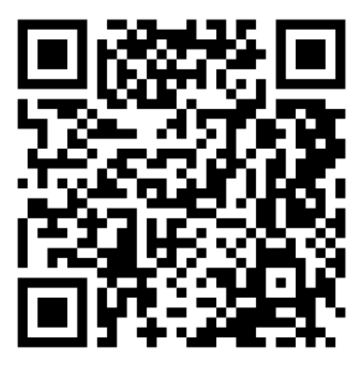



Additional resources
Generate QR codes
AWS speakers only
Microsoft PowerPoint Help & Learning site
Essential basics on using PowerPoint from Microsoft
The World of Presentations podcast
Conversations with industry experts about PowerPoint design, mechanics, and presenting
BrightCarbon events
Free webinars on PowerPoint design, presenter skills, and more
AWS speakers,
more resources
are on the wiki

Slide 35

Ana Carolina Silva
Alejandro Rosalez
@anacarolinasilva
alejandrorosalez (GitHub)

Slide 36
How to use this event template

Slide 37
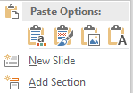
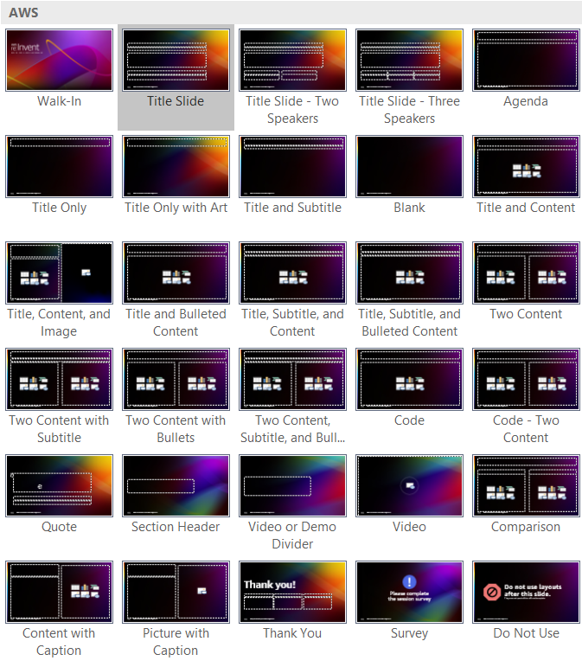
How to add or reuse content
Follow these steps to use this template
to create a new slide deck:
Enter your content on the blank slides and delete any unneeded or hidden slides.
If you want to add more slides, on the Insert tab, select the little arrow under New Slide, and then select your desired layout from the options displayed (shown below). Fill out your slide content using the preformatted context placeholders.
End the deck with the Thank You slide and then the Survey Reminder slide layouts.
Follow these steps to apply this template
to your existing slide deck:
Select all of the slides in the left-hand pane of this template file and delete them (click on one and press Ctrl + A and then Delete).
Open the deck you’ve already created and select all of the slides in the left-hand pane (Ctrl + A) and copy them (Ctrl + C).
In the template file, right-click in the empty left-hand pane and click Use Destination Theme (use this same method to transfer individual slides).
For each slide in your deck, apply the appropriate layout (Home tab > Slides section > Layout).
Reset the slides (Home tab > Slides section > Reset) and ensure all content is in the appropriate placeholders and resets to the correct location. If needed,
copy-paste the content into the correct placeholders.
Save the file and create/revise content as described to the left.
29 available
slide layouts

Slide 38
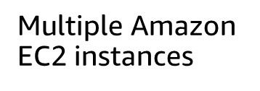
Font guidance
Font family
Only use the Amazon Ember font family (with the exception of code, which should use
Lucida Console).
Use Amazon Ember Display in bold for titles, sentence case (sentence-style capitalization).
Use Amazon Ember Display for slide text, sentence case.
Font styling
Do not underline text that is not a hyperlink.
Use font sizes that are at least 20 pt. for slide text and at least 12 pt. for diagrams.
If using color for emphasis in text, use bold as well.
Do these fonts match?
Multiple Amazon EC2 instances
If not, contact the event manager for a font pack.

Slide 39
Visual accessibility guidelines
For visibility, use a minimum 20 pt for slide text and 12 pt for diagrams. For lines, use a minimum 1.5 pt line weight.
Color also affects visibility. Text (or lines) and the background should have a contrast ratio of at least 4.5:1. Generally, white or black on a strongly contrasting background is the best choice. This slide shows some color choices with good contrast and some color choices with poor contrast.
Avoid using color as a sole indicator of difference (for example, use labels in addition to color to differentiate lines).
Visible color combos
21.0
13.1
7.7
9.2
10.8
7.7
7.7
21.0
12.6
7.7
9.2
10.8
7.7
7.7
18 pt+ type only
4.6
4.6
4.6
4.6
1.6
1.6
2.3
2.3
2.0
2.7
2.7
2.3
1.7
0.0
1.2
1.4
1.0
1.0
1.7
Color combos to avoid
2.3
1.4
1.2
0.0
1.1
1.2
1.2
2.0
2.0
1.2
1.4
1.1
0.0
1.4
1.4
2.3
2.7
1.7
1.0
1.2
1.4
0.0
1.0
1.7
2.7
1.7
1.0
1.2
1.4
1.0
0.0
1.7
1.7
2.0
2.3
1.7
1.7
0.0

Slide 40
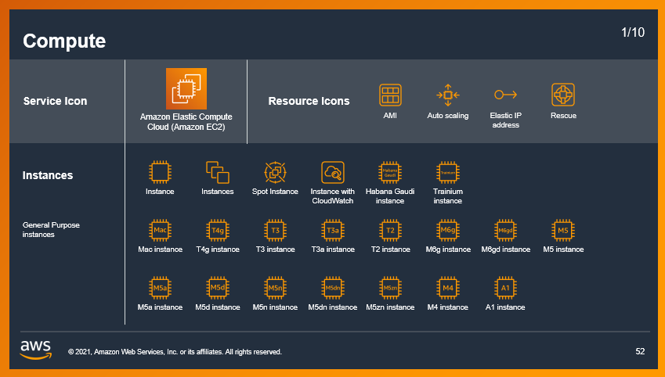

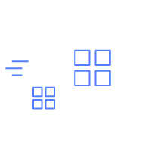

Icons, logos, diagrams, animations, and images
Download AWS architecture icons from the AWS website
Only use logos, icons, photos, screenshots, and illustrations that your company has permission (a license) from the copyright owner to use.
Keep slide diagrams as simple as possible; split content over several slides rather than forcing it all onto one.
Use simple, subtle animations as needed to direct audience attention and clarify relationships. Avoid dramatic transitions or animations (such as “Random Bars,” “Dissolve,” or “Spin”).
AWS speakers, download illustrations, icons, and AWS logos from the brand portal
AWS speakers, find licensed stock photography on Amazon Freeway or request access to Adobe Stock

