Slide 1













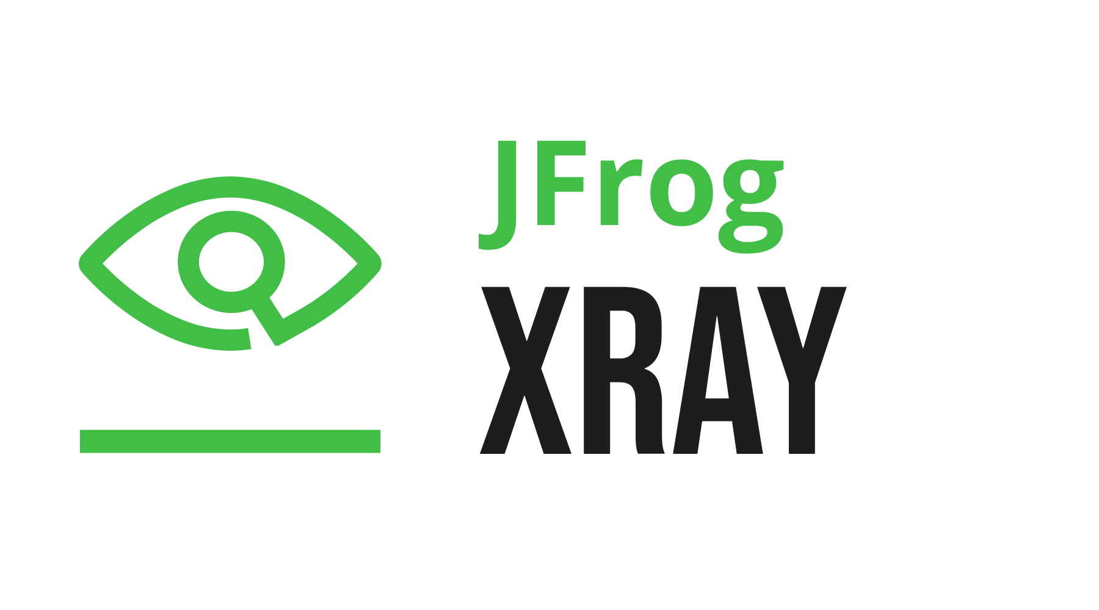



EC2
AWS Cloud
Availability Zone 1
Availability Zone 2
VPC
Public subnet
Public subnet
NAT gateway
NAT gateway
Admin
Auto Scaling group
Bastion
Bastion
Users
Private subnet
Private subnet
Auto Scaling group
Primary node
Primary node
Elastic Load
Balancing
Secondary node
Auto Scaling group
Secondary node
Artifactory secondary
Xray node(s)
Auto Scaling group
Xray node(s)
Elastic Load
Balancing
Amazon RDS
HA (optional)
Amazon RDS
Amazon S3

Slide 2





ECS
AWS Cloud
Availability Zone 1
Availability Zone 2
VPC
10.0.128.0/20
10.0.144.0/20
Public subnet
Public subnet
NAT gateway
NAT gateway
Admin
Auto Scaling group
Bastion
Bastion
Private subnet
Private subnet
10.0.0.0/19
10.0.32.0/19
Users
Port: 8081/8082
Amazon ECS
Port: 443
Auto Scaling group
NGINX
Artifactory
ECS service: Artifactory (primary)
Port: 443
Port: 8081
Port: 443
Ports: 8081/8082
Elastic Load
Balancing
ECS service: Artifactory (secondary)
NGINX
Artifactory
NGINX
Artifactory
Amazon RDS
HA (optional)
Amazon S3
Amazon RDS
10.0.0.0/16

Slide 3



EKS
AWS Cloud
Availability Zone 1
Availability Zone 2
Availability Zone 3
VPC
Public subnet
Public subnet
Public subnet
10.0.128.0/20
10.0.144.0/20
10.0.160.0/20
NAT gateway
NAT gateway
NAT gateway
Admin
Auto Scaling group
Bastion
Bastion
Bastion
10.0.0.0/19
10.0.32.0/19
10.0.64.0/19
Users
Private subnet
Private subnet
Private subnet
EKS node (primary)
Amazon EKS
Auto Scaling group
Nginx
Artifactory
Elastic Load
Balancing
Auto Scaling group
EKS node (secondary)
EKS node (secondary)
Nginx
Artifactory
Nginx
Artifactory
Amazon RDS
Amazon RDS
HA (optional)
Amazon S3
10.0.0.0/16
Notes:
››

