Slide 1




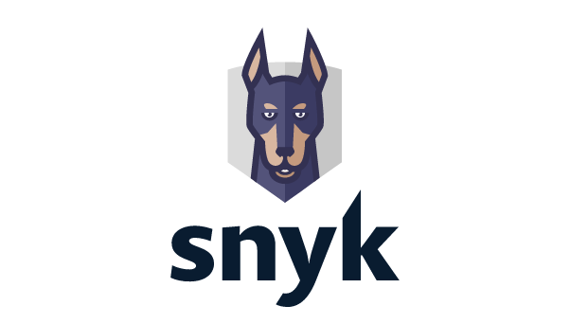
Full integration option
AWS Lambda integration option
Amazon ECR integration option
AWS Cloud
AWS Cloud
AWS Cloud
AWS Lambda
Amazon Elastic
Container Registry
AWS Lambda
Amazon Elastic
Container Registry
Cross-account
IAM role
Cross-account
IAM role
Cross-account
IAM role
Snyk integration

